Slide 1
Environmental Processes
Fundamental processes in soil, atmospheric and aquatic systems
2.i
Ion exchange

Slide 2
Aims:
to provide overview of main concepts and terminology in ion-exchange processes (surface charge, pzc, CEC, AEC)
to discuss possible soil environmental properties related to its ion-exchange capacity
Outcomes:
students will be able to evaluate bioavailability/leaching of charged species from charged surfaces
students will be able to determine and discuss exchange capacity of soil due to its composition
students will be able to predict possible environmental behavior of charged species due to clay/organic matter content of surface.

Slide 3
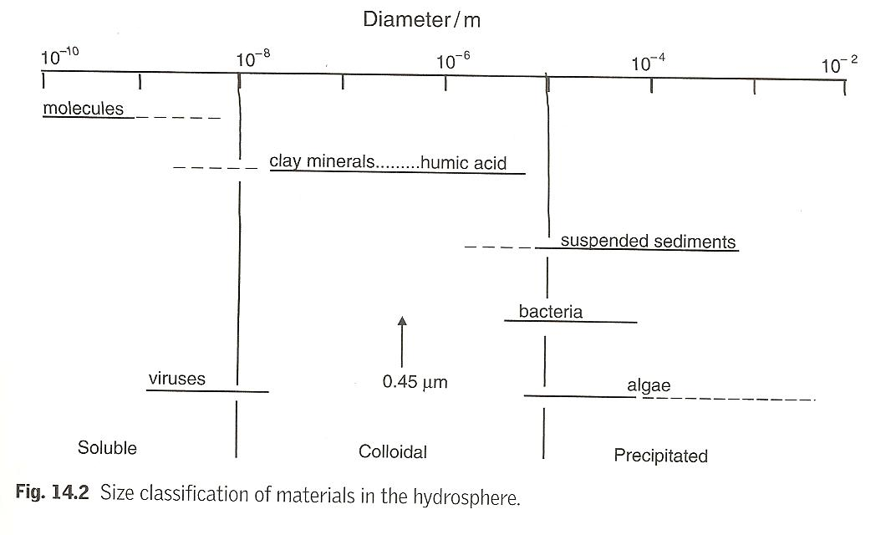
Environmental colloids
Specific surface area - the surface area of particles per unit mass or unit volume of particles.

Slide 4
Permanent charge
Types of charge
Permanent (due to isomorphous substitution - the replacement of one ion for another of similar size within the crystalline structure of the clay).
pH-dependent (variable, due to edges).
pH-dependent charge: on edges
H⁺ bound tightly, so the lower the pH, the less exchange there is (i.e., lower nutrient availability)
Octahedral sheet neutral
Net negative charge

Slide 5
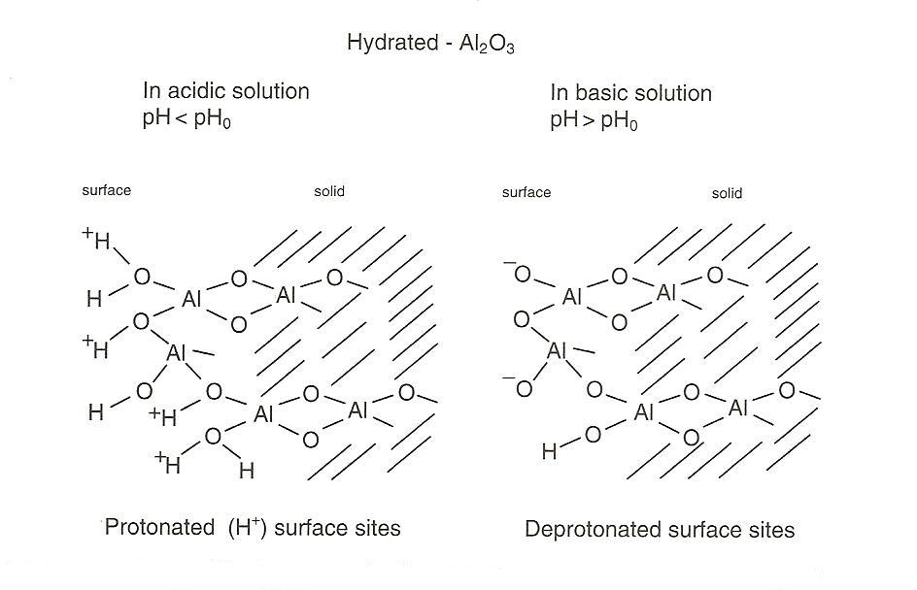
Surface charge
Surface functional groups
Hydrated Al₂O₃
Protonated (H⁺)
surface sites
Deprotonated
surface sites

Slide 6
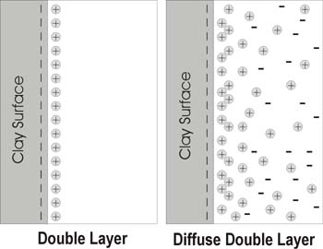
Electrical double layer
The charge properties of a colloid surface are often described in terms of an electrical double layer.

Slide 7
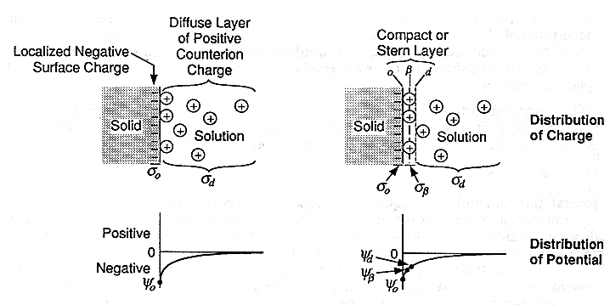
Gouy-Chapman double-layer model
Stern-Grahame triple-layer model

Slide 8
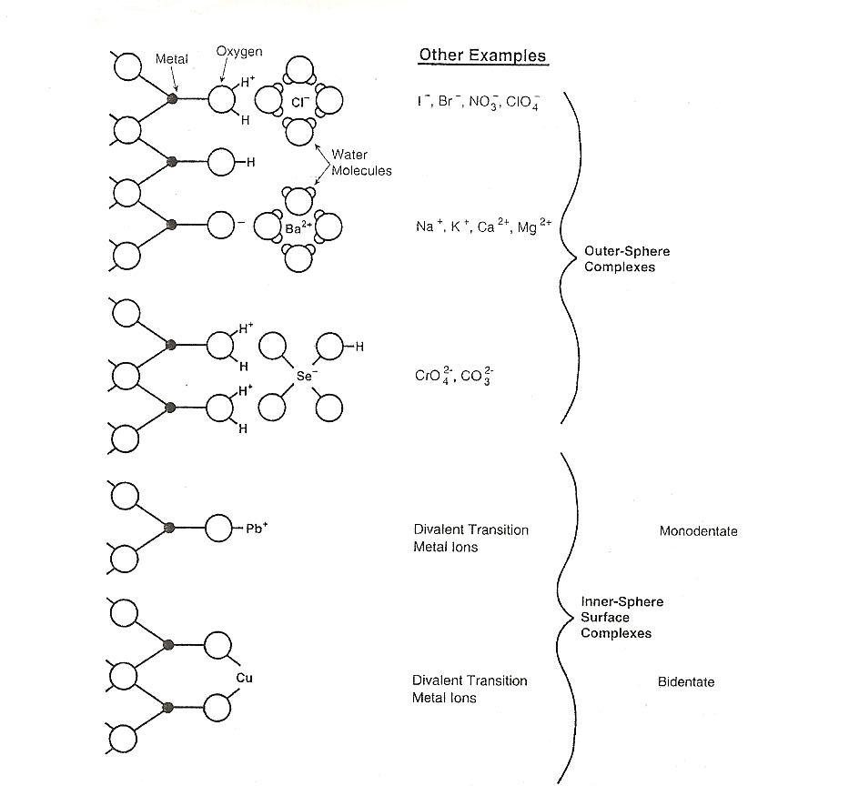
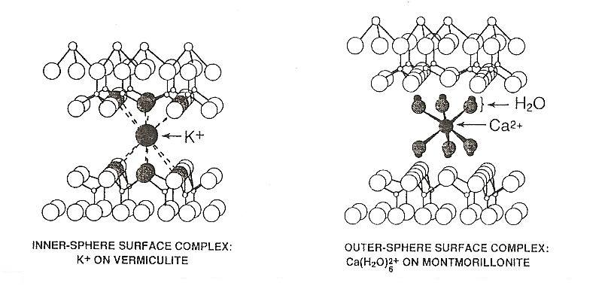
Surface complexes

Slide 9
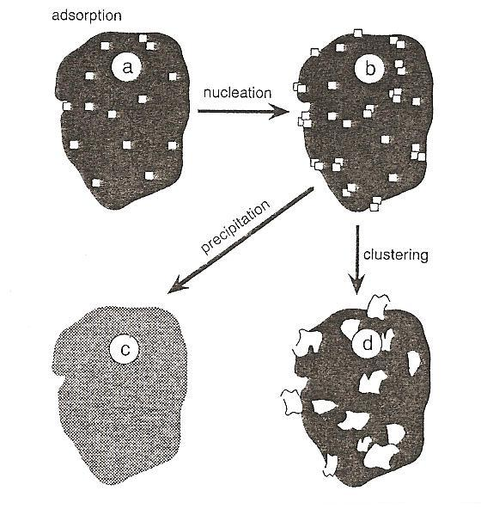
Surface precipitation
As the amount of metal cation or anion sorbed on a surface increases to a high surface coverage, a precipitate of the cation or anion form with the ions of the mineral. This is known as surface precipitation.

Slide 10
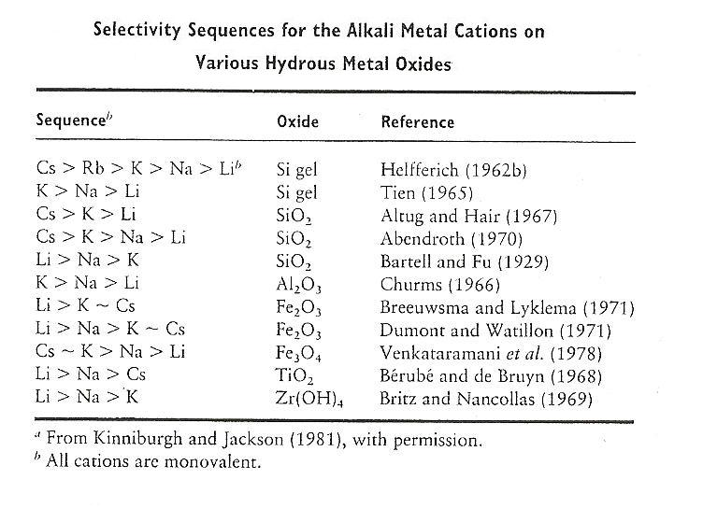
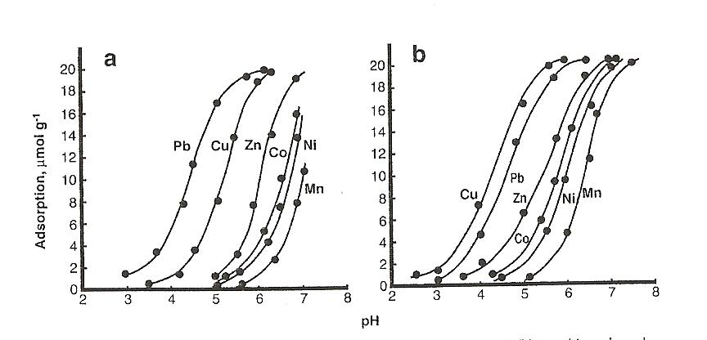
Sorption of metal cations
Sorption of metal cations is pH-dependent.
The pH position of the adsorption edge for a particular metal cation is related to its hydrolysis or acid-base characteristics.
Adsorption of a range metals on (a) hematite and (b) goethite

Slide 11
Exchange affinity
Held more strongly
Held more weakly
H⁺ ≥ Al³⁺ > Ca²⁺ > Mg²⁺ > NH₄⁺ = K⁺ > Na⁺
This is referred to as the “Lyotropic series”
Strength of adsorption proportional to valence ÷ hydrated radius

Slide 12
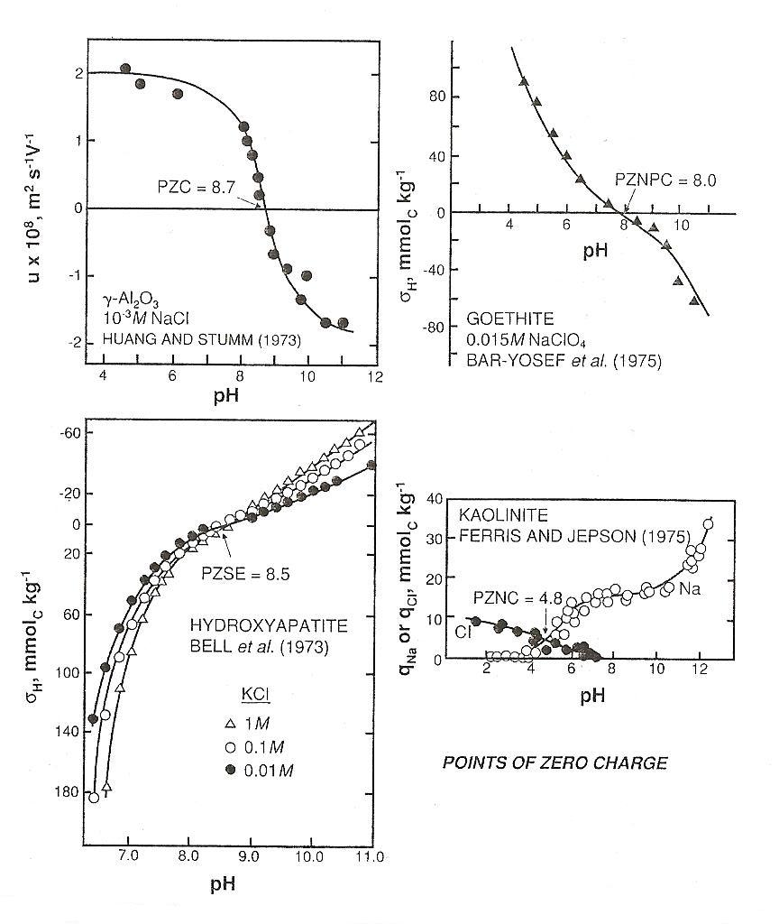
Points of zero charge
Point of zero charge (PZC) can be defined as the suspension pH at which a surface has a zero net charge.
If pH<PZC, the surface is positively net-charged
If pH>PZC, the surface is negatively net-charged

Slide 13
Controls on ion exchange
Strength of adsorption
  Related to hydrated ionic radius and valence
    The smaller the radius and greater the valence, the more closely and strongly the ion is adsorbed. Strength ≅ valence/radius
Relative concentration in soil solution

Slide 14
Cation Exchange Capacity
The sum total of all exchangeable cations that a soil can adsorb.
Expressed in terms of positive charge adsorbed per unit mass.
If CEC =10 cmol_{c}/kg
→ soil adsorbs 10 cmol of H⁺
→ can exchange it with 10 cmol K⁺, or 5 cmol Ca²⁺
  number of charges, not number of ions, what matters
cmol_{c} = centimole of unbalanced charge

Slide 15

Cation exchange capacity (CEC)
Cation exchange capacity (CEC) refers to the number of exchangeable cations that soil solids can adsorb. CEC is expressed as moles of positive charge adsorbed per unit mass, while an absolute unit is meq/100 g.
Colloid | Approximate CEC
Kaolinite | 3 - 15
Montmorillonite | 100
Fe/Al oxides (sesquioxides) | 3
Organic matter (humus) | 150-250
Amorphous minerals | 5-350

Slide 16

Anion Exchange Capacity (AEC)
Soils in which the predominant colloids are sesquioxides (oxides of Fe and Al) may have a net positive charge. This creates opportunities for anion adsorption and exchange.
A clay-size particle of hydrous aluminium oxide has a positive charge under acid conditions, as indicated in the following reaction and therefore contributes to the soils anion exchange capacity (AEC). Materials like sesquioxides may acquire a pH-dependent charge.
Colloid | Approximate AEC (cmol_{c}/kg)
Kaolinite | 2
Gibbsite (Al) | 5
Goethite (Fe) | 5
Allophane | 15

Slide 17
References
“Environmental Chemistry (a global perspective)” Gary W. vanLoon, Stephen J. Duffy: Oxford University Press, New York; (2nd edition 2005) ISBN 978-0-19-927499-4
“Environmental Soil Chemistry”. Donald L. Sparks, Academic Press, Published 1995. ISBN 0-12-656445-0
“Environmental Organic Chemistry ” Rene P. Schwarzenbach, Philip M. Gschwend and Dieter M. Imboden. 2nd Edition, John Wiley &L Sons, Inc.; Copyright 2003. ISBN: 0-471-35750-2

Slide 18
References
“Geochemistry”Wiliam White, John Wiley and Sons, Australia, Wiley-Blackwell 2011. ISBN-13: 978-0470656686
http://www.youtube.com/watch?v=6iPnW6UyCgo&feature=related
http://lawr.ucdavis.edu/classes/ssc102/Section6.pdf
http://www.landfood.ubc.ca/soil200/interaction/ions.htm

