Slide 1
Fundamental processes in soil, atmospheric and aquatic systems
2(ii)
Partitioning

Slide 2
Aims
To provide thermodynamic concepts of the partitioning of chemical compounds between gaseous, liquid and solid phases

Slide 3
Outcomes
Students will be able to assess the fate and behavior of chemical compounds in natural and engineered environment
Students will be able to predict how the molecules will distribute among different environmental phases

Slide 4
K_{H} = Pº_{L}/C^{sat}_{w}
K_{ow} = C^{sat}_{o}/C^{sat}_{w}
Air
K_{oa} = C^{sat}_{o}/Pº_{L}
Gas, T, P
K_{H}
K_{oa}
Pº_{L}
Octanol
Water
NOM, biological lipids, other solvents
T, chemical composition
Fresh, salt, ground, pore
T, salinity, cosolvents
K_{ow}
Pure Phase
(l) or (s)
C^{sat}_{o}
C^{sat}_{w}
Ideal behavior
4

Slide 5
Partitioning will be driven by intermolecular interactions between solute and partitioning media:
  Van der Waals forces
  polarity/polarizability
  H bonding

Slide 6
Henry’s Law
Air-Water Partitioning – equilibrium partitioning between air and water
  K_{H} – Henry’s law constant

Slide 7
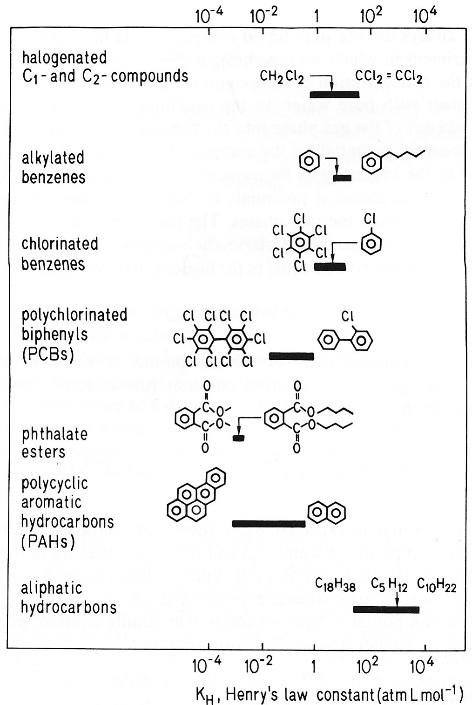
Ranges of Henry’s law constants for some classes of organic pollutants

Slide 8
Partitioning between air and any solvent
In an ideal solution, γ = 1. If γ is constant, then:
“dimensionless”

Slide 9
Factors influencing Henry’s law constant
Temperature
Salinity (solution composition)
Cosolvents

Slide 10
The effect of temperature
T_{av} – the average temperature of the temperature range considered (K)
ΔH “Henry” = ΔH vaporization minus the excess enthalpy of solubilization.
When solvent is similar to solute, ΔH^{E} may be negligible.
Notes:
ni ΔH “Henry” se nigde ne nalazi u formulama

Slide 11
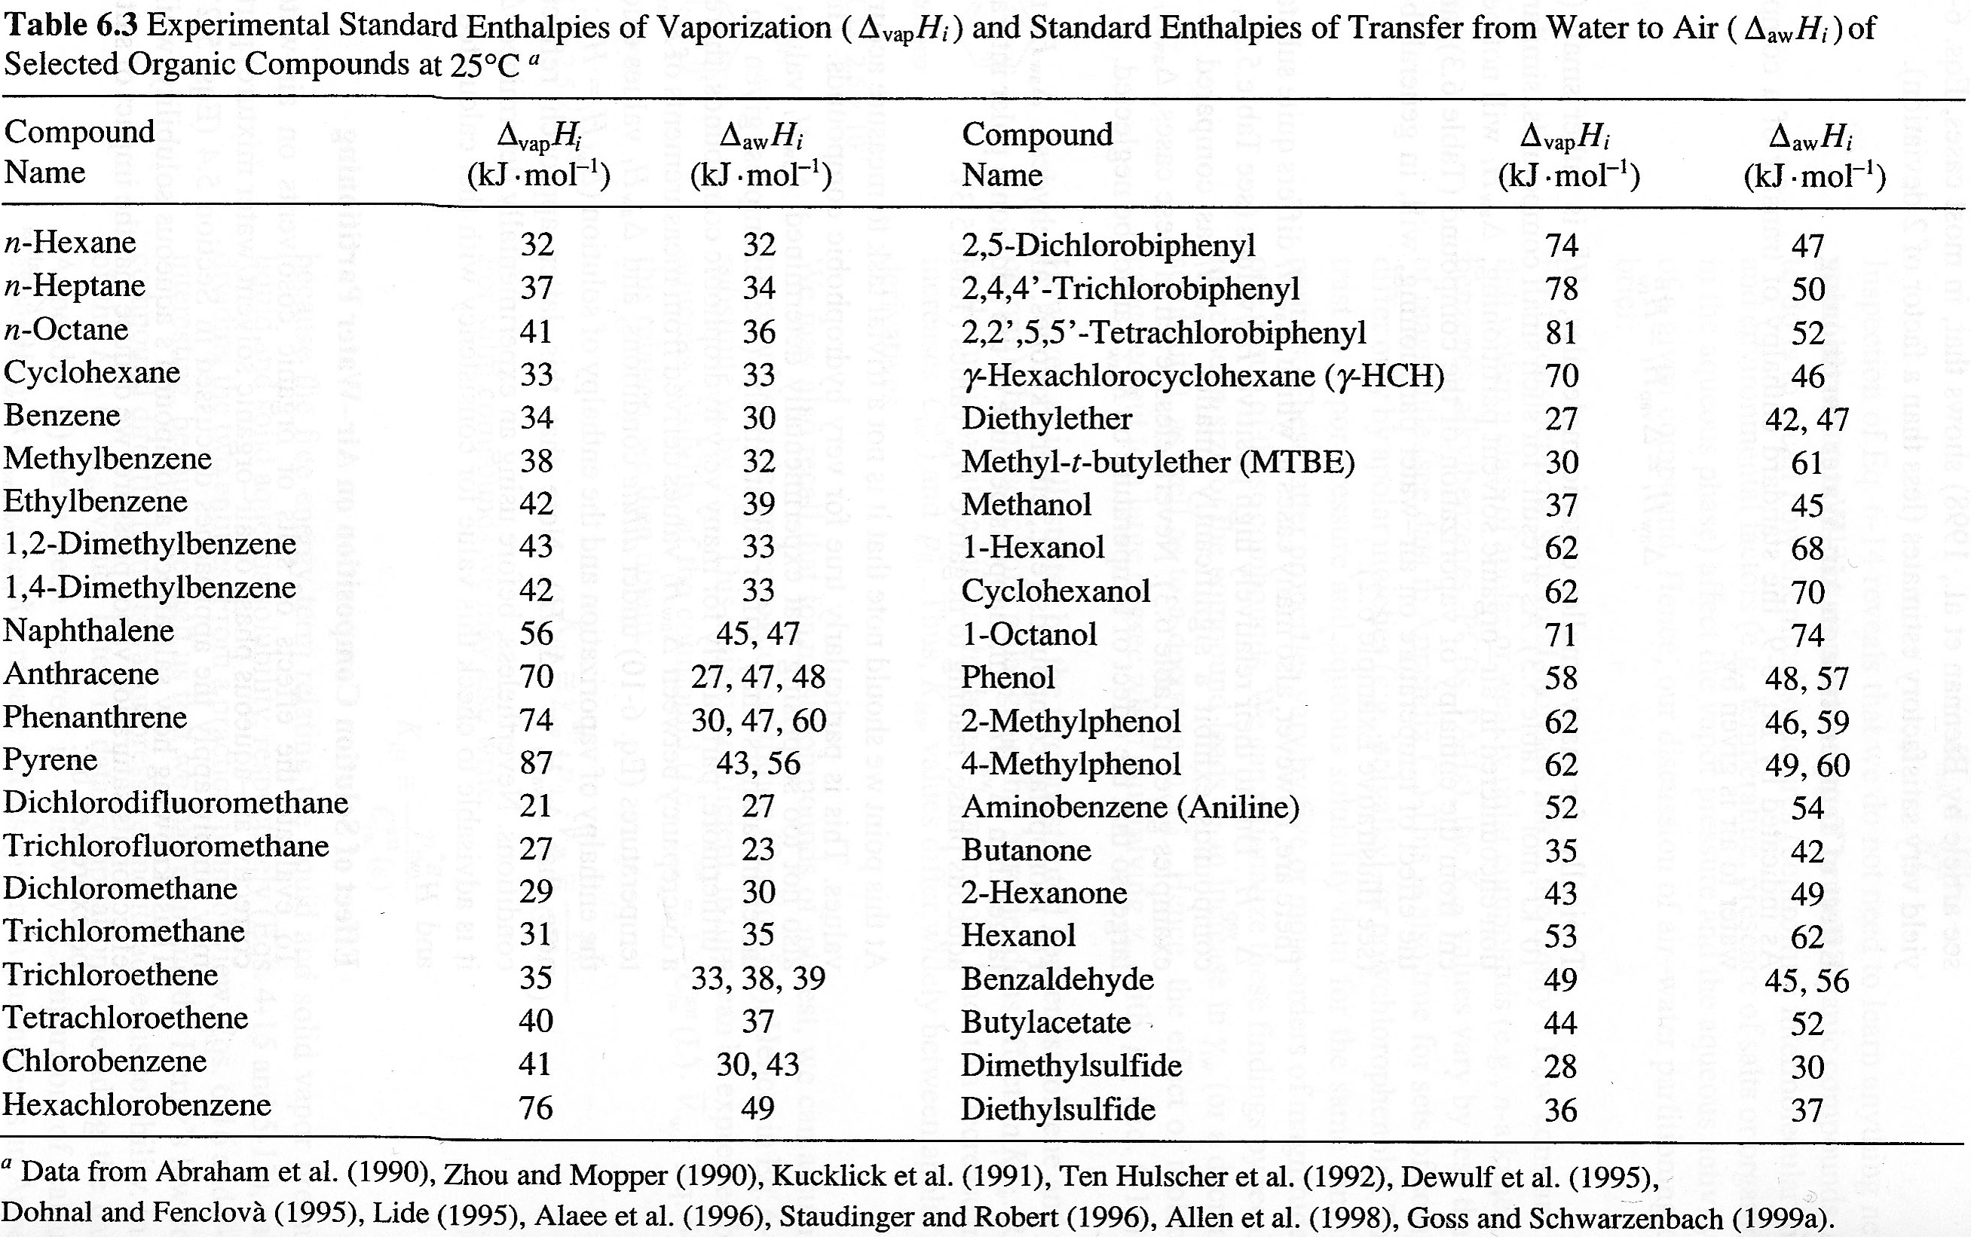

Slide 12
Effect on salinity and cosolvents on Henry’s law constant
  Salinity will increase Henry’s law constant by decreasing the solubility (increasing the activity coefficient) of the solute in water.
  Cosolvents will decrease Henry’s law constant by increasing the solubility (decreasing the activity coefficient) of the solute in water.
    σ_{i}^{c} is the cosolvent term, which depends on the identity of both the cosolvent and solute
    f_{v} is the volume fraction of cosolvent

Slide 13
LFERs relating partition constants in different air-solvent systems
Partitioning depends on size, polarity/polarizability, and H-bonding
IF the intermolecular interactions are similar in both solvents, then a simple LFER is sufficient to predict partition constants:
If the types of intermolecular interactions of a variety of solutes interacting with two chemically distinct solvents 1 and 2 are very different, a one-parameter LFER for all compounds is inadequate.

Slide 14
Multiparameter LFERs
molar volume describes vdW forces
refractive index describes polarity
H-bonding
additional polarizability term
This is a generic equation for estimating the partition of a compound between air and any solvent.

Slide 15
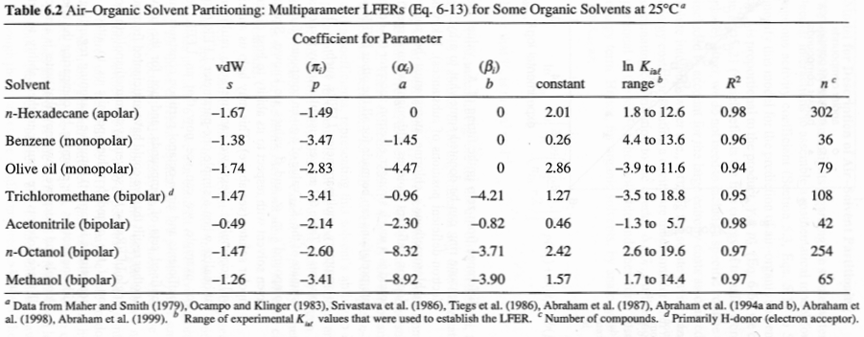

Slide 16
Estimation of air-water partition constants

Slide 17
Bond contributions for estimation of log K_{iaw}
K_{H} from fragment constants: structure-property relationships
  where f are factors for structural units, and F are correction factors for affects such as polyhalogenation, etc.
  specific structural units increase or decrease the compound's K_{H} by about the same amount.

Slide 18
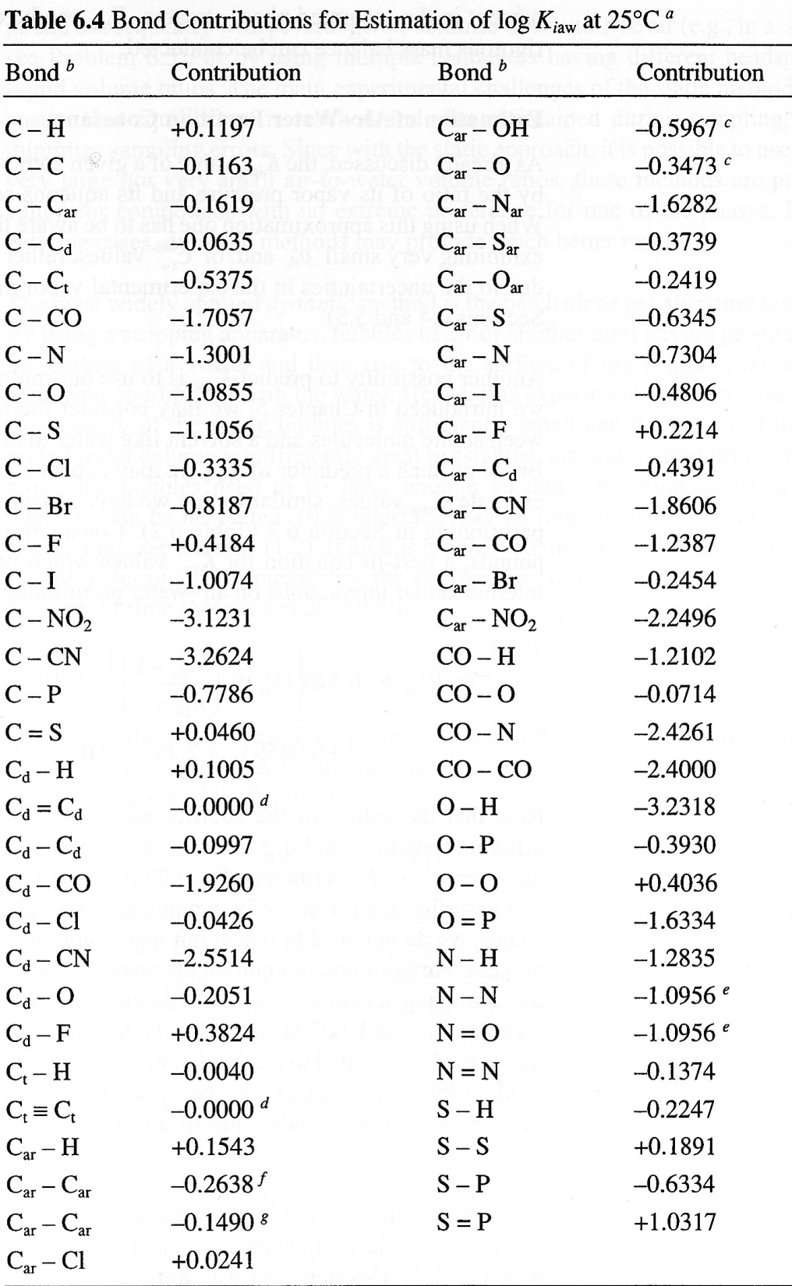

Slide 19
Organic Liquid-Water Partitioning
Equilibrium partitioning between water and any organic liquid

Slide 20
The effect of salinity
  Salinity will increase tendency to partition into the organic phase by decreasing the solubility (increasing the activity coefficient) of the solute in water.
  It is assumed that salts are largely insoluble in the organic phase.
  Account for salinity effects via Setschenow constant:

Slide 21
The effect of temperature
  We assume that the enthalpy change of the partitioning process is constant over the relevant range of T
  Total enthalpy change = different between excess enthalpy of solubilization in water and solvent

Slide 22
Temperature dependence of K_{ilw}
  Typically H^{E}_{iw} and H^{E}_{il} are similar in magnitude, so the temperature dependence of K_{lw} is small (negligible)
  Not valid when there is great dissimilarity between solute and solvent, i.e. PCBs, PAHs in water, ethanol in nonpolar solvent
  In this case, correction for temperature is necessary:

Slide 23
Estimation of K_{ilw}
molar volume describes vdW forces
refractive index describes polarity
H-bonding
additional polarizability term
cavity term

Slide 24
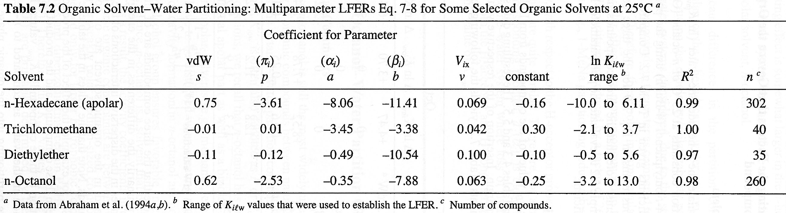

Slide 25
Equilibrium constants are related:

Slide 26
Octanol-water partition coefficient
Importance
  Huge database of K_{ow} values available
  Method of quantifying the hydrophobic character of a compound
  Can be used to estimate aqueous solubility
  Can be used to predict partitioning of a compound into other nonpolar organic phases:
    other solvents
    natural organic material (NOM)
    biota (like fish, cells, lipids, etc.)
Why octanol?
  Has both hydrophobic and hydrophilic character ("ampiphilic")
  Therefore a broad range of compounds will have measurable K_{ow} values

Slide 27
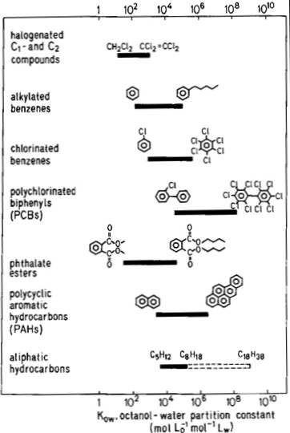
Ranges of octanol-water partition constants (K_{ow}) for some importanta classes of organic compounds

Slide 28
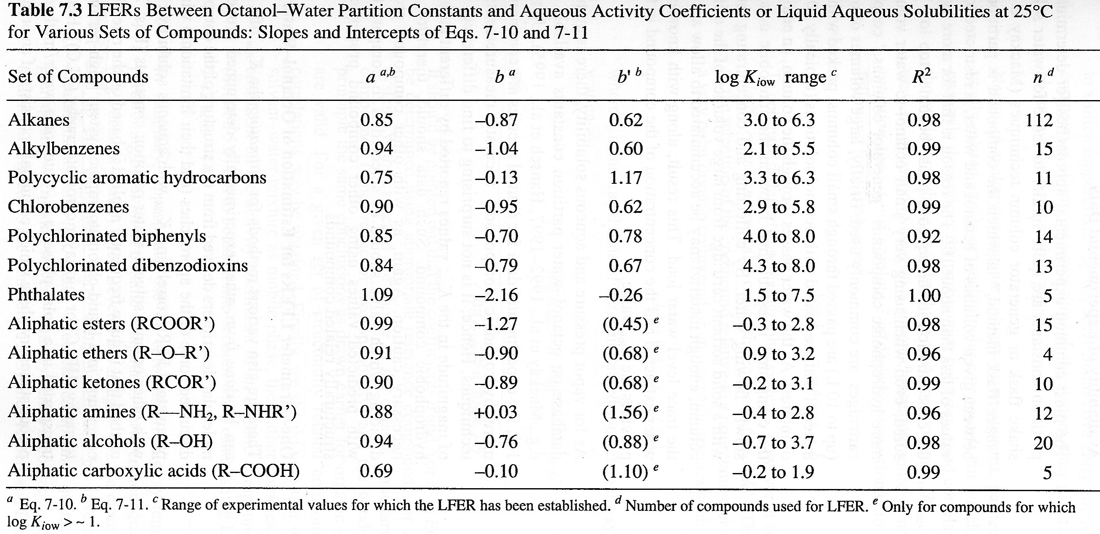

Slide 29
K_{ow} from fragment constants: structure-property relationships
Meylan and Howard (1995):
  n = frequency of each type of fragment
  f = factors for each type of fragment
  c = correction factors

Slide 30
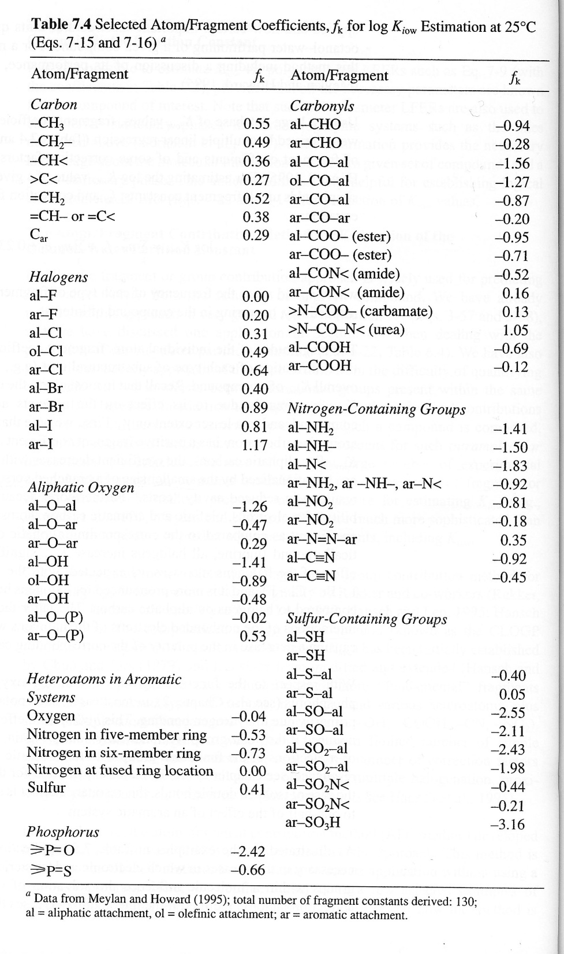
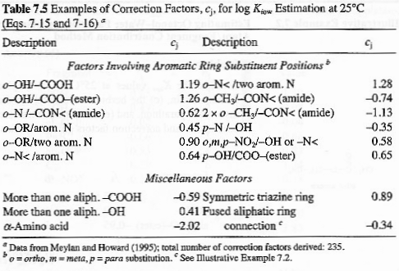

Slide 31
LFERs for relating different organic liquid-water systems
IF the two solvents are similar, then simple LFER can be used for a series of similar compounds:
For example, hexadecane and octanol partition constants can be related with following LFER:
  Valid for apolar and weakly polar solutes
  Does not work for very polar compounds, such as phenols

Slide 32
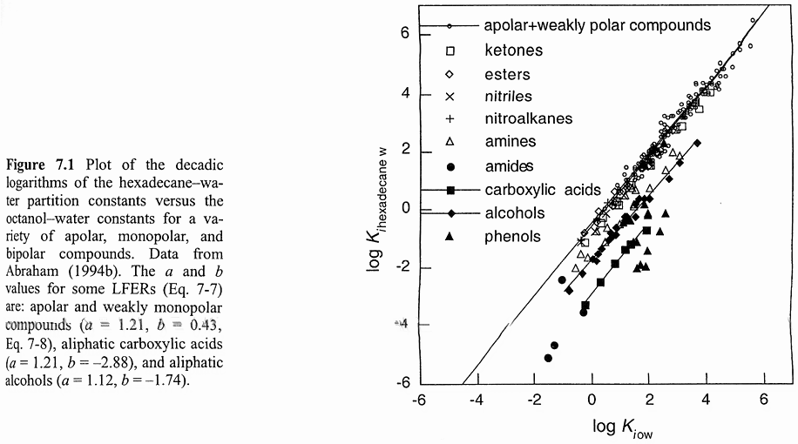

Slide 33
Dissolution of organic compounds in water from organic liquid mixtures
LNAPLs (gasoline, heating oil)
DNAPLs (chlorinated solvents)
PCBs, hydraulic oils

Slide 34
Cosolvent effects?
  examples, gasohol, MTBE
The effect of solution composition?
Assuming these effects are negligible:
  in many cases γ_{imix} = 1

Slide 35
Partitioning with solid phases (Sorption processes)
Hard to differentiate between adsorption and absorption
  absorption – sorption (penetration into) a 3D matrix
  adsorption – sorption to a 2D surface
  Usually, adsorption and absorption takes simultaneously
Sorbate: the molecule adsorbed or absorbed
Sorbent: the matrix into/onto which the sorbate adsorbs or absorbs

Slide 36
Sorption affects:
  transport:
    generally, molecules which are sorbed are less mobile in the environment
    sorbed molecules are not available for phase transfer processes (air-water exchange, etc.)
  degradation:
    sorbed molecules are not bioavailable
    sorbed molecules usually shielded from UV light (less direct photolysis)
    sorbed molecules cannot come into contact with indirect photoxidants such as OH
    rates of other transformation reactions may be very different for sorbed molecules

Slide 37
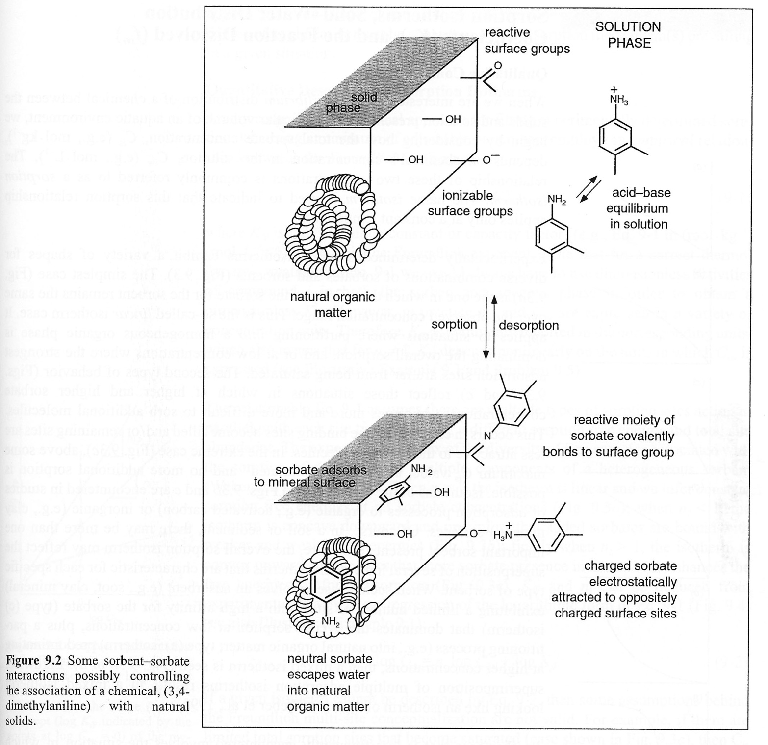
Sorption is complex because sorbents in the natural environment are complex, and sorption may occur via several different mechanisms.

Slide 38
The solid-water distribution coefficient:
  C_{is} = mol/kg solid or mg/kg solid
  C_{iw} = mol/L water or mg/L solid
  K_{id} = L/kg
This model assumes that:
  All sorption sites have equal energy
  An infinite number of sorption sites exist
equilibrium “constant” describing partitioning between solid and water phases

Slide 39
However, for sorption on environmental matrices these two assumptions are generally not true!
The complex nature of K_{id} will be explained in more details in chapter 3.1!

