Slide 1
Chemical and biochemical changes
2(iii)
  a. Hydrolysis
  b. Redox reactions
  c. Photo induced reactions
  d. Transition metal complexes

Slide 2
Aims
(i) to provide overview of main concepts and terminology in chemical and biochemical changes.
(ii) to discuss possible soil, atmospheric and aquatic systems environmental processes.
(iii) To discusses of bio-physico-chemical processes of metals and metalloids in soil, atmospheric and aquatic systems.

Slide 3
Outcomes
students will be able to evaluate hydrolysis, redox reactions, photo induced reactions, transition metal complexes and biochemical transformations.

Slide 4
Outcomes:
(ii) Students will be able to determine and discuss about fundamentals of biotic and abiotic interactions of metals and metalloids with soil components” contain six chapters, which deal with:
- impact of physico-chemical-biological interactions on metals and metalloid transformations in soils;
- transformation and mobilization of metals, metalloids and radionuclides by microorganisms;
- kinetics and mechanisms of sorption/desorption in soils;
- spectroscopic techniques for studying metal-humic complexes in soil;
- factors affecting the sorption-desorption of trace elements in soil;
- modelling adsorption of metals and metalloids by soil components.

Slide 5
Outcomes:
(iii) Students will be able to predict possible environmental behavior of charged species due to clay/organic matter content of surface. Knowledge on the mechanisms and assessment of P-induced Pb immobilization in situ and water. Students will be able to predict possible ways of monitoring the process and to assess the mechanisms of reactions in the soil, air and water.

Slide 6
Chemical and biochemical changes
A chemical change is a phenomenon quite different from a physical change. If liquid water boils or freezes (both of which are examples of a physical change resulting from physical processes), it is still water. Physical changes do not affect the internal composition of an item or items; a chemical change, on the other hand, occurs when the actual composition changes—that is, when one substance is transformed into another. Chemical change requires a chemical reaction, a process whereby the chemical properties of a substance are altered by a rearrangement of atoms.
Biogeochemical processes from soils affect the fate behaviour and bioavailability of metals and metalloids in soils. Read more:
Read more: http://www.answers.com/topic/nitrogen-cycle#ixzz1lci9t1yE
Notes:
A chemical change is a phenomenon quite different from a physical change. If liquid water boils or freezes (both of which are examples of a physical change resulting from physical processes), it is still water. Physical changes do not affect the internal composition of an item or items; a chemical change, on the other hand, occurs when the actual composition changes—that is, when one substance is transformed into another. Chemical change requires a chemical reaction, a process whereby the chemical properties of a substance are altered by a rearrangement of atoms.
Biogeochemical processes from soils affect the fate behaviour and bioavailability of metals and metalloids in soils. Read more:
http://www.answers.com/topic/nitrogen-cycle#ixzz1lci9t1yE

Slide 7
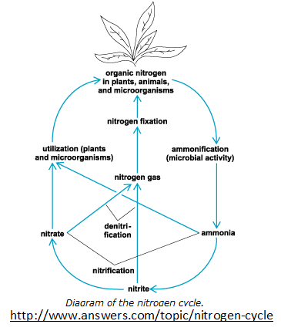

Slide 8
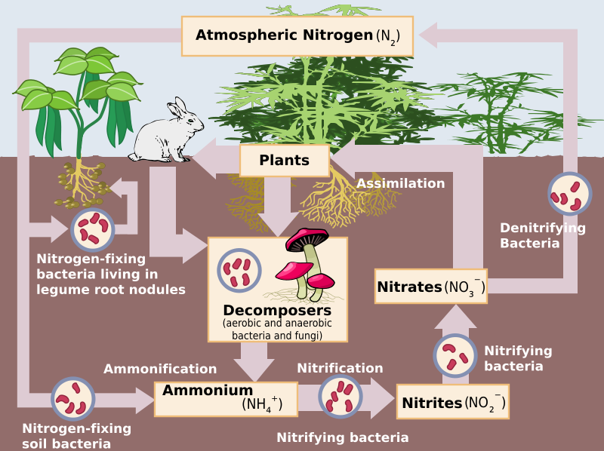
Schematic representation of the flow of nitrogen through the environment. The importance of bacteria in the cycle is immediately recognized as being a key element in the cycle, providing different forms of nitrogen compounds assimillable by higher organisms.
http://www.answers.com/topic/nitrogen-cycle#ixzz1lci9t1yE

Slide 9
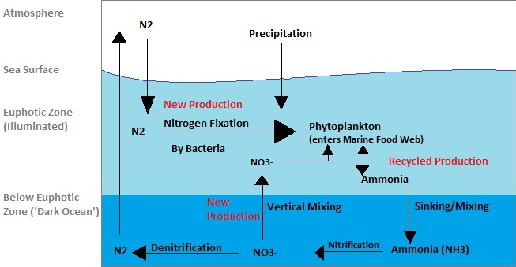
A schematic presentation of the Marine Nitrogen Cycle
http://www.answers.com/topic/nitrogen-cycle#ixzz1lci9t1yE

Slide 10
  a. Hydrolysis
Chemical reaction in which water (H₂O or HOH) and another reactant exchange functional groups to form two products, one takes the H and the other one, the OH.
For example, an ester can be hydrolyzed to form a carboxylic acid and an alcohol.
In most hydrolyses involving organic compounds, the other reactants and products are neutral;
Such reactions are often accelerated by enzymes (as in much of digestion and metabolism in general) or other catalysts.
Notes:
In most hydrolyses involving organic compounds, the other reactants and products are neutral;
Such reactions are often accelerated by enzymes (as in much of digestion and metabolism in general) or other catalysts.

Slide 11
Hydrolysis is the name for a reaction in which substance chemically reacts with water.
Hydrolysis should be distinguished from solvation, which is the process of water molecules associating themselves with individual solute molecules or ions.

Slide 12
I. Salts of Weak Acids
In general, all salts of weak acids behave the same, therefore we can use a generic salt to represent all salts of weak acids.
Let NaA be a generic salt of a weak acid and A¯ its anion. Here are two specific examples of salts of weak acids:
Substance | Formula | The anion portion (A¯)
sodium acetate | NaC₂H₃O₂ | C₂H₃O₂¯
sodium benzoate | C₆H₅COONa | C₆H₅COO¯

Slide 13
The generic chemical reaction (in net ionic form) for hydrolysis may be written:
A¯ + H₂O → HA + OH¯
This reaction is of a salt of a weak acid (NOT the acid) undergoing hydrolysis.
The salt is NaA, and it reacts with the water. Keep in mind that the acid (HA) does not undergo hydrolysis, the salt’s ion(s) do(es).
By the way, the potassium ion, K⁺, (and several others) could also be used above without affecting any discussions of this topic. As a practical matter, only Na⁺ and K⁺ tend to get used in examples.
Notes:
By the way, the potassium ion, K⁺, (and several others) could also be used above without affecting any discussions of this topic. As a practical matter, only Na⁺ and K⁺ tend to get used in examples.

Slide 14
However, keep in mind that Na⁺ is present in the solution. Some teacher might want to ask a "sneaky" question on a test.
It is important to notice several things:
The Na⁺ (notice only OH¯ is written) IS NOT involved.
Notes:
However, keep in mind that Na⁺ is present in the solution. Some teacher might want to ask a "sneaky" question on a test.

Slide 15
2) HA is the UNDISSOCIATED acid.
3) There are free hydroxide ions (OH¯) in the solution!! This is the thing that makes the pH greater than 7.
Keep in mind that it is not the acid that makes the acidic pH of a solution, it is the amount of hydrogen ion (or hydronium ion, H3O+, if you wish). In order to produce the hydrogen ion, the acid must dissociate.
Now, I can see a question forming in your mind. If there is acid (HA) and base (OH¯), why don't they just react and give back the reactants on the left side? Now, that really is a good question.
The answer? This reaction is an equilibrium. Now, if you are taking chemistry for the first time, you probably just got done with equilibrium a few weeks ago and it might have been hard to understand. That's understandable, but please realize that equilibrium is one of more important concepts in chemistry. Keep up the work!!
Notes:
Keep in mind that it is not the acid that makes the acidic pH of a solution, it is the amount of hydrogen ion (or hydronium ion, H₃O⁺, if you wish). In order to produce the hydrogen ion, the acid must dissociate.
Now, I can see a question forming in your mind. If there is acid (HA) and base (OH¯), why don't they just react and give back the reactants on the left side? Now, that really is a good question.
The answer? This reaction is an equilibrium. Now, if you are taking chemistry for the first time, you probably just got done with equilibrium a few weeks ago and it might have been hard to understand. That's understandable, but please realize that equilibrium is one of more important concepts in chemistry. Keep up the work!!

Slide 16
When a chemical reaction comes to equilibrium, there is a mixture of all involved substances in the reaction vessel. This mixture is characterized by a constant composition.
The key point that makes a reaction come to equilibrium is that it is reversible.
(Keep in mind that constant composition DOES NOT imply equal composition.)
So, while it is true that the HA and OH¯ will react in the reverse direction, so can the A¯ and the H₂O in the forward direction. The key point is that thereverse reaction happens in small extent.
Notes:
(Keep in mind that constant composition DOES NOT imply equal composition.)

Slide 17
The important points will be
how much OH¯ is formed and
(2) what is the pH of the solution?
Quick answers:
the amount of OH¯ formed will be >10⁻⁷ M (present in pure water) and
the pH will be greater than 7, so the solution of the salt of a weak acid should be basic.

Slide 18
II. Salts of Weak Bases
HB⁺ is usually not considereds as a salt, but as a conjugated acid of the base.
(Compare how this is worded compared to the "salt of weak acid" discussion.) HB⁺ is a cation, but that word is not used as much in discussions as is "anion" is above.

Slide 19
Substance | Formula | The cation portion (HB⁺)
ammonium chloride | NH₄Cl | NH₄⁺
methyl ammonium nitrate | CH₃NH₃NO₃ | CH₃NH₃⁺
HNH₃⁺ :
NH₃ is the base (symbolized by B) and an H⁺ has been attached to it in a chemical reaction. The NH₃ has been protonated and the result (NH₄⁺) is now an acid. Why? Because it now has a proton to donate.

Slide 20
Its source is the salt (HB⁺Cl¯) that is dissolving in the water and it DOES NOT affect the pH. Its presence in writing the appropriate chemical reactions and doing the calculations is omitted. However, keep in mind that Cl¯ is present in the solution. Some teacher might want to ask a "sneaky" question on a test.
Notes:
Its source is the salt (HB⁺Cl¯) that is dissolving in the water and it DOES NOT affect the pH. Its presence in writing the appropriate chemical reactions and doing the calculations is omitted. However, keep in mind that Cl¯ is present in the solution. Some teacher might want to ask a "sneaky" question on a test.

Slide 21
Now, I can see a question forming in your mind. If there is base (B) and acid (H₃O⁺), why don't they just react and give back the reactants on the left side? Now, that really is a good question.
The answer, of course, is given in above in the discussion of salts of weak acids. It would be the same explanation here, so I won't repeat it. What you might want to do, however, is look at the different phrasing in part I as compared to part II.
Notes:
Now, I can see a question forming in your mind. If there is base (B) and acid (H₃O⁺), why don't they just react and give back the reactants on the left side? Now, that really is a good question.
The answer, of course, is given in above in the discussion of salts of weak acids. It would be the same explanation here, so I won't repeat it. What you might want to do, however, is look at the different phrasing in part I as compared to part II.

Slide 22
When calculations are done, the important points will be
how much H₃O⁺ is formed and
what is the pH of the solution?
Quick answers:
  (1) the amount of H₃O⁺ formed will be greater than the 10⁻⁷ M (present in pure water) and
  (2) the pH will be less than 7, so the solution of the salt of a weak base will be acidic.

Slide 23
Hydrologic cycle
The hydrologic cycle has critical role in some of the most important ecosystem feedbacks between organisms and the physical environment.
Ecosystems both respond to water availability ,and change water availability.
Soil moisture is one of the major regulators of plant growth and the productivity of terrestrial ecosystems.
At the same time, plants remove water from the soil and release it into the atmosphere.
Water influences climate through evaporative cooling, cloud formation, and precipitation.
Water not removed by plants or evaporation moves over or through the soil into streams and rivers and, ultimately, the ocean.
Notes:
The hydrologic cycle has critical role in some of the most important ecosystem feedbacks between organisms and the physical environment.
Ecosystems both respond to water availability ,and change water availability.

Slide 24
Water is unevenly distributed among aquatic enviroments such as lakes, rivers, and ocean: most is seawater.
The situation on earth is indeed as Samuel Coleridge’s ancient mariner saw it: ”Water, water, everywhere, nor any drop to drink”.
Notes:
Water is unevenly distributed among aquatic enviroments such as lakes, rivers, and ocean: most is seawater.
The situation on earth is indeed as Samuel Coleridge’s ancient mariner saw it: ”Water, water, everywhere, nor any drop to drink”.

Slide 25
b.Redox Reactions
Redox reactions, have a number of similarities to acid-base reactions. Fundamentally, redox reactions are a family of reactions that
simply because we need two (2) half-reactions to form a whole reaction.
This half-reaction says that we have solid copper (with no charge) being oxidized (losing electrons) to form a copper ion with a plus 2 charge. Notice that, like the stoichiometry notation, we have a "balance" between both sides of the reaction. We have one (1) copper atom on both sides, and the charges balance as well.
Chemists typically write out the electrons explicitly:
Cu (s) → Cu²⁺ (aq) + 2 e⁻
Notes:
have a number of similarities to acid-base reactions. Fundamentally, redox reactions are a family of reactions that
simply because we need two (2) half-reactions to form a whole reaction.
This half-reaction says that we have solid copper (with no charge) being oxidized (losing electrons) to form a copper ion with a plus 2 charge. Notice that, like the stoichiometry notation, we have a "balance" between both sides of the reaction. We have one (1) copper atom on both sides, and the charges balance as well.

Slide 26
The symbol "e⁻" represents a free electron with a negative charge that can now go out and reduce some other species, such as in the half-reaction:
2 Ag⁺ (aq) + 2 e⁻ → 2 Ag (s)
The abbreviations "aq" and "s" mean aqueous and solid, respectively.

Slide 27
We can now combine the two half-reactions to form a redox equation:
Cu(s) Cu²⁺ (aq)+2e⁻
2Ag⁺ (aq)+ 2e⁻ 2 Ag(s)
--------------------------------------
Cu(s)+2Ag⁺ (aq)+ 2e⁻ Cu²⁺ (aq)+2Ag(s)+2e⁻ or
Cu(s)+2Ag⁺ (aq) Cu²⁺ (aq) +2Ag(s)

Slide 28
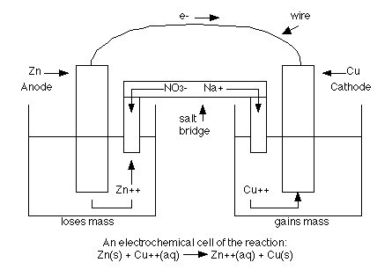
Notes:
An external electric current hooked up to an electrochemical cell will make the electrons go backwards. This process is called electrolysis. This is used, for example, to make something gold plated. You would put the copper in a solution with gold and add a current which causes the gold ions to bond to the copper and therefore coating the copper. The time, current, and electrons needed determine how much "coating" occurs. The key to solving electrolysis problems is learning how to convert between the units. Useful information:
1 A=1 C/sec; 96,500 coulombs (1 Faraday) can produce one (1) mole of e⁻; the electrons needed for deposition on electrode is determined by the charge of the ion involved.

Slide 29
An external electric current hooked up to an electrochemical cell will make the electrons go backwards. This process is called electrolysis. This is used, for example, to make something gold plated. You would put the copper in a solution with gold and add a current which causes the gold ions to bond to the copper and therefore coating the copper. The time, current, and electrons needed determine how much "coating" occurs. The key to solving electrolysis problems is learning how to convert between the units. Useful information:
1 A=1 C/sec; 96,500 coulombs (1 Faraday) can produce one (1) mole of e⁻; the electrons needed for deposition on electrode is determined by the charge of the ion involved.

Slide 30
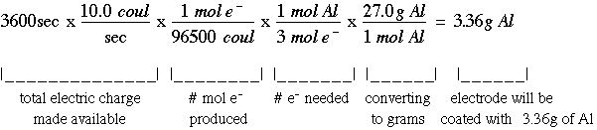
Example Problem: If you are trying to coat a strip with aluminum and you have a current of 10.0 A (amperes) running for one hour, what mass of Al is formed?
The solution of this problem involves a lengthy unit conversion process:

Slide 31
The reference electrode
In practice, the redox potential difference is measured with respect to a standard electrode.
The standard electrode is a hydrogen half-cell, with the reaction in which all components are in their standard states (1 atm pressure for the gas, 1M activity for the proton, or pH=0).
H₂ (g) → 2 H⁺ (aq) + 2 e⁻

Slide 32
Reference electrodes provide a standard redox reaction that will accept or release electrons to the soil solution.
Two types of reference electrodes are in use: Ag/AgCl and Calomel.

Slide 33
The Ag/AgCl electrode consists of a Ag metal wire and a AgCl salt. The basic reaction is:
Ag → Ag⁺ + e⁻
When the reaction goes to the right (Ag is oxidized) the electron is sent to the voltmeter and could be transmitted to the Pt wire to reduce chemicals in the soil solution if the voltmeter were not present. If the reaction goes to the left then an electron comes from the voltmeter into the electrode.
The Ag and Ag⁺ are surrounded by a solution of KCl which maintains electrical neutrality. When the reaction above goes to the right, then a K⁺ is released to the soil through the ceramic tip of the electrode. When the reaction goes to the left then a Cl⁻ anion is released through the ceramic tip.

Slide 34
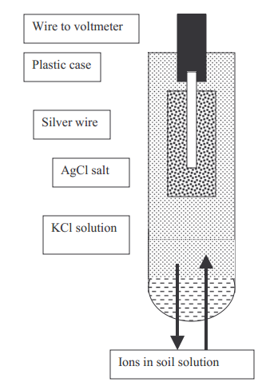
Schematic presentation of referent electrode set-up
http://www.water-research.net/course/RedoxWriteup.pdf
Notes:
The Ag/AgCl electrode consists of a Ag metal wire and a AgCl salt. The basic reaction is:
Ag → Ag⁺ + e⁻
When the reaction goes to the right (Ag is oxidized) the electron is sent to the voltmeter and could be transmitted to the Pt wire to reduce chemicals in the soil solution if the voltmeter were not present. If the reaction goes to the left then an electron comes from the voltmeter into the electrode.
The Ag and Ag⁺ are surrounded by a solution of KCl which maintains electrical neutrality. When the reaction above goes to the right, then a K⁺ is released to the soil through the ceramic tip of the electrode. When the reaction goes to the left then a Cl⁻ anion is released through the ceramic tip.

Slide 35
Another type of reference electrode in common use is the calomel which contains Hg.
The basic reaction is:
Hg → Hg⁺+ e⁻
This electrode works the same as the Ag/AgCl.
While both kinds of reference electrodes give reliable data, the voltages measured with each electrode are interpreted slightly differently. It is for this reason that users must know which electrode they have.
The voltage measured in the field must be corrected to what would have been obtained with a different reference electrode, called the standard hydrogen reference electrode.
This electrode cannot be used in the field, but our interpretations of
redox potential measurements are based on values determined with it.
Therefore, all voltages measured in the field with either the Ag/AgCl or
calomel reference electrode have to be adjusted to the value that would have
been obtained had a standard hydrogen electrode been used. The basic
correction factors are
Ag/AgCl in saturated KCl solution +200
Calomel +250
These correction factors are temperature dependent, but in most instances the effect of temperature is much lower than the variability in the data for a given time.
Therefore, a temperature correction is not necessary unless very precise measurements are required.
Notes:
While both kinds of reference electrodes give reliable data, the voltages measured with each electrode are interpreted slightly differently. It is for this reason that users must know which electrode they have.
The voltage measured in the field must be corrected to what would have been obtained with a different reference electrode, called the standard hydrogen reference electrode.
This electrode cannot be used in the field, but our interpretations of
redox potential measurements are based on values determined with it.
Therefore, all voltages measured in the field with either the Ag/AgCl or
calomel reference electrode have to be adjusted to the value that would have
been obtained had a standard hydrogen electrode been used. The basic
correction factors are
Ag/AgCl in saturated KCl solution +200
Calomel +250
These correction factors are temperature dependent, but in most instances the effect of temperature is much lower than the variability in the data for a given time.
Therefore, a temperature correction is not necessary unless very precise measurements are required.

Slide 36
Formula for Converting Field Data to Redox Potential:
Field Voltage +Correction Factor = Redox Potential (Eh)
The symbol Eh or EH is used to indicate a voltgage that has been corrected to what would have been obtained with a standard hydrogen electrode.

Slide 37
Relation between electrode potential and free energy of reaction
The complete reaction of an electrochemical cell can be treated like any other reaction, using the equation for ΔG' presented in an earlier page. Since the activity terms in the logarithmic ratio are the same as the activity terms in the equations for E above, it is a straightforward exercise to substitute among equations to find the relation between E and ΔG. This gives the following relationships:
ΔG' = -zF ΔE'
ΔGº = -zF ΔEº
ΔGº' = -zF ΔEº'

Slide 38
c.Photoinduced reactions
‘Dark’ Reactions
Most organic compounds react very slowly, even with oxygen, at normal temperature.
As a rule, they can be considered generally nonreactive.
BUT !...

Slide 39
Let Be Light !
Visible and ultraviolet radiation can promote the reactivity of almost all compounds.
Recall a well known fact that items exposed (northern hemisphere) on southern side of buildings decay more quickly than those on northern side.

Slide 40
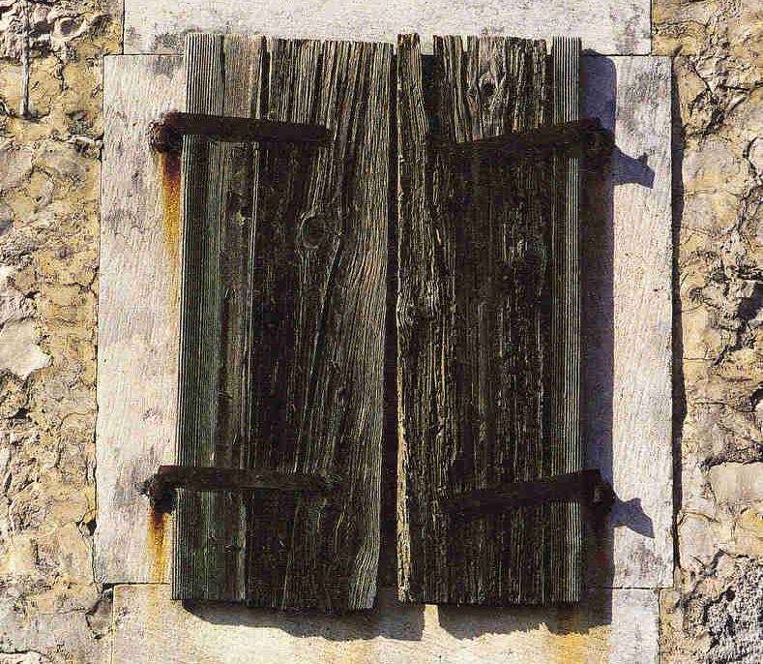
On the side facing south, the wooden (and metal) items decay faster

Slide 41

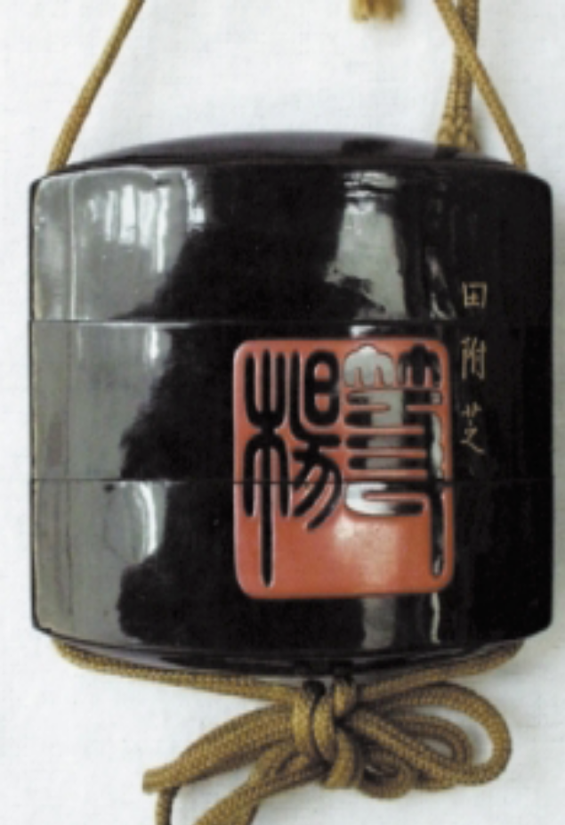
Museum item
Side exposed to light
Side not exposed to light

Slide 42
Basics of Photochemistry
Primary photophysical process.
Subsequent chemical change(s)

Slide 43
Photophysical process
Actually, it means absorption of light quanta.
It promotes molecule from ground- to excited state (energy rich one).
But, to catch the light quanta, molecule has to have a CHROMOPHORE !

Slide 44
Chromophores
Chromophores are structural details in molecule(s) that enable high(er) probability of light absorption.
Normally, it comprises double bonds in molecule, i.e., π-electrons:

Slide 45
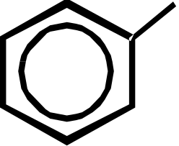
Chromophore
Double bond
Aromatic ring
Far more efficient are polarized double bonds.

Slide 46
Photophysical process
Once molecule acquires light quantum, it has many ways to decay, involving the chemical change.
Simplified approach tells that molecule can exist in ground state singlet or triplet
  The same holds for excited state

Slide 48
Jablonski diagram
MO Description

Slide 49
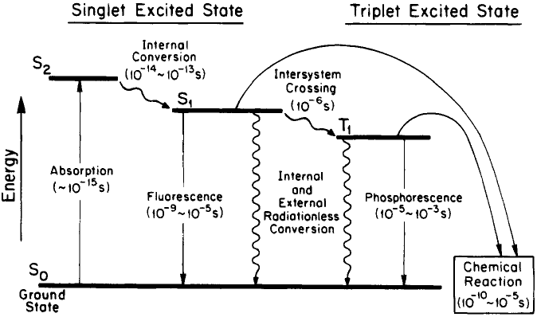

Slide 50
Singlets and triplets are known as multiplicities of state.
Electronic transition among states of different multiplicities is not likely to happen (is ‘forbidden’),
But, as many other things, something forbidden still could happen.

Slide 51
These ‘violations’ could be promoted by, so called, SENSITIZERS.

Slide 52
Sensitizers quickly, and in good yields populate excited triplet states.
Triplets live long enough to encounter other molecules.

Slide 53
Sensitization

Slide 54
Photophysics → Photochemistry

Slide 55
Primary chemical intermediates in photochemical metathesis are organic free radicals.
Free radicals are highly reactive.
Radicals react with almost everything!

Slide 56
Additional sensitization
(singlet oxygen)

Slide 57
Coatings & Erosion
VOC-s exposed to light can be promoted to more reactive compounds.
Oxygen-containing derivatives can be aggressive to living organisms and to artifacts.
Reactive intermediates may lead to polymers, forming sticky coating.

Slide 58
Everything matters
Ozone is not emitted directly from industrial sources and vehicles.
It is formed in troposphere as a result of reactions involving oxides of nitrogen and volatile organic compounds.

Slide 59
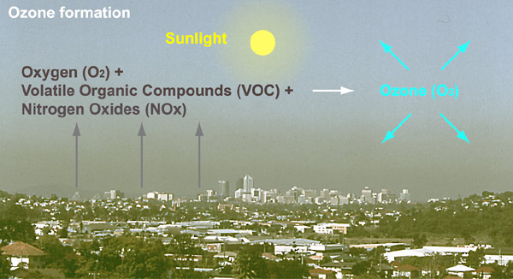

Slide 60
Internet Resources
http://www.iaq.dk/index.html
http://www.airclim.org/airAndEnvironment/AE_chp3.htm
http://www.epa.gov/region4/airqualitytoolkit/10_Glossaries/US NPS - Air Quality Glossary.pdf
http://www.heritage.xtd.pl/pdf/full_czop.pdf
http://www.epa.gov/iaq/voc.html
http://www.environment.gov.au/soe/2006/publications/commentaries/atmosphere/glossary.html
http://www.airimpacts.org/documents/local/aqbook.pdf

Slide 61
  d.Transition metal complexes
Transition metal complexes
Transition metals and their common oxidation states
What is a metal complex?
Geometries of complexes
Common ligands
Isomerism in coordination complexes
Naming transition metal complexes

Slide 62
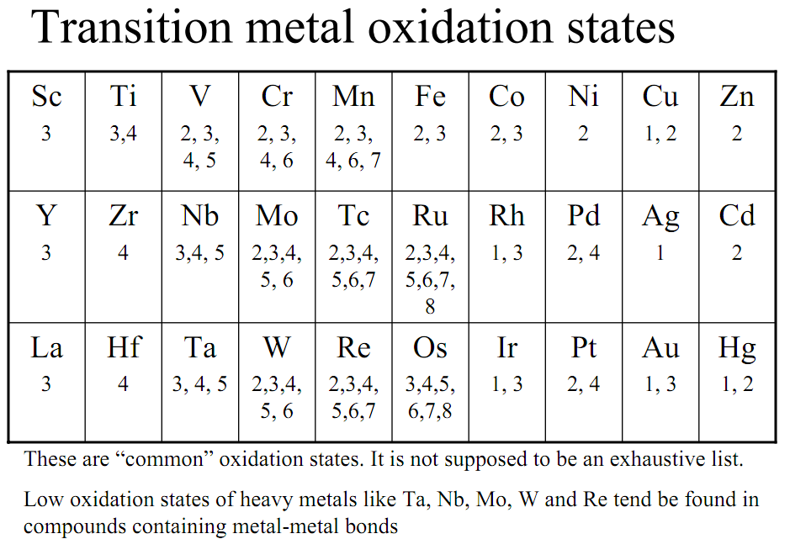

Slide 63
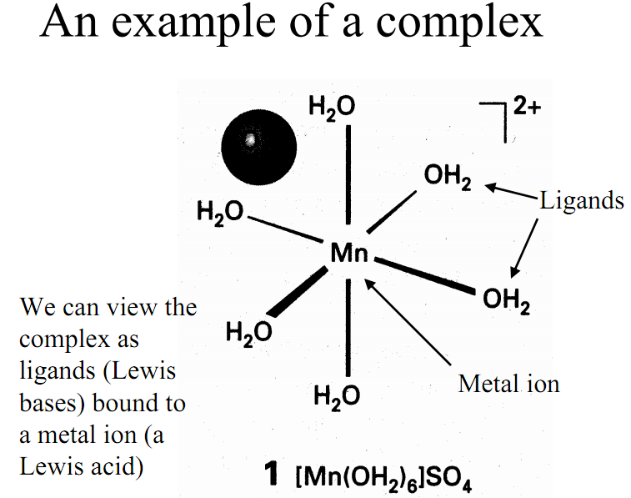

Slide 64
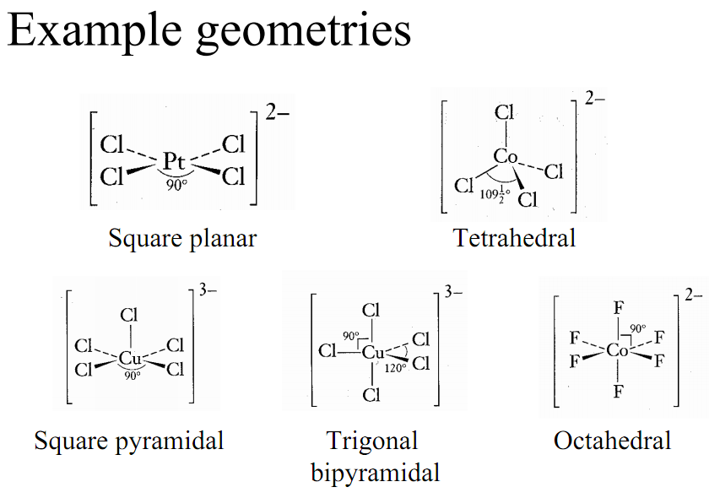

Slide 65
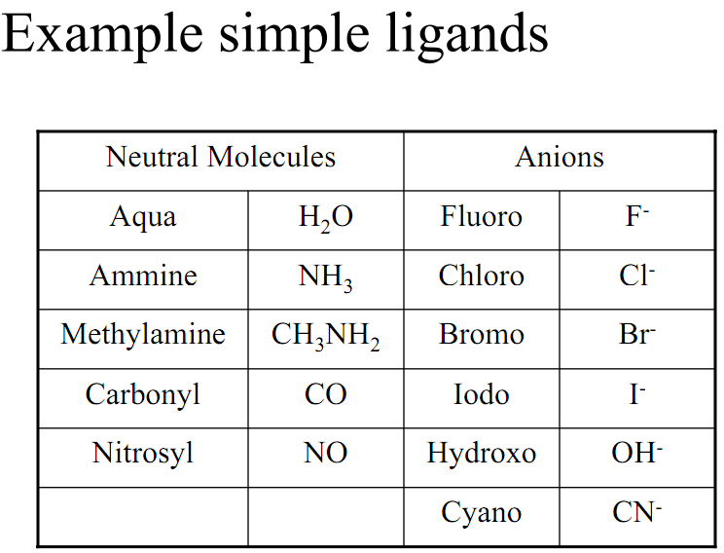

Slide 66
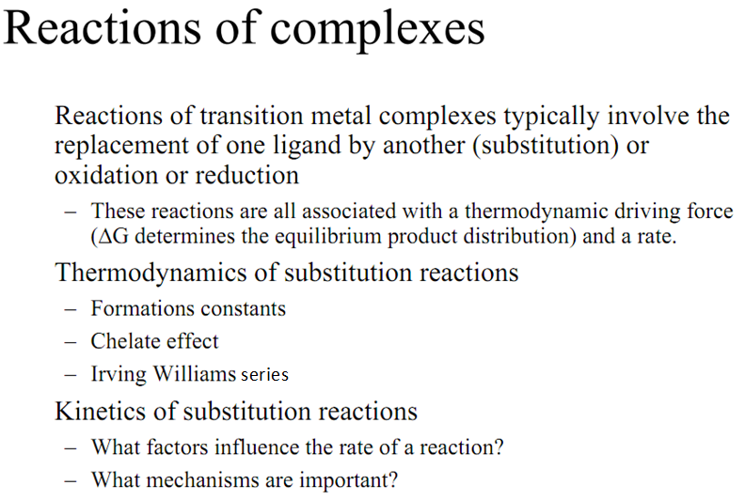
Notes:
Irwing Williams order i usually known as Irwing Williams series.

Slide 67
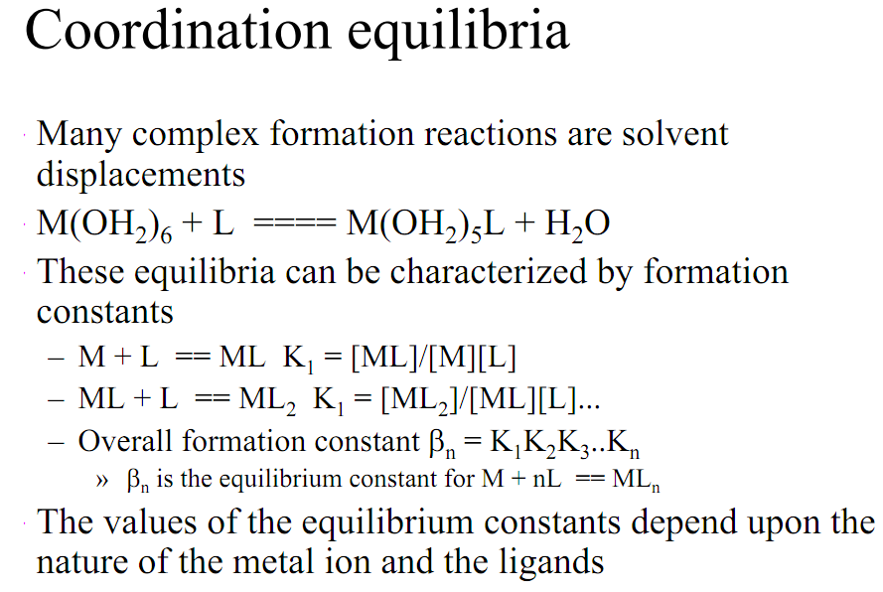

Slide 68
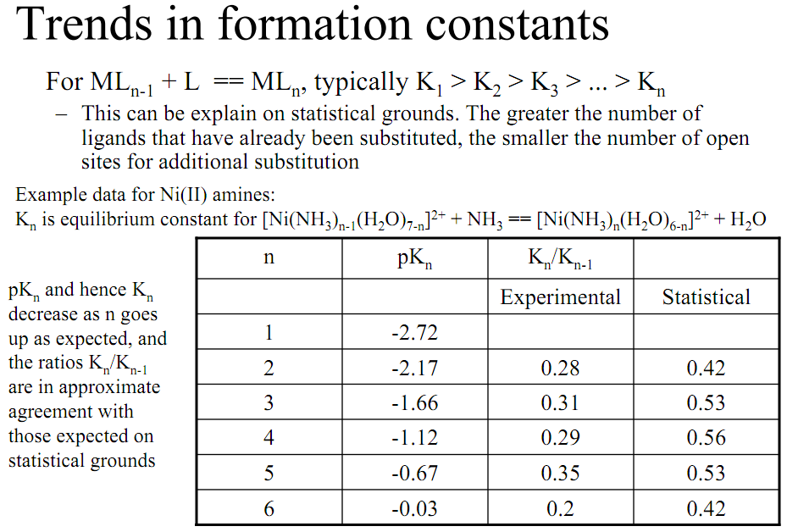

Slide 69
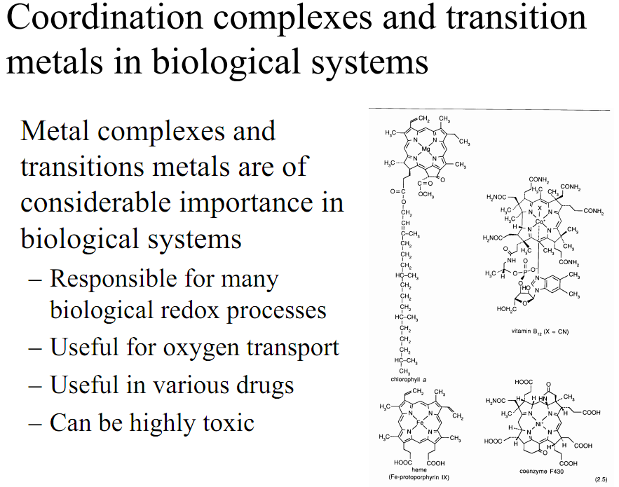

Slide 70
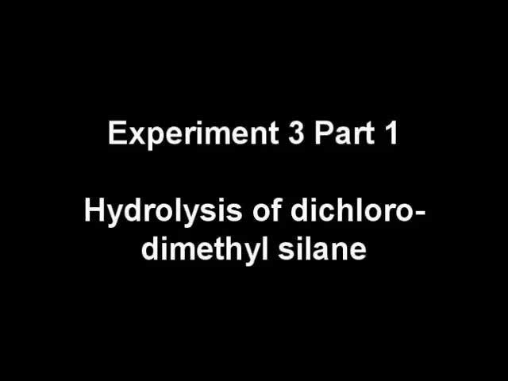
Video recording.
http://www.youtube.com/watch?v=TD0JbxPmuMg

Slide 71
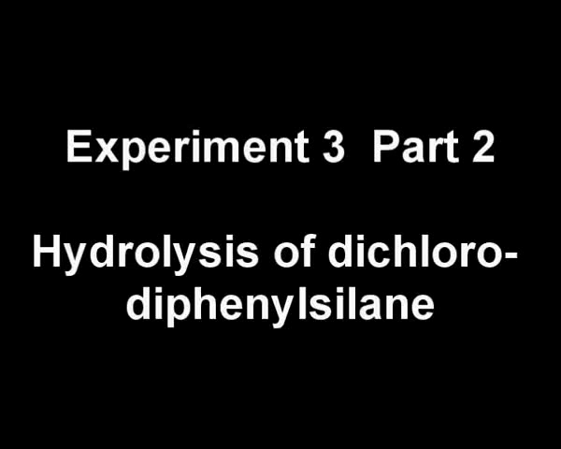
Video recording.
http://www.youtube.com/watch?v=osLRRoUnhKQ

Slide 72
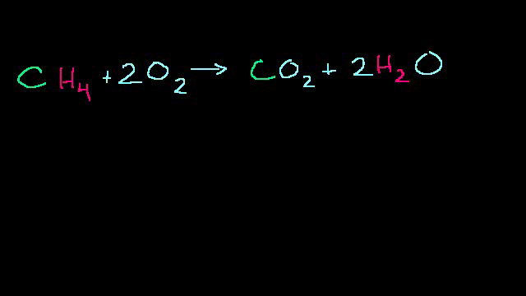
Redox reactions mechanisms and examples on how to solve a problem
Video recording.
http://www.youtube.com/watch?v=xbaa2CpNEbk

Slide 73
Methodology
Preparation of sample
The soil and sludge were collected and prepared in London in 1990 (Nouri, et al.,1980). Duplicate 250 grams samples of air dried sewage sludge/soil mixtures comprising 100, 90, 80, 50 and 0 per cent soil were placed in sintered glass membrane filter funnels and kept at the field capacity moisture by regular watering with deionised water. Soil solution was extracted by placing the funnel in a suction flask linked to a vacuum line. The first early extraction produced very little filtrate so an improved standardized procedure was adapted in which 40 ml of deionised water was slowly added to the mixtures, 30 minutes before vacuum filtration. This filtrate was more realistically a “saturation extract” than a representative sample of soil solution. After filtration the pH values of the filtrates were determined and sub samples were taken to dryness with concentrated nitric acid to destroy any soluble organic molecules prior to chemical analysis. For comparative purposes, small sub samples of the sludge/soil mixtures, taken at the beginning and end of the experiment, were extracted with water and the metal concentrations determined in the extract (McLaren and Crawford, 1973). Twelve saturations extracts were obtained over a period of eight months.

Slide 74

Conclusion
The model equation developed for the mobility of heavy metals in the soil contaminated with sewage sludge is given as:
The analysis of the result shows that there is a very good level of agreement between the experimental and simulated results obtained. This can also be confirmed by the statistical analysis of the result through the correlation coefficient found to be 0.9983, 0.9999, and 1.000 for 100% soil, 90% soil and 50% soil respectively.
In conclusion, the model developed can be considered to be a good representation of the phenomenon of mobility of metals in the soil.

Slide 75
where: C = Concentration of solute; D_{L} = Hydrodynamic dispersion coefficient; v_{x} = Pore velocity along flow path; ρ_{b} = solid density; θ = porosity for saturated conditions; C′′′ = Mass of solute sorbed per dry unit weight of soil.
This equation contains a term for dispersion, advection, and sorption (Vince DeCapio, 2003).
Knowing that
C" = k_{d} · C

Slide 76
References:
Paul, Eldor Alvin - "Soil Microbiology and Biochemistry" - Academic Press is an imprint of Elsevier 30 Corporate Drive, Suite 400, Burlington, MA 01803, USA Linacre House, Jordan Hill, Oxford OX2 8DP, UK Third edition 2007 ISBN 13: 978-0-12-546807-7
William R. Horwath - "Carbon cycling and Formation of soil organic Matter“ - Academic Press is an imprint of Elsevier 30 Corporate Drive, Suite 400, Burlington, MA 01803, USA Linacre House, Jordan Hill, Oxford OX2 8DP, UK Third edition 2007 , ISBN 10: 0-12-546807-5, Page:303-467
3. Hartmut Yersin –”Electronic and Vibronic Spectra of Transition Metal Complexes II”
Springer-Verlag Berlin Heidelberg ,New York .1997 . Printed in Germany.
ISSN 0340-2033.

Slide 77
4. A.G. Khan, C. Kuek, T.M. Chaudhry, C.S. Khoo, W.J. Hayes –
" Environmental Chemistry"; Stanley E. Manahan - New York Washington D.C. 2000, ISBN 99-047521
5. A.G. Khan, C. Kuek, T.M. Chaudhry, C.S. Khoo, W.J. Hayes A.G. Khan –
“Role of plants, mycorrhizae and phytochelators in heavy metal contaminated land remediation” - Chemosphere 41 (2000), pg 197-207, PII: S0045-6535(99)00412- 9
6. Martin N. Hughes and Robert K Pool –
"Metal speciation and microbial growth-the hard (and soft) facts“ - Journal of General Microbiology (1991) Great Britain, pg 137, 725-734; doi: 10.1099/00221287-137-4-725
7. Mark Fungayi Zaranyika and Tsitsi Chirinda –
" Heavy metal speciation trends in mine slime dams: A case study of slime dams at a goldmine in Zimbabwe “ , Academic Journals, 14 March, 2011. ISSN-2141-226X

Slide 78
8. Hooda P. S., McNulty D., Alloway B. J., Aitken M. N. – “Plant availability of heavy metals in soils previously amended with heavy application of sewage sludge”, J. Sci of Food and Agric., 1997, 73, p. 446-454. http://onlinelibrary.wiley.com/doi/10.1002/(SICI)1097-0010(199704)73:4%3C446::AID-JSFA749%3E3.0.CO;2-2/abstract
9. Camobreco V. J., Richards B. K., Steenhuis T. S., Peverly J. H., McBride M. B. “Movement of heavy metal through undisturbed and homogenized soil columns”, Soil Science, 1996, 161:740-750.
10. http://en.wikipedia.org/wiki/Hydrolysis
http://www.lenntech.com/waterglossary.htm#ixzz1lcdQ6E4F
https://www.novapublishers.com/catalog/product_info.php?products_id=2951
http://ww2.chemistry.gatech.edu/~wilkinson/Class_notes/CHEM_3111_6170/Intoduction_to_transition_metal_complexes.pdf

