Slide 1
Environmental Impact of Light
Fundamental processes in soil, atmospheric and aquatic systems
Chemical and biochemical changes
2.iii.c (2 hrs)

Slide 2
‘Dark’ Reactions
Most organic compounds react very slowly, even with oxygen, at normal temperature.
As a rule, they can be considered generally nonreactive.
BUT !...

Slide 3
Let Be Light !
Visible and ultraviolet radiation can promote the reactivity of almost all compounds.
Recall a well known fact that items exposed (northern hemisphere) on southern side of buildings decay more quickly than those on northern side.

Slide 4
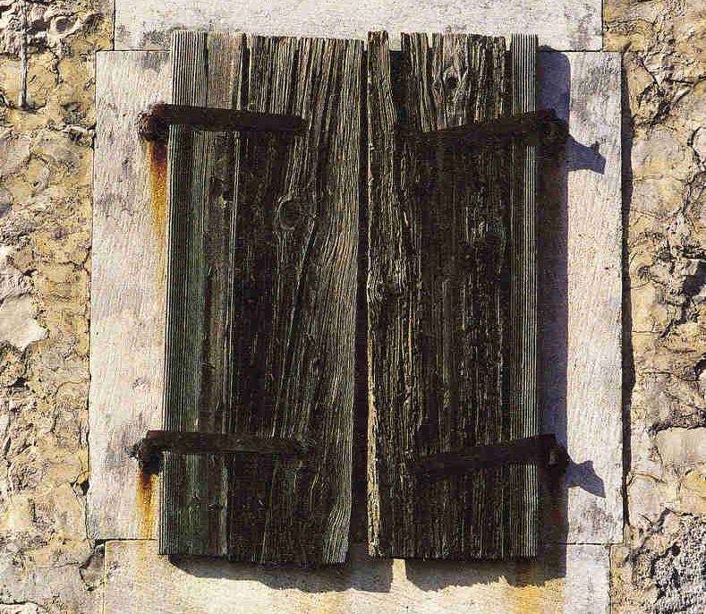
On the side facing south, the wooden (and metal) items decay faster

Slide 5
Museum item
Side exposed to light
Side not exposed to light

Slide 6
Basics of Photochemistry
Primary photophysical process.
Subsequent chemical change(s)

Slide 7
Photophysical process
Actually, it means absorption of light quanta.
It promotes molecule from ground- to excited state (energy rich one).
But, to catch the light quanta, molecule has to have a CHROMOPHORE !

Slide 8
Chromophores
Chromophores are structural details in molecule(s) that enable high(er) probability of light absorption.
Normally, it comprises double bonds in molecule, i.e., π-electrons:

Slide 9
Chromophore
Double bond
Aromatic ring
Far more efficient are polarized double bonds.

Slide 10
Photophysical process
Once molecule acquires light quantum, it has many ways to decay, involving the chemical change.
Simplified approach tells that molecule can exist in ground state singlet or triplet
  The same holds for excited state

Slide 13
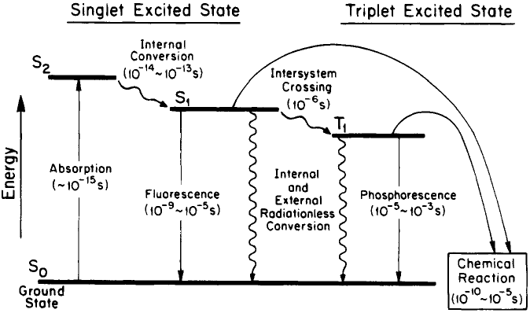

Slide 14
Singlets and triplets are known as multiplicities of state.
Electronic transition among states of different multiplicities is not likely to happen (is ‘forbidden’),
But, as many other things, something forbidden still could happen.

Slide 15
These ‘violations’ could be promoted by, so called, SENSITIZERS.

Slide 16
Sensitizers quickly, and in good yields populate excited triplet states.
Triplets live long enough to encounter other molecules.

Slide 17
Sensitization

Slide 18
Photophysics → Photochemistry

Slide 19
Primary chemical intermediates in photochemical metathesis are organic free radicals.
Free radicals are highly reactive.
Radicals react with almost everything!

Slide 20
Additional sensitization
(singlet oxygen)

Slide 21
Coatings & Erosion
VOC-s exposed to light can be promoted to more reactive compounds.
Oxygen-containing derivatives can be aggressive to living organisms and to artifacts.
Reactive intermediates may lead to polymers forming sticky coating.

Slide 22
Everything matters
Ozone is not emitted directly from industrial sources and vehicles.
It is formed in troposphere as a result of reactions involving oxides of nitrogen and volatile organic compounds.

Slide 23
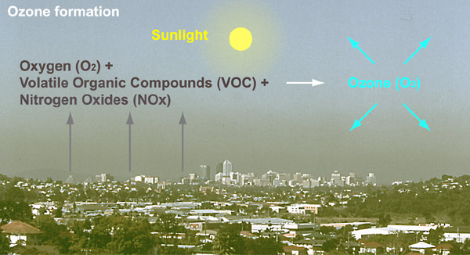

Slide 24
What pollution we can control?
  Industry,
  Traffic,
  Agriculture
  and (….. leisure)

Slide 25
Internet Resources
http://www.iaq.dk/index.html
http://www.airclim.org/airAndEnvironment/AE_chp3.htm
http://www.epa.gov/region4/airqualitytoolkit/10_Glossaries/US NPS - Air Quality Glossary.pdf
http://www.heritage.xtd.pl/pdf/full_czop.pdf
http://www.epa.gov/iaq/voc.html

Slide 26
http://www.environment.gov.au/soe/2006/publications/commentaries/atmosphere/glossary.html
http://www.airimpacts.org/documents/local/aqbook.pdf

