Slide 1
Environmental Processes
Part 2: Fundamental processes in soil, atmospheric and aquatic systems
2.3.5 Biochemical Transformations

Slide 2
Aims and outcomes
to provide overview of main concepts and terminology in biotic transformations.
to discuss possible transformations under aerobic and anaerobic conditions.
students will be able to identify principal biotic transformations of main pollutants.
students will be able to discuss about fundamentals of biotic and abiotic transformations

Slide 3
Hydrogen donors
(organic and inorganic)
„Aerobic respiration"
H2O
All strict or facultative
aerobic organisms in
the presence of oxygen
AEROBIC
(Oxygen
present)
O2
“Anaerobic respiration"
NO²⁻,N2O,N2
ANAEROBIC
(Oxygen not
present)
„Nitrate respiration “
Aerobic and facultative anaerobic bacteria
NO3-
S²⁻
„Sulfate respiration“
Obligatory anaerobic bacteria
SO4²⁻
S²⁻
"Sulfur respiration"
Facultative and obligatory anaerobic bacteria
S
CH3COOH
"Carbonate respiration"
acetogenic bacteria
CO2,HCO3⁻
CH4
"Carbonate respiration„
methanogenic bacteria
Penicillium spec. Pseudomonas spec. Desulfuvibrio desulfuricans
CO2,HCO3⁻
Fe²⁺
Fe³⁺
(„Iron respiration “)

Slide 4
0
O2[nmol∙cm⁻³]
100
Electron
acceptors
Bacterial processes
(Representative reactions)
0
Respiration:
(CH2O)x(NH3)y(H3PO4)z+xO2 → xCO2+xH2O+yNH3+zH3PO4
+O2
Oxygen
Nitrification:
NH4⁺+2O2 → NO3⁻+H2O+2H⁺
sulfide oxidation:
HS⁻ + 2O2 → SO4²⁻ + H⁺
Depth of sediment [cm]
Reduction of nitrate:
2CH2O+NO3⁻+2H⁺
-O2
Nitrogen
Reduction of sulfate:
2CH3CHOCOOH + SO4²⁻ → 2CH3COOH + 2HCO3⁻ + H2S
CH4 + SO4²⁻ → HCO3⁻ + HS⁻ + H2O
4H2 + SO4²⁻ → HS⁻ + OH⁻ + 3H2O
Sulfate
CO2, some
C1 – C2
compounds
Acetate fermentation:
CH₃COOH → CH₄ + CO2
CO₂-Reduction:
CO2 + 4H2 → CH4 + 2H2O
10
-200
+700
Eh [mV]
Stages of degradation processes

Slide 5
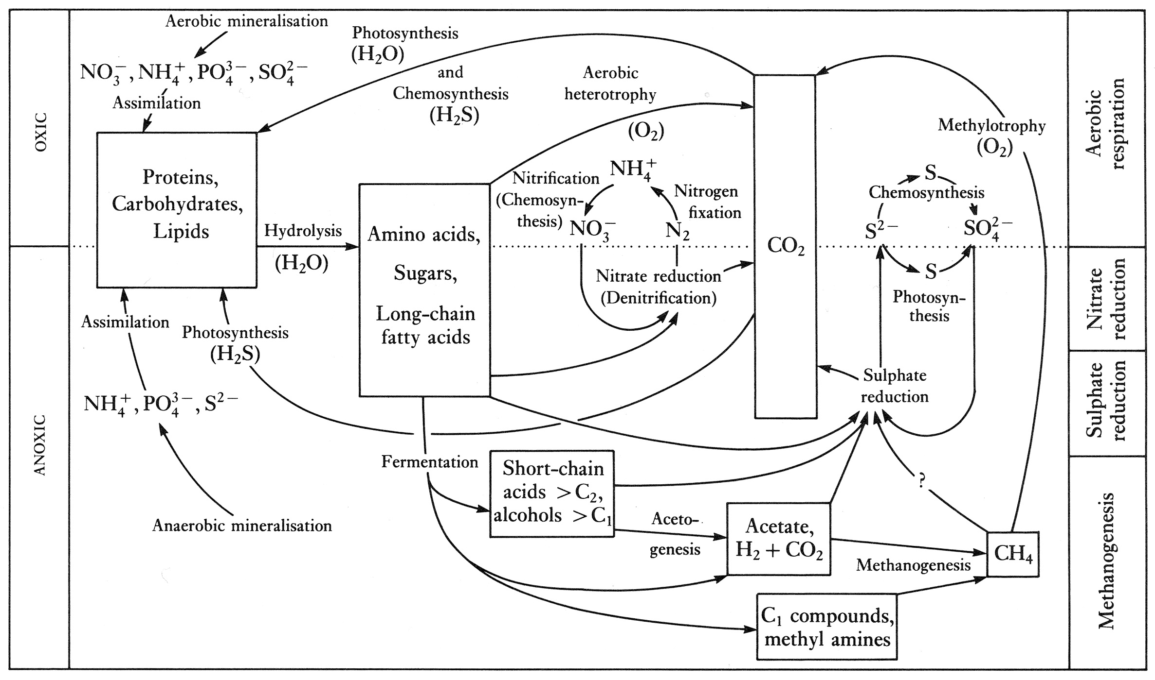

Slide 6
A –Mainly in the atmosphere
Indirect photochemical and oxidative degradation in the gas phase, primarily by OH radicals, ozone and nitrogen dioxide
Direct photochemical transformation in the atmosphere ("photolysis")
B – Mainly in water
Biological - mainly microbial - oxidative degradation in surface water
chemical hydrolysis
Photochemical degradation in aqueous solution (direct and indirect)
Biodegradation / modification by aquatic plants (eg algae)
C - Mainly soil / sediment
Biological - mainly microbial - oxidative degradation in soil
Photochemically-oxidative degradation on the surface
Degradation / modification by green land plants
Anaerobic bio-reductive and abiotic degradation (eg in anoxic sediments)

Slide 7
Primary biotic transformation and degradation of organic chemicals in soil
Type of reaction | Examples | Degraded chemicals
Oxidative processes | C-hydroxylation | Aromatic Compounds, side chains, aliphatic rings
 | ß-oxidation | Fatty acids, mineral oil, tenside
 | Epoxidation | Aromatic bonds, olefin,
 | N-oxidation | Aniline
 | Oxidative dechlorination | Apliphatic chlorinated Hydrocarbons, 2-chlorobenzoate, chlorophenyl acetate, Polychlorinated dibenzodioxins (PCDDs)
 | Oxidative coupling | Phenole, Aniline
 | Oxidative ring split | Benzene, tenside, phthalate, polychlorinated biphenyls (PCBs), PCDD
 | Mineralization | Almost all organic compounds
Reductive processes | C-reduction | Alkenes, aromatic rings, quinones
 | N-redution | Nitro compounds
 | S-reduction | Sulfoxide, disulfides
 | Reductive dechlorination | Aliphatic chlorinated hydrocarbons, pentachlorophenol
Hydrolytic processes | Ester hydrolysis | Carboxylic acid esters, phthalate, sulfates
 | Amide hydrolysis | Amides
 | Nitrile hydrolysis | Nitriles
 | Epoxy hydrolysis | Intermediates in the hydroxylation of aromatic rins and in oxidative dechlorination of aliphatic chlorinated hydrocarbons
 | Hydrolytic dechlorination | Aliphatic chlorinated hydrocarbons, penta chlorophenol, 2-chloro alkanoic acids, 4-chlorobenzoic acid
 | Hydrolytic ring split | Cyclohexane derivatives

Slide 8
Cometabolism
CATABOLISM
Energy sources
End product
ATP
Carbon source
Nutrients
ANABOLISM
Biomass
Reference: Reineke, W. und Schlömann, M. (2007): Umweltmikrobiologie. Springer Verlag Berlin. P. 33

Slide 9
METABOLISM
Phenol
NADPH+H⁺ O₂
NADP⁺ H₂O
pyrocatechol
O₂
Cis-, cis- muconic acid
ORTHO-path
Acetyl-CoA+Succinat
INTERMEDIATE-METABOLISM
COMETABOLISM
3,4-Dichlorophenol
NADPH+H⁺ O₂
NADP⁺ H₂O
4,5-Dichloro pyrocatechol

Slide 10
Aerobic degradation of aromatic compounds (BTEX aromatics)
(A)
(B)
Benzene
Benzene
O₂
H₂O
NADH
NAD⁺
NADH
NAD⁺
+ O₂
Dioxetane
Epoxide
+ H₂O
Benzen-
dihydrodiol
Benzen-
dihydrodiol
NAD⁺
NADH
NAD⁺
NADH
pyrocatechol
pyrocatechol

Slide 11
Degradation pathways of catechol and protocatechuate: ortho-way
Pyrocatechol
Protocatachuate
Pyrocatechol-1,2-dioxygenase
O₂
O₂
Protocatachuate-3,4-Dioxygenase
Muconate
Carboxymuconat
Muconate-Cycloisomerase
Carboxymuconat-Cycloisomerase
Muconolacton
Carboxymuconolacton
CO₂
Isomerase
Isomerase

Slide 12
Oxoadipat-Enollacton
Hydrolase
3-Oxoadipat
CoA-Transferase
Succinyl-CoA
Succinat
3-Oxoadipyl-CoA
Succinyl-CoA
Thiolase

Slide 13
Degradation pathways of catechol and protocatechuate: meta-way
Pyrocatechol
Protocatachuate
Pyrocatechol-2,3-Dioxygenase
Protocatachuate-4,5-Dioxygenase
Dehydroge-nase
Carboxyhydroxymuconat-semialdehyd
Hydroxymuconat
Hydroxymuconatsemialdehyd
Dehydrogenase
Tautomerase
Hydrolase
Decarboxy-
lase
Hydroxycarboxymuconat
Oxalocrotonat
Oxopentenoat

Slide 14
Hydratase
Hydratase
4-Hydroxy-2-oxovalerat
4-Hydroxy-4-carboxy-2-oxovalerat
Aldolase
Aldolase
+
+
Pyruvat
Acetaldehyd
Pyruvat
Oxalacetat
Dehydrogenase

Slide 15
- H₂O - CHO-COOH
+ O₂ + 2H
+ H₂O
- 2H
3,5-Dichloropyrocatechol
2,4-Dichlorophenoxyacetate
2,4-Dichlorophenol
- Cl⁻
+ O₂
Trans-2-Chlordienlacton
2,4-Dichlor-cis, cis-Muconat
Degradation of 2,4-D by specific bacteria
+ H₂O
Chlormaleylacetat

Slide 16
+ O₂
+ O₂
- Cl⁻
Chlorobenzene
3-Chlorbrenzcatechin
2-Chlor-cis-,cis-muconsäure
4-Oxoadipat-enol-lacton
+ O₂
+ 2H
- CO₂
- Cl
2-Chlorobenzoate
pyrocatechol
+ H₂O
- H⁺ - Cl⁻
4-Chlorobenzoate
4-Hydroxybenzoate
+ H₂
- H⁺ - Cl⁻
Mechanisms of dehalogenation of monoaromatics
3-Chlorobenzoate
Benzoate

Slide 17
Reduction of benzoyl-CoA to acetyl-CoA
Benzoyl-CoA
Rhodopseudomonas
palustris
Thauera aromatica
2-Hydroxycyclohexan-1-carbonyl-CoA
H₂O
6-Hydroxycyclohex-1-en-1-carbonyl-CoA
H₂O
Cyclohexa-1-en-1-carbonyl-CoA
Cyclohexa-1,5-dien-1-carbonyl-CoA
6-Oxocyclohex-1-en-1-carbonyl-CoA
H₂O
2-Oxocyclohexan-1-carbonyl-CoA
H₂O
3-Hydroxypimelyl-CoA
Pimelyl-CoA
2-Heptendioat-1-CoA thioester

Slide 18
AEROBIC
ANAEROBIC
(methanogenic conditions)
Trichloroethylene(TCE)
Tetrachlorethylene
Trichloroethylene
TCE-Epoxid
Dichloroethylene
(cis-1, 2 -, trans 1,2 - and 1,1-isomers)
Carbon monoxide
Formate
vinyl chloride
Ethylene
glyoxylate
Dichloro acetate
Ethan

Slide 19
Further reading
Frank Woodard. “Industrial waste treatment handbook”. Butterworth–Heinemann, 2000 (ISBN 0-7506-7317-6) Chapter 8.
“Soil Microbiology, Ecology and Biochemistry”. Edited by Eldor A. Paul, Colorado State University, Ft. Collins, U.S.A., 552 pages (3rd Edition 2007), ISBN: 978-0-12-546807-7
“Umweltmikrobiologie ”. W. Reineke, M. Schlömann , (1st Edition 2007), ISBN: 978-3-8274-1346-8
G. Pietramellara et al. (2009). “Extracellular DNA in soil and sediment : fate and ecological relevance” . Biol Fertil Soils 45, p219-235, DOI: 10.1007/s00374-008-0345-8
Meckenstock et al. (1999). “¹³C/¹²C isotope fractionation of aromatic hydrocarbons during microbial degradation”. Env. Microbiology 1(5), 409-414

