Slide 1
Environmental Processes
Partitioning of pollutants
3.i
Sorption involving organic matter
(between air/soil and water/soil)

Slide 2
Aims:
  to provide overview of molecular interactions that govern phase transfer processes in the environment
  to discuss partitioning behavior of a compound in the environment
Outcomes:
  students will be able to evaluate compound partitioning between water, dissolved organic matter, and sediment organic matter based on physico-chemical properties of compounds
  students will be able to estimate partition constants on the basis of compound's chemical structure and physico-chemical properties

Slide 3
Adsorption vs. Absorption: The difference between adsorption and absorption is that adsorption is the attraction between the outer surface of a solid particle and a contaminant, whereas absorption is the uptake of the contaminant into the physical structure of the solid.
Identical molecules behave very differently, depending on whether they are:
in the gas phase (gas),
surrounded by water molecules (dissolved),
clinging onto the exterior of solids (adsorbed),
buried within a solid matrix (absorbed).

Slide 4
sorption affects transport:
generally, molecules which are sorbed are less mobile in the environment
sorbed molecules are not available for phase transfer processes (air-water exchange, etc)
and degradation:
sorbed molecules are not bioavailable
sorbed molecules usually shielded from UV light (less direct photolysis)
sorbed molecules cannot come into contact with indirect photoxidants such as OH
rates of other transformation reactions may be very different for sorbed molecules

Slide 5
K_{H} = Pº_{L}/C^{sat}_{w}
K_{ow} = C^{sat}_{o}/C^{sat}_{w}
Air
K_{oa} = C^{sat}_{o}/Pº_{L}
A gas is a gas
T, P
K_{oa}
K_{H}
Pº_{L}
Octanol
Water
NOM, biological lipids, other solvents
T, chemical composition
K_{ow}
Fresh, salt, ground, pore
T, salinity, cosolvents
Pure Phase
(l) or (s)
C^{sat}_{o}
C^{sat}_{w}
Ideal behavior

Slide 6
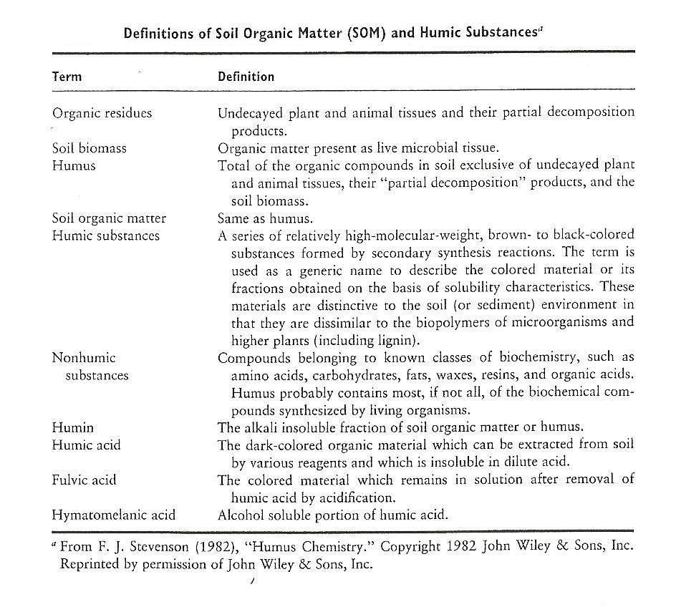

Slide 7
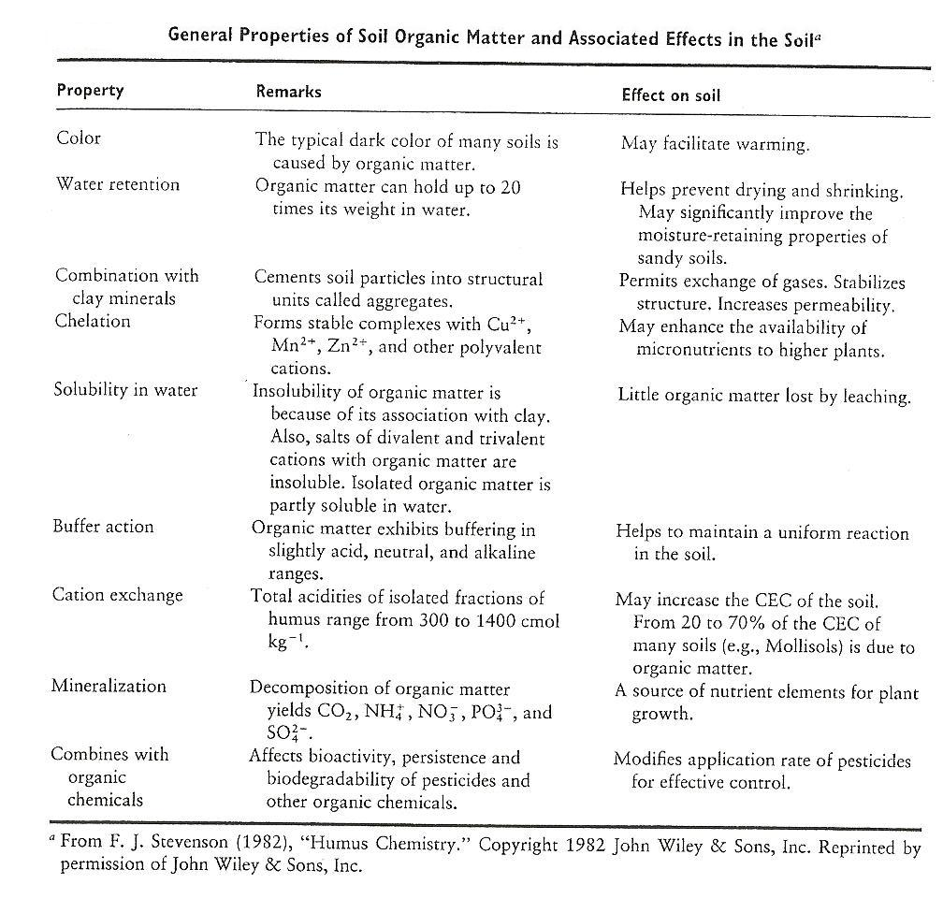

Slide 8
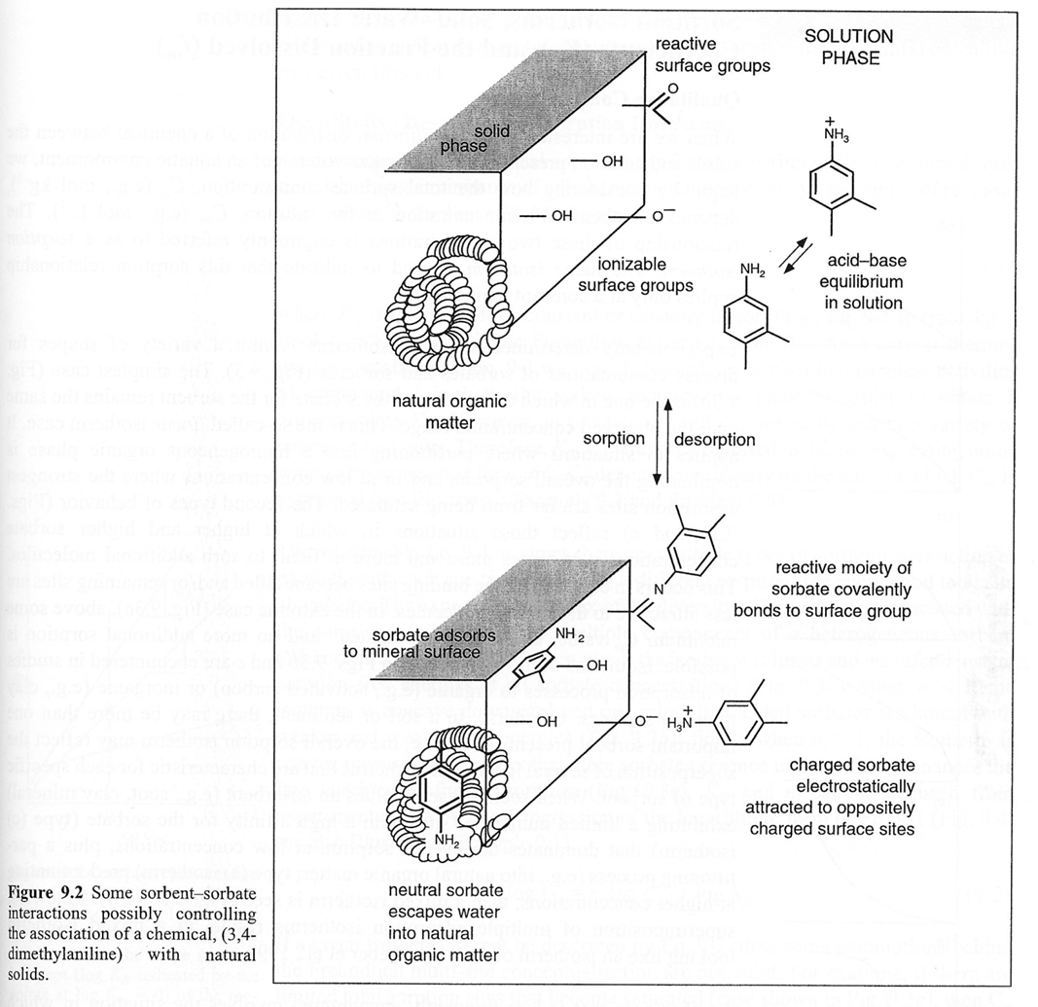

Slide 9
K_{ow} octanol-water partition coefficient
K_{ow} coefficient provides a relatively convenient means of predicting the partitioning behaviour of a hydrophobic organic substance between being dissolved in water and being sorbed by solid organic matter associated with water
K_{ow} = C_{o}/C_{aq}
C_{o} – equilibrium molar solubility of the solute in octanol
C_{aq} – equilibrium molar solubility of the solute in water

Slide 10
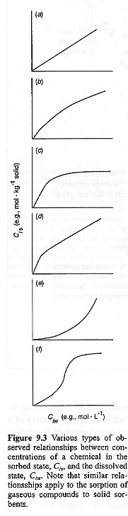
Sorption isotherms can have many shapes
as more compound is sorbed, sorption becomes more favorable
linear (K_{d} cst)
levels off at max value
as more is sorbed, sorption becomes less favorable
mixed
???
the shape of the isotherm must be consistent with the mechanism of sorption
BUT the shape of the isotherm alone does not prove which sorption mechanism is operating

Slide 11
The complex nature of K_{d}
The apparent distribution of a compound between water and solids (K_{d}) may be a result of many different types of sorption processes.
These processes include:
exchangeable adsorption of ionized form to charged surface
covalently bonded adsorption of ionized form to mineral surface
adsorption to mineral surface
sorption to organic carbon
σ refers to conc of suitable sites (mol/m²)
total amount in dissolved phase consists of neutral and ionized forms

Slide 12
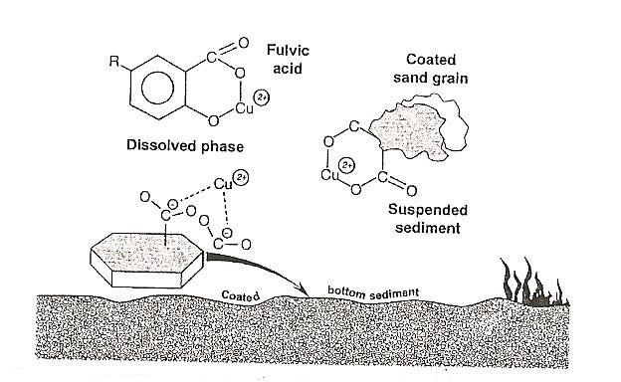
Humic substances – metal ions interactions
This interactions are important in affecting the retention and mobilty of metal contaminants in soils and waters
These interactions include reactions between dissolved organic carbon (DOC) and metal ions, and complexation reactions between suspended organic matter (SOC) and metal ions, and bottom sediment and metal ions

Slide 13
SOM – clay complexes
The types of interactions involved in SOM – clay complexes include:
  physical adsorption or interaction via van der Waals forces
  electrostatic interactions
  cation and anion bridges (clay mineral – metal – HS)
  chemical adsorption
  hydrogen bonding

Slide 14
Retention of pesticides and other organic substances by humic substances
Pesticides have a strongly affinity for SOM and SOM is most important in pesticide retention
Factors that affect the retention of pesticides by SOM:
  number, type and accessability of functional groups
  nature of pesticides
  pH
  exchangeable cations
  moisture
  temperature
  soil component (types and quantities of clay minerals and other constituents)

Slide 15
Literature
Schwarzenbach, R.P., Gschwend, P.M., Imboden, D.M. (2003). Environmental Organic Chemistry, 2nd Edition John Wiley and Sons, New Jersey.
Gary W. vanLoon, Stephen J. Duffy “Environmental Chemistry (a global perspective)” Oxford University Press, New York (2nd edition), 2005.
Donald L. Sparks “Environmental Soil Chemistry” Academic Press, Published 1995.
G. J. Lair, M. H. Gerzabek, G. Haberhauer, Environ Chem. Lett. (2007) 5:23–27

