Slide 1
Environmental Processes
Partitioning of pollutants
3.iii
Sorption in living media (bioavailability)

Slide 2
Aims:
  to provide overview and terminology in sorption in living media (biavailability; bioaccumulation; biomagnification)
  to asses bioaccumulation and biomagnification via food web.
Outcomes:
  students will be able to evaluate bioavailability and bioaccumulation potential of chosen pollutants based on their physico-chemical properties and environmental conditions.

Slide 3
Bioaccumulation
“Bioaccumulation is defined as the accumulation of chemicals in the tissue of organisms through any route, including respiration, ingestion, or direct contact with contaminated water, sediment, and pore water in the sediment.” – U.S. Environmental Protection Agency, 2000.
Bioaccumulation Factor
The extent of chemical bioaccumulation usually is expressed in the form of a bioaccumulation factor (BAF), which is the ratio of the chemical concentrations in the organism (C_{B}) to those in water (Cw):
BAF = C_{B}/C_{W}

Slide 4
Bioavailability
Bioavailability of a chemical substance in a particular environmental media such as water, sediment, and food is defined as "the fraction of chemical in a medium that is in a state which can be absorbed by the organism.“
This is the process by which the chemical concentration in an aquatic organism achieves a level that exceeds that in the water, as a result of chemical uptake through all possible routes of chemical exposure (e.g., dietary absorption, transport across the respiratory surface, dermal absorption, inhalation).

Slide 5
Bioconcentration
Bioconcentration – "A process leading to a higher concentration of a substance in an organism than in environmental media to which it is exposed (after WHO, 1979)." - International Union of Pure and Applied Chemistry, 1993
Bioconcentration refers to a condition, usually achieved under laboratory conditions, where the chemical is absorbed only from the water via the respiratory surface (e.g., gills) and/or the skin.
Bioconcentration Factor
Bioconcentration can be described by a bioconcentration factor (BCF), which is the ratio of the chemical concentration in an organism (C_{B}) to the concentration in water (C_{w}):
BCF = C_{D}/C_{W}
The BCF, like the BAF, also can be expressed in terms of the dissolved chemical concentration (C_{WD}):
BCF = CD/C_{WD}

Slide 6
Biomagnification
Biomagnification – “Result of the process of bioaccumulation and biotransfer by which tissue concentrations of chemicals in organisms at one trophic level exceed tissue concentrations in organisms at the next lower trophic level in a food chain.” - Environmental Protection Agency, 2010.
This is the process in which the chemical concentration in an organism achieves a level that exceeds that in the organism's diet, due to dietary absorption. The extent of chemical biomagnification in an organism is best determined under laboratory conditions, where organisms are administered diets containing a known concentration of chemical, and there is no chemical uptake through other exposure routes (e.g., respiratory surface, dermis).
Biomagnification can be described by a biomagnification factor (BMF), which is the ratio of the chemical concentration in the organism to the concentration in the organism's diet:
BMF = C_{B}/C_{D}
The chemical concentration in the organism (C_{B}) and the diet of the organism (C_{D}).

Slide 7
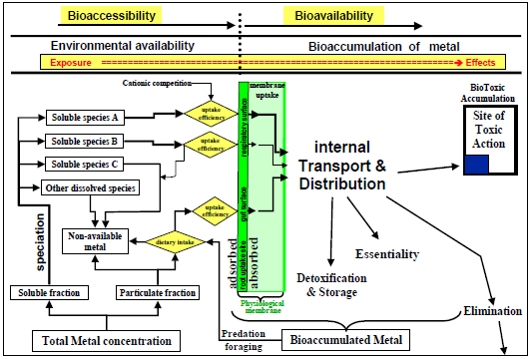
Conceptual diagram of processes controlling the bioavailability and the bioaccumulation, both toxic and benign, of metals from the environment.

Slide 8
Literature
Jim McGeer, Gerry Henningsen, Roman Lanno, Nicholas Fisher, Keith Sappington, and John Drexler, Issue Paper On The Bioavailability And Bioaccumulation Of Metals, U.S. Environmental Protection Agency, 2004.

