Slide 1
Hydrocarbon migration
4(i)

Slide 2
The lecture content:
- Hydrocarbons in geosphere
(bitumen, inherited bitumen, petroleum).
- Source and reservoir rocks.
- Primary and secondary migration.
- Accumulation.

Slide 3
The most important types
of organic matter in geosphere are:
- the fulvic and humic acids,
- humin,
- kerogen
(in coal, oil shales, source rocks or in sediments),
- bitumen and inherited bitumen,
- oil (petroelum),
- gas and
- graphite.

Slide 4
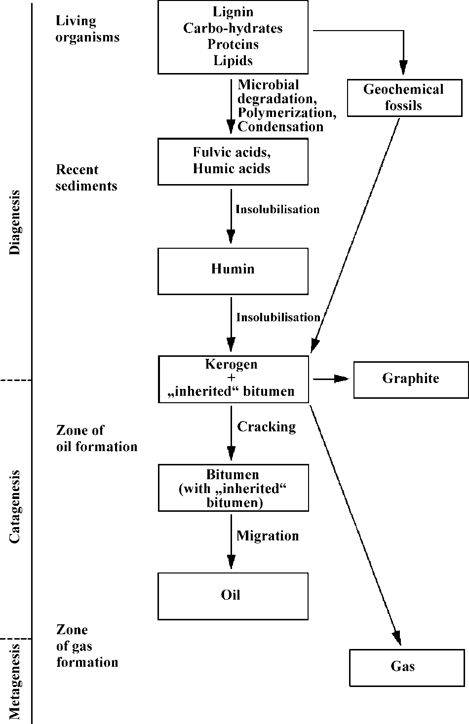
All types of organic matter in geosphere are genetically related and are part of the carbon cycle in nature, or carbon cycle in the geosphere. Central place in that part of the cycle belongs to kerogen, because some of these forms are organic substances in geosphere on the way to transform into it while others, however, derive from kerogen.
A simplified scheme of the transformation
of organic matter in the Earth’s crust.

Slide 5
The total bitumen of sedimentary
rocks actually consists of two forms:
- “Inherited bitumen "
(is composed of some lipid molecules and it was not incorporated into polymeric materials in type of fulvic and humic acids, kerogen and humin during the diagenesis).
- Bitumen
(that is derived as a product of catagenetic cracking of the kerogen).
These two types of bitumen are combined in the sedimentary rocks during the catagenesis.

Slide 6
The share of the bitumen in "total" bitumen is incomparably higher (over 95%). It is actually main precursor of oil, because it is composed mainly of migrated bitumen derived from kerogen cracking.
“Inherited bitumen” contains many compounds with preserved hydrocarbon skeleton of biological precursors. They carry important "genetic information".
Based on some compounds from the inherited bitumen, and based on composition, structure and abundance of this bitumen, it is possible to draw some important information about the origin of oil.

Slide 7
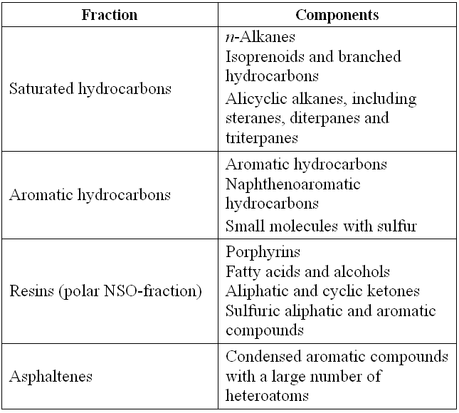
Bitumen fractions and their main components

Slide 8
Oil (petroleum)
Oil represent migrated and accumulated product of diagenetic and catagenetic transformations of organic matter in sedimentary rocks.
From the organic-geochemical point of view oil is one of the final products of transformation of organic matter in sedimentary rocks which, based on all that has been said so far, can be summarized as follows:
in the stage of diagenesis, under the action of microorganisms, in extinct organisms of the biosphere, biopolymers (proteins, carbohydrates, lignin, complex lipids) degrade to geomonomers (amino acids, monosacharides, phenols, fatty acids); geomonomers, if not subjected to further microbial decomposition to even smaller molecules (H2O, CH4, NH3, N2, and H2S) polymerize to fulvic and humic acids, then to humin, and finally to kerogen, which is the end stage of diagenesis; under the influence of heat, pressure and mineral catalysts, in catagenetic phase, over a very long span of geologic time, the kerogen converts to bitumen, which in mixture with the inherited bitumen, under certain conditions migrates (primary and secondary migration) from the original to reservoir rocks where it is accumulated, making oil.

Slide 9
Source rocks
If in a sedimentary rock, during catagenetic transformations of kerogen, significant amounts of bitumen are generated, enough to enable migration together with the inherited bitumen (possibly to the reservoir rock for oil), this rock is called the "source" or "parent" rock for oil.

Slide 10
Classification of source rocks for oil:
Effective
(any sedimentary rock that has already generated and expelled hydrocarbons)
Possible
(any sedimentary rocks whose potential has not yet been known, but which are capable of generating and expelling hydrocarbons)
Potential source rocks.
(potential source rocks are any immature sedimentary rocks known to be capable of generating and expelling hydrocarbons if their levels of thermal maturity were higher)

Slide 11
Criteria for determining the source rock potential
- Sedimentary rock must contain specific, at least the minimum amount of organic matter.
- Organic matter (bitumen and kerogen) in sediment rock must be at a certain level of thermal maturity.
- Kerogen must be type I or type II.

Slide 12
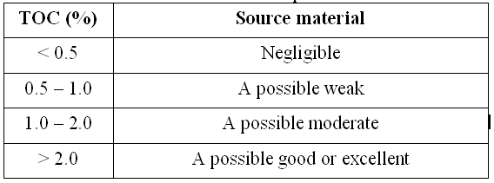
Typical ranges of Total Organic Carbon (TOC) values in the sediments of a different source potential

Slide 13
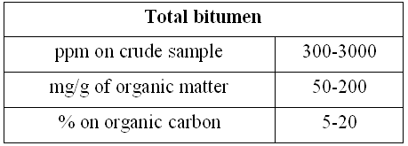
Limit values of the bitumen content in source rocks

Slide 14
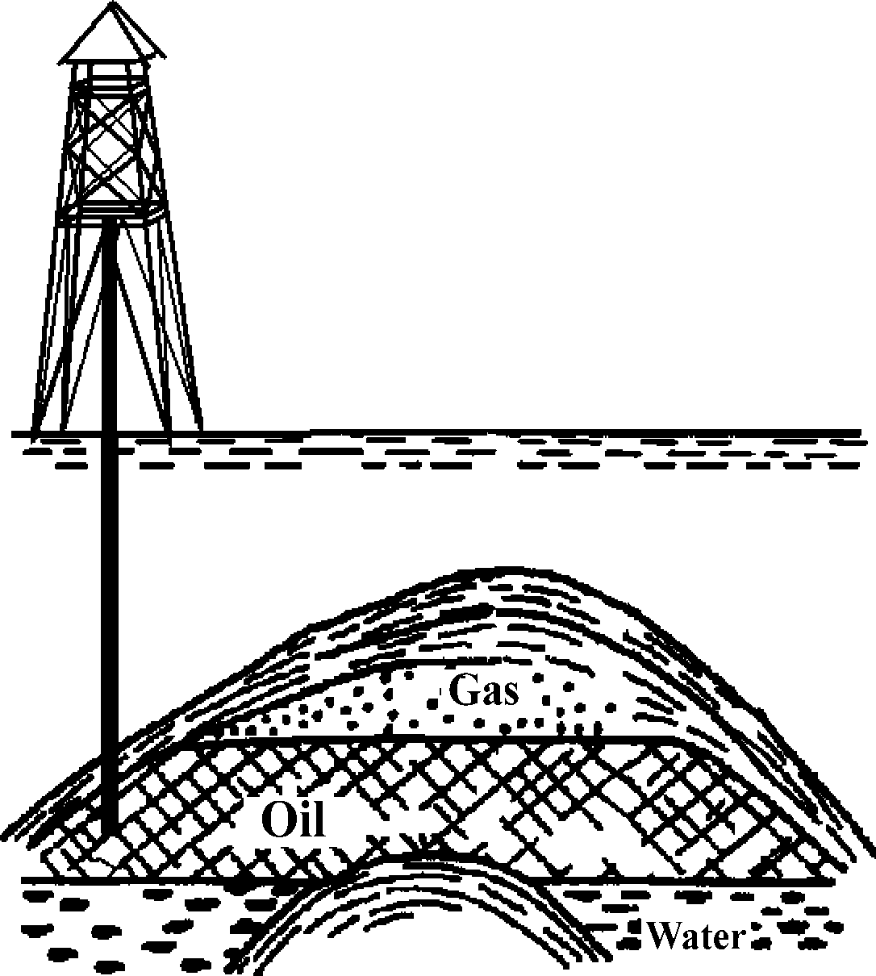
Reservoir rocks
A simplified illustration of the oil reservoir rock.

Slide 15
Primary and secondary migration
Movement of bitumen from the site of its generation in the source rock to the reservoir rock, in the organic geochemistry is called migration.
The migration of bitumen starts in the source rock itself. Migration through it is called primary migration.
Movement from the source rock to the reservoir is called secondary migration.

Slide 16
Bitumen migrates from areas of higher pressure and higher temperature to the area of lower pressure and temperature.
The reservoir rock is usually at a greater depth than the corresponding source rock.
If the reservoir rock is permeable in its part, there is also a possibility of tertiary migration, or movement of oil to a new reservoir at even lower depths.

Slide 17
Accumulation
Accumulation is the collection process of bitumen in tight reservoir rocks – the end of migration
- The temperature pressures in reservor rocks are generally lower.
- The contact of oil with inorganic environment in the reservoirs is weaker.
- Further changes in the composition of oil still take place in the reservoir rocks:
1) maturation changes,
2) deasphalting process,
3) water washing and
4) biodegradation.

