Slide 1
4.2 POPs migration
EP
Environmental Processes

Slide 2
Aims:
to give students basic information about pollutants properties relevant for their possible transport
to discuss mechanisms of pollutants migration in local scale as well as those of long range transport
Outcomes:
students will understand the mechanisms of pollutant transport in the environment
students will be able to evaluate its ability for long-range transport on the base of compound properties

Slide 3
Lecture Content
Basic physical-chemical properties of pollutants relevant for pollutants transport
Migration mechanisms in air, water, soil
Global distribution of pollutants
Content of the practical work:

Slide 4
Important properties of pollutants
Targeted compounds:
PTS = Persistent Toxic Substabces
PBTs = Persistent, Bioaccumulative, Toxic compounds
POPs = Persistent Organic Pollutants

Slide 5
Important properties of pollutants
Common properties of persistent organic pollutants:
Persistent:
  Resistance to chemical, biochemical, photochemical degradation-degradation in the environment is slow or practically negligible.
  Ability to stay in the environment for years.
(Bio)accumulative:
  Accumulation in the abiotic environment (interaction with organic matter in soils and sediments)
  Accumulation in fatty tissues of living organisms (bioconcentration, bioaccumulation)
Toxic
  negative influence on living organisms in low concetration
  Ability to be transformed to compounds showing these effects
Ability of long-range transport
  Physical properties of compounds
Production in important quantities

Slide 6
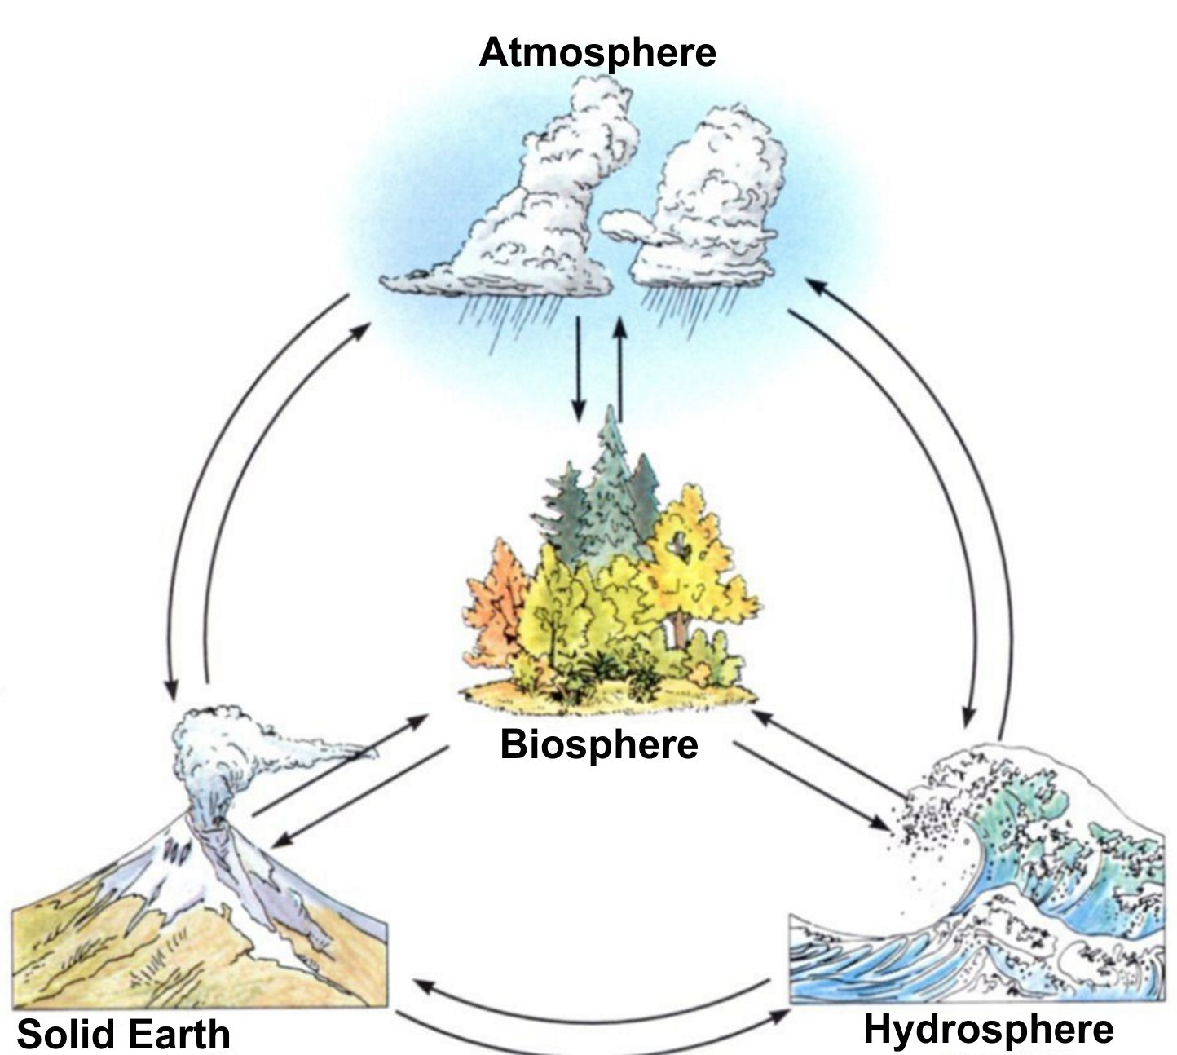
Transport of pollutants between environmental compartments
The environment consists of environmental compartments:
Atmosphere
Hydrosphere
Pedosphere
Litosphere
Biosphere
These compartments could be divided to sub-compartments - e.g. hydrosphere:
Oceans
Rivers
Underground water
Glaciers
Compounds could be transported in/between the environmental compartments

Slide 7
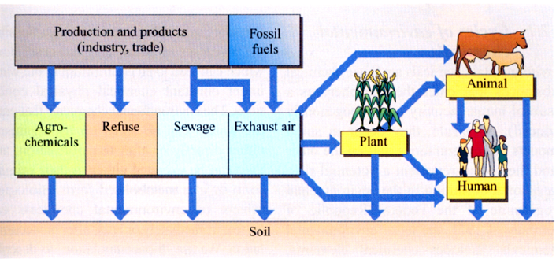
Natural Cycles in Nature
Natural cycles of the elements
Carbon Cycle
Nitrogen cycle
Cycles of compounds
Geochemical cycle
Biochemical cycle
Cycles in compartments
Water
Soil
Global anthropogenous cycle

Slide 8
POPs in the Environment
Physical-chemical properties relevant for the environmental distribution of organic pollutants
Property | Property
Molecular mass | Saturated vapor pressure
Structure | Henry’s constant
Polarity | K_{water/air}
Reactivity | K_{particle/air}
Solubility in water | K_{particle/water}
Solubility in lipids | K_{water/soil}
K_{OW} distribution coefficient | BCF (Bioconcentration factor)

Slide 9
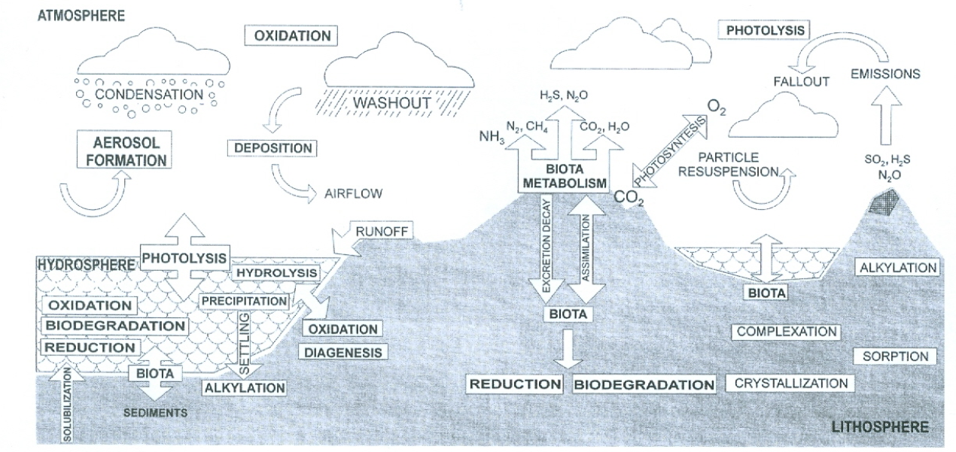
Environmental Fate of Pollutants

Slide 10
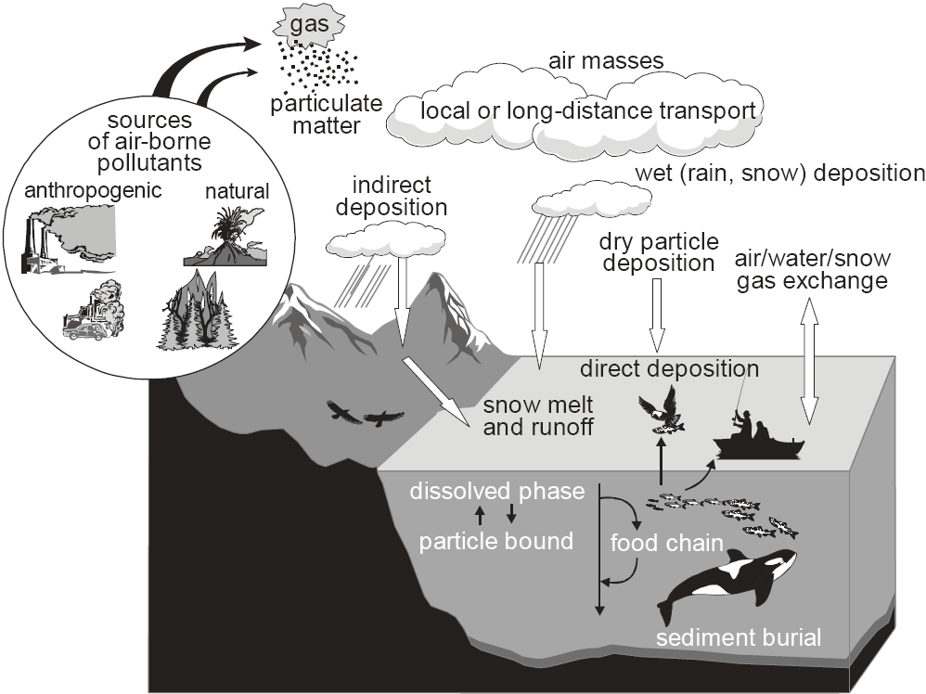
Transport Mechanisms of Pollutants in the Environment

Slide 11
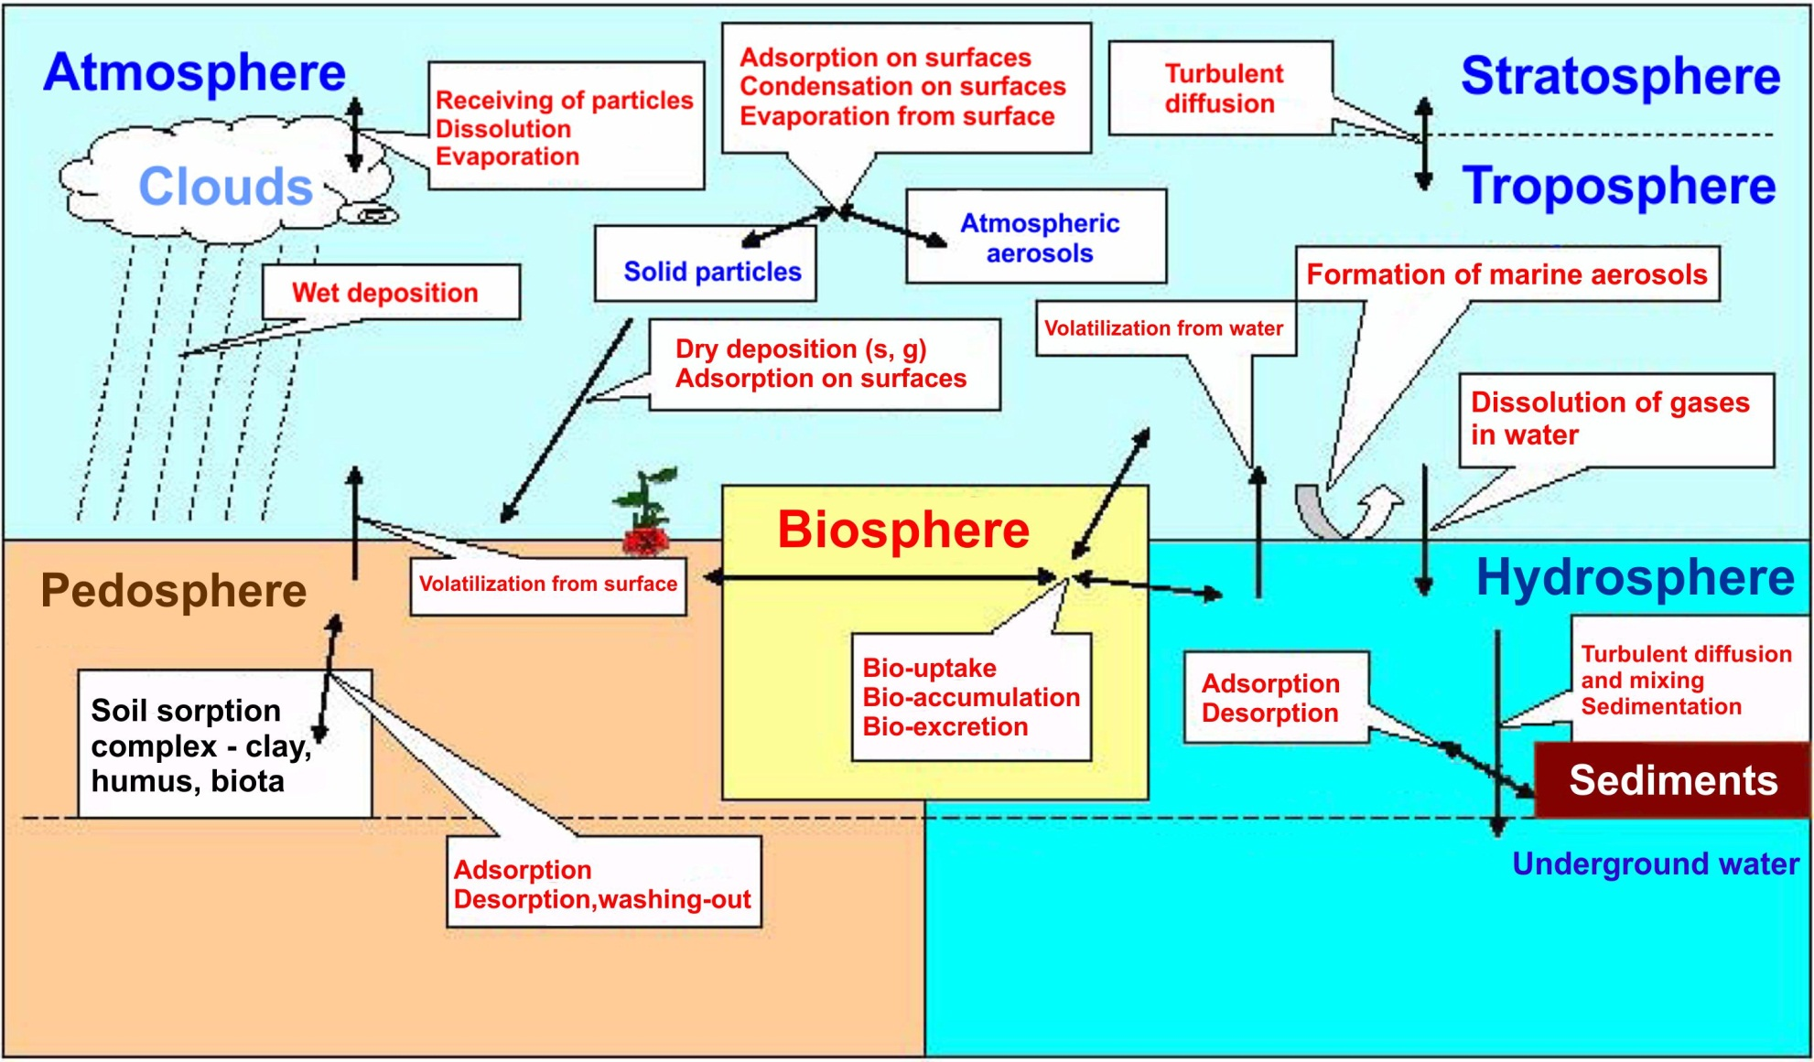
Transport of Pollutants in the Environment

Slide 12
Transport of pollutants in the environment
Atmosphere
precipitation
volatilization
volatilization
Pollutant
dry and wet deposition
Water
adsorption
desorption
release
bioaccumulation
Soil
Biota

Slide 13
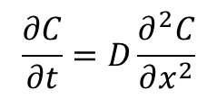
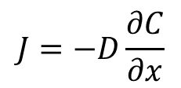
Transport within one compartment
Transport mechanisms:
1. Diffusion
spontaneous transport which goes from regions of higher concentration to regions of lower concentration
$$J=−D\frac{∂C}{∂x}$$
Fick's first law of diffusion:
where
J … diffusion flux (amount of substance per unit area per unit time, e.g. mol.m⁻².s⁻¹)
D … diffusion coefficient (or diffusivity) in dimensions of [length² time⁻¹], e.g. m².s⁻¹
C … concentration in dimensions of [amount of substance per unit volume], e.g. mol.m⁻³
x … length (m)
$$\frac{∂C}{∂t}=D\frac{∂^{2}C}{∂x^{2}}$$
Fick's second law of diffusion:
t … time (s)
other symbols as above

Slide 14
Transport within one compartment
Transport mechanisms:
1. Diffusion
Diffusivity in air:
[cm².s⁻¹]
where:
T – temperature [K]
m_{air} –average molecular mass of air [28.97 g.mol⁻¹]
m – molecular mass of compounds [g.mol⁻¹]
P – pressure of gaseous phase [atm]
V_{air} – average molar volume of gases in air [~ 20.1 cm³.mol⁻¹]
V – molar volume of compound [cm³.mol⁻¹]

Slide 15
Transport within one compartment
Transport mechanisms:
1. Diffusion
Diffusivity in water:
[cm².s⁻¹]
where:
η … viscosity at given temperature [cPoise = 10⁻².g.cm⁻¹.s⁻¹]
V – molar volume of compound [cm³.mol⁻¹]

Slide 16

Transport within one compartment
Transport mechanisms:
2. Advection
Advective transport describes the movement of some quantity via the bulk flow of a fluid (as in a river or pipeline)
$$F_{adv}=C∙v$$
where
F_{adv} … advective flux (amount of substance per unit area per unit time, e.g. mol.m^{˗2}.s^{˗1})
C … concentration in dimensions of [amount of substance per unit volume], e.g. mol.m⁻³
V … flow velocity [m.s⁻¹]

Slide 17
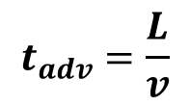
Transport within one compartment
Transport mechanisms:
2. Advection
If the flow velocity is constant, then advection transport time t_{adv} could be calculated as:
$$t_{adv}=\frac{L}{v}$$
[ s ]
where
L … distance of advection [m]
V … flow velocity [m.s⁻¹]
Remark:
Convection is usually defined as the sum of transport by diffusion and advection.

Slide 18
Transport between environmental compartments
Wet deposition of gases and particles
Gas deposition to surfaces (soil, water, vegetation)
Re-emission from water, soil and biota
Dry particle deposition

Slide 19
Atmospheric deposition
Transport of compounds from air to water and/or soil surface by:
Wet atmospheric deposition:
  Precipitation scavenging (bellow-cloud scavenging)
    falling rain droplets collide with particles
  In-cloud scavenging
    aerosol particles collide with the water droplets in clouds (e.g. inside fog)
  Snow scavenging (falling snow "removes" the material below it)
  Nucleation scavenging (aerosol particles initiate forming cloud droplets and then are lost when the cloud droplets become rain drops)
Dry atmospheric deposition
  Deposition of aerosol and gases adsorption on surfaces

Slide 20
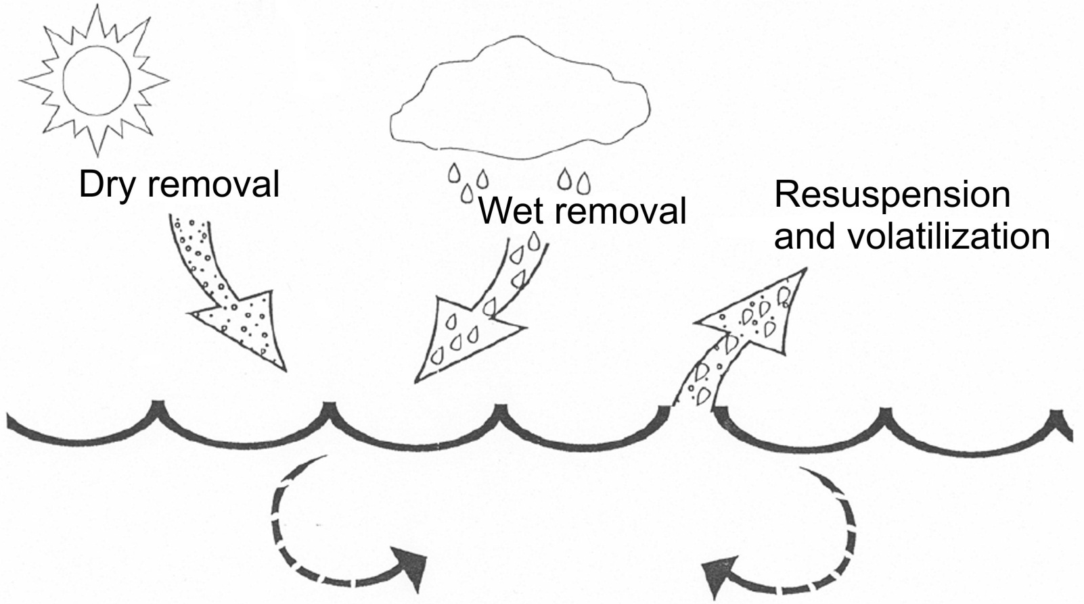
Atmospheric deposition
Atmospheric loading = Net flux =
= (Dry removal + Wet removal) – (resuspension + volatilization)

Slide 21
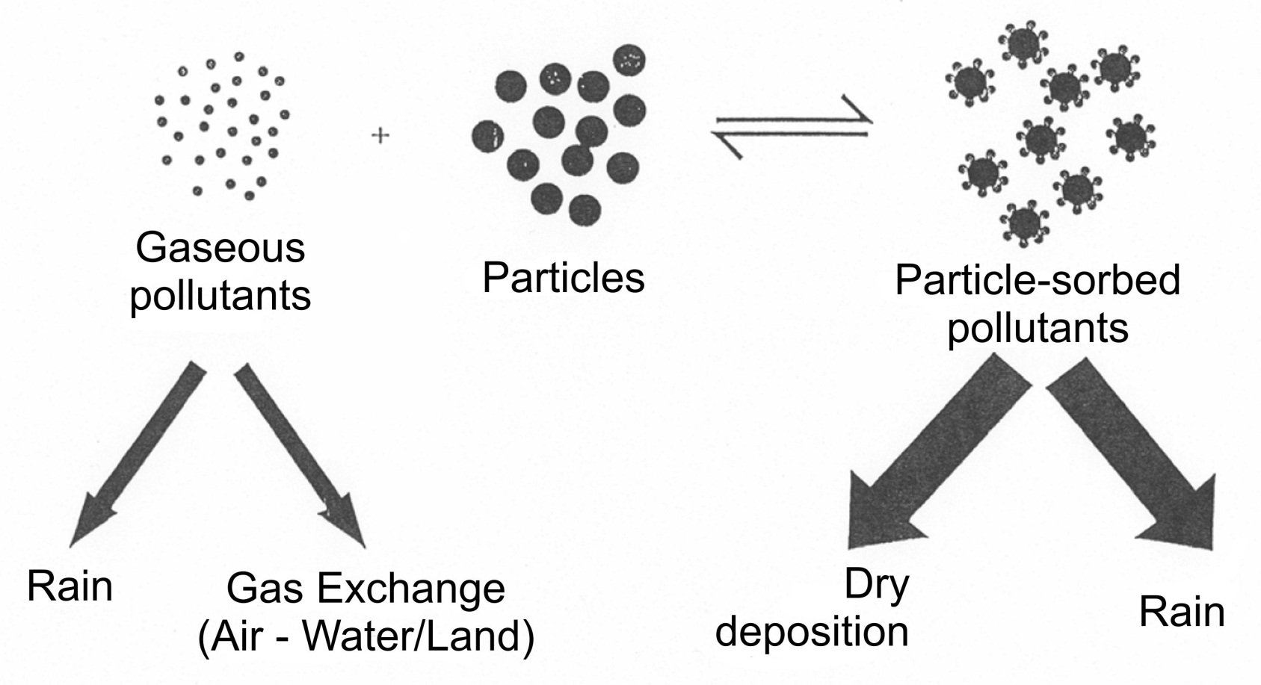
Atmospheric deposition
Phase distribution of semivolatile pollutants

Slide 22

Atmospheric deposition
Rain-out, wash-out and deposition: one-way advective transport processes
Gas adsorption on soil surface/absorption in water: reversible processes, direction depending on the real conditions (fugacity of the concrete compound in both phases on concrete place)
Fugacity: partial pressure in ideal gases:
$$f_{A}=_{A}∙x_{A}∙P$$
Where:
f_{A} … fugacity of the compound A
Θ_{A} … fugacity coefficient of the compound A
x_{A} … molar fraction of the compound A in mixture
P … total pressure

Slide 23
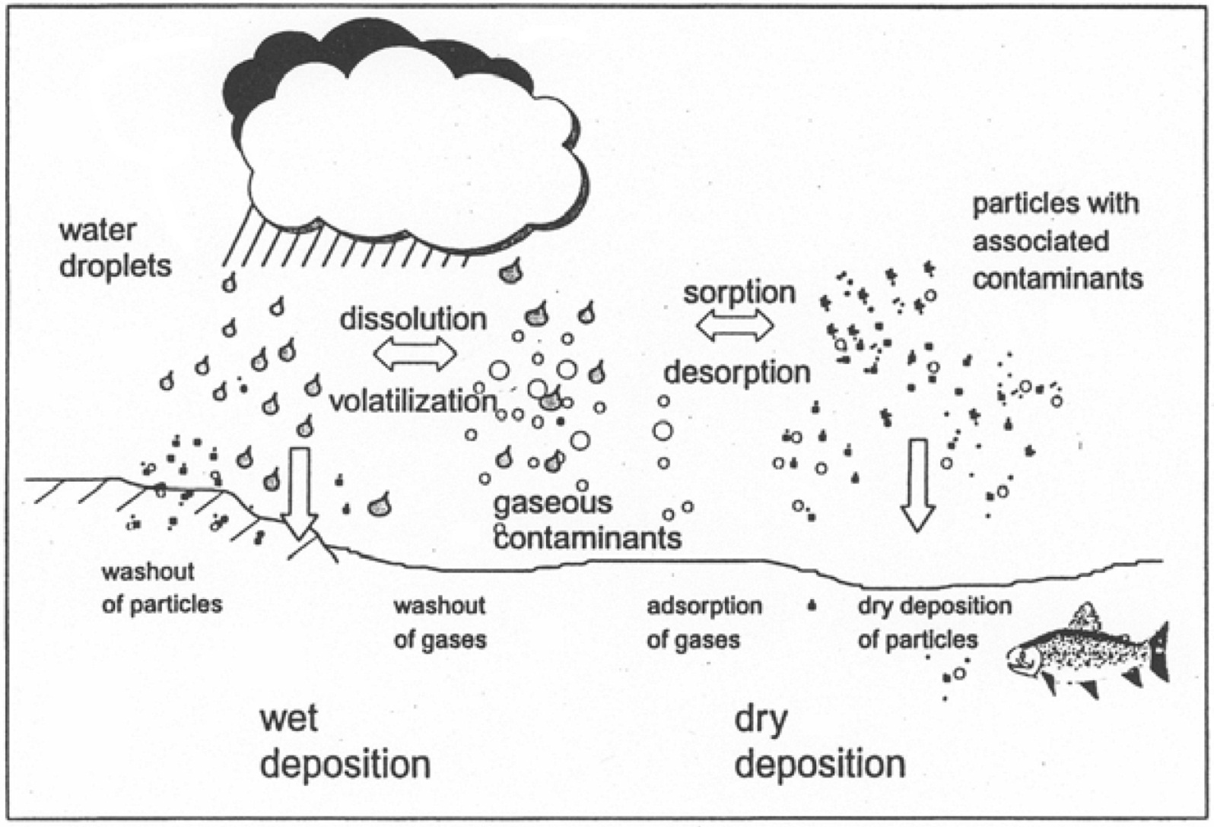
Atmospheric depositional processes
Notes:
Daly Da& Wania Wania, Environ. Sci. Technol. 2004, 38, 4176-4186.

Slide 24
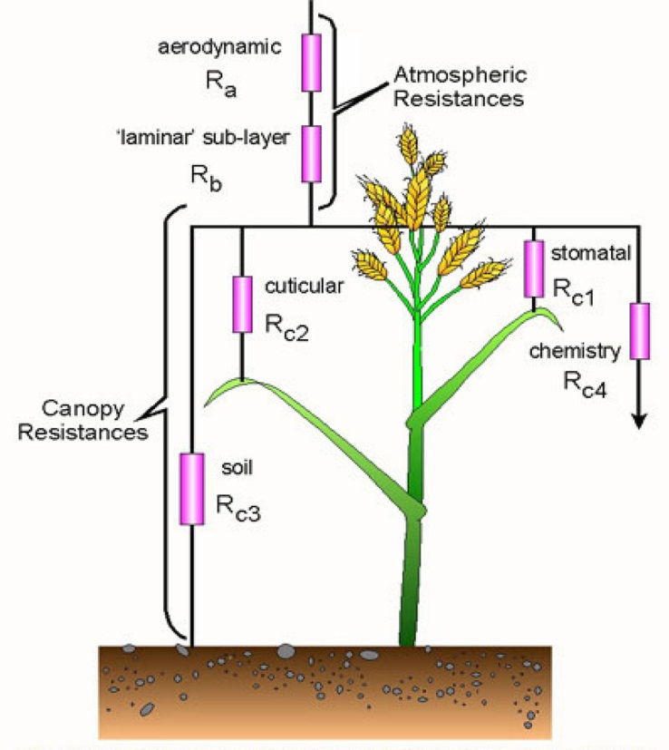
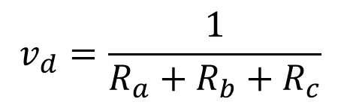
Dry atmospheric deposition
Deposition velocity v_{d} is inversely proportional to three “resistors” (analogy to passage of electric current)
$$v_{d}=\frac{1}{R_{a}+R_{b}+R_{c}}$$
[m.s⁻¹]
where:
R_{a} = atmospheric resistance
R_{b} = resistance of laminar layer
R_{c} = resistance of surface cover
R_{a} , R_{b} – depend on the stability of atmosphere
R_{c} – depends on chemical composition and physical structure of receiving surface and deposited material

Slide 25
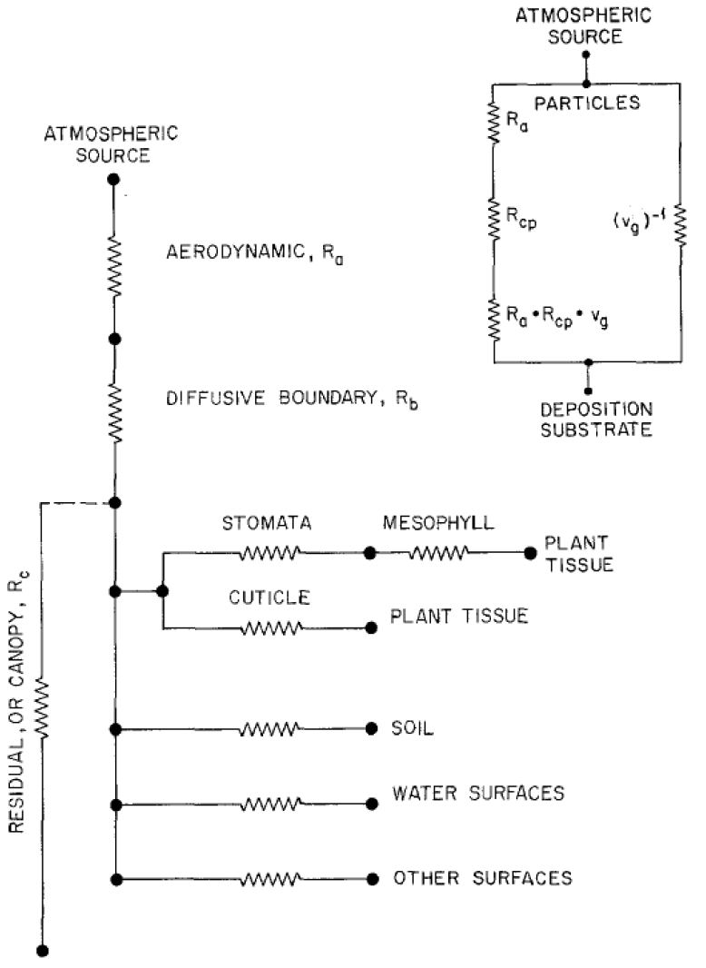
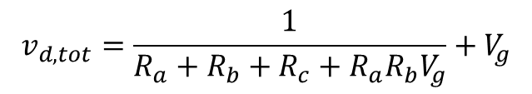
Resistance model for dry atmospheric deposition
$$v_{d,tot}=\frac{1}{R_{a}+R_{b}+R_{c}+R_{a}R_{b}V_{g}}+V_{g}$$
Aerodynamic resistance (R_{a}) - wholly determined by atmospheric properties (predominantly turbulent exchange)
A quasi-laminar boundary layer resistance (R_{b}) accounts for pollutant transfer in the vicinity of receptor surfaces which is affected by the molecular diffusivity
A surface or canopy resistance (R_{c}) combines the consequences of all uptake processes involving individual elements of the surface into a single number that is characteristic of the pollutant in question and the surface at the site under consideration
A gravitational settling term (V_{g}) is needed for larger (more dense) particles where the settling velocity is not negligible. V_{g} is a function of the particulate density and diameter.

Slide 26

Dry atmospheric deposition
Dry deposition flux F_{dd} could be expressed as:
$$F_{dd}=v_{d}∙A∙C_{A}∙{FR}_{A}$$
[mol.s⁻¹]
where:
v_{d} … deposition velocity [m.s⁻¹]
A … area of the air/water or air/soil interface [m²]
C_{A} … atmospheric concentration of compound A [mol.m⁻³]
FR_{a} … fraction of the compound A associated with aerosol

Slide 27
Wet atmospheric deposition
Wet atmospheric deposition:
  Precipitation scavenging (bellow-cloud scavenging)
    falling rain droplets collide with particles
  In-cloud scavenging
    aerosol particles collide with the water droplets in clouds (e.g. inside fog)

Slide 28

Wet atmospheric deposition
Wet atmospheric deposition flux F_{wd} could be described by the equation:
$$F_{wd}=☹∙A∙z_{A}∙C_{A}$$
[mol.s⁻¹]
where:
Λ … total scavenging coefficient [s⁻¹]
z_{A} … height of air layer [m]
C_{A} … atmospheric concentration of compound A [mol.m⁻³]

Slide 29
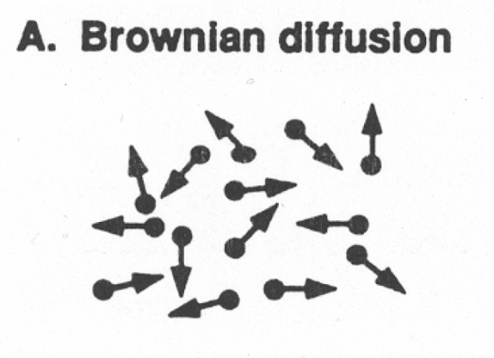
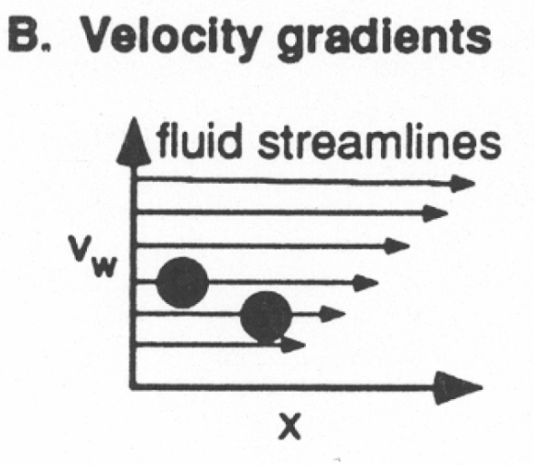
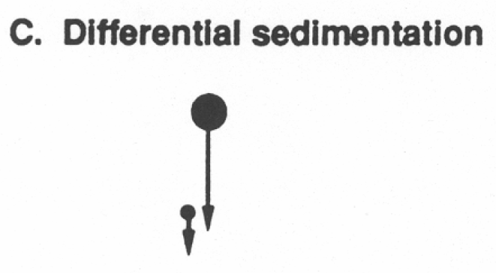
Sedimentation
transport mechanism particles in the water body
tendency for particles in suspension to settle out of the fluid in which they are entrained, induced by gravity
Transport mechanisms of sedimentation:

Slide 30
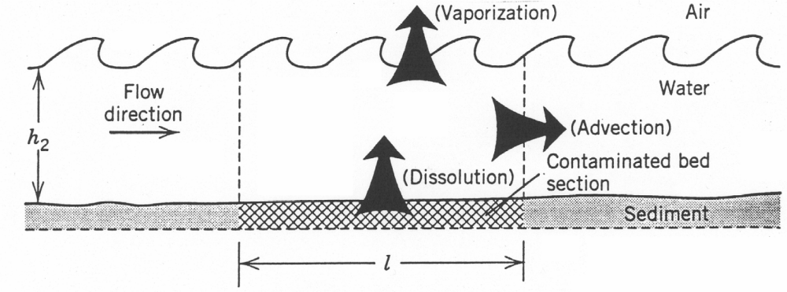
Resuspendation
Possible pathways of pollutants after resuspendation

Slide 31
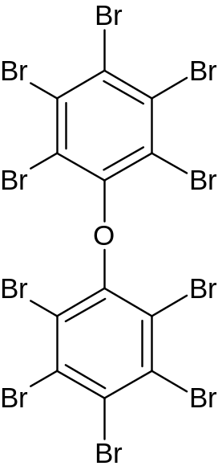
Long-range atmospheric transport of persistent organic pollutants
Classification of POPs owing to long-range transport mechanisms:
Single-hop compounds:
  non-volatile, water insoluble, transported on particles in air or water
  Compound is emitted to the atmosphere, transported and deposited to earth’s surface and never returns to atmosphere)

Slide 32
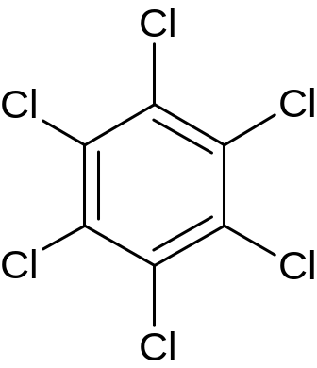
Long-range atmospheric transport of persistent organic pollutants
Classification of POPs owing to long-range transport mechanisms:
Multi-hop compounds:
  semi-volatile, distributed between gas and condensed phase
  compound reenters the atmosphere after initial deposition to the earth’s surface, it can travel long distances via subsequent multiple atmospheric hops; also the so-called grasshopper effect

Slide 33
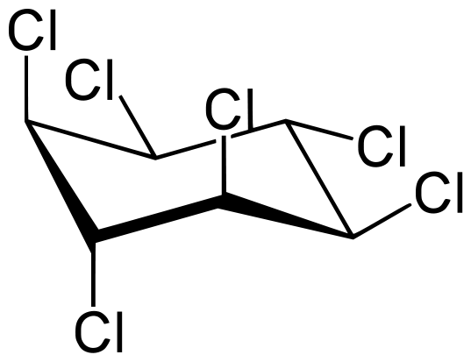
Long-range atmospheric transport of persistent organic pollutants
Classification of POPs owing to long-range transport mechanisms:
No-hop compounds:
  Compounds relatively soluble in water
  Main LRT mechanism is through water

Slide 34
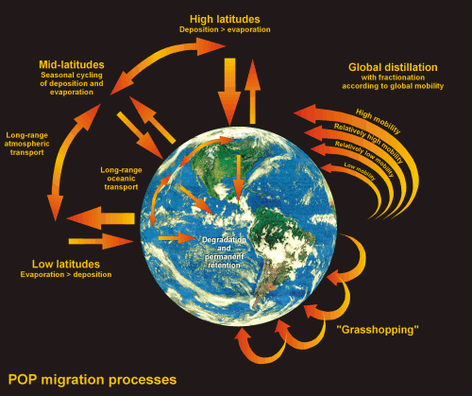
POP Migration Processes

Slide 35
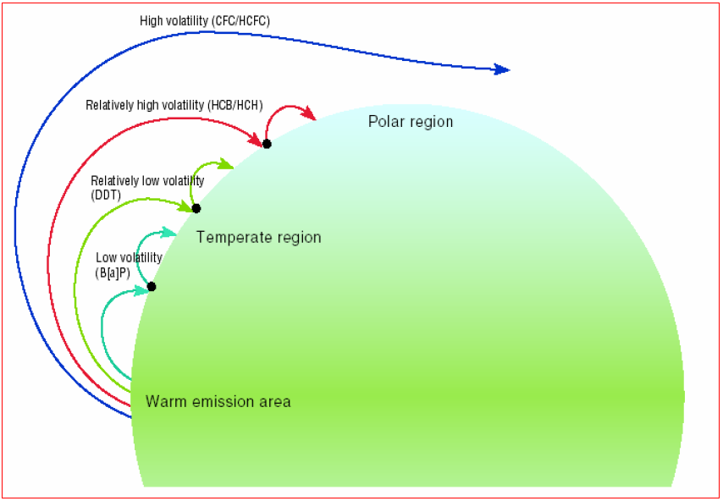
Global Distillation of POPs

Slide 36
Further reading
E. Mehmetli, B. Koumanova: The Fate of Persistent Organic Pollutants in the Environment. Springer 2008
S. Harrad: Persistent Organic Pollutants. John Wiley & Sons, 2010, ISBN 978-1-40-51693-0
R. Lohmann, K. Breivik, J. Dachs and D. Muir: Global fate of POPs: Current and future research directions. Environmental Pollution 150/1 (2007) 150-165
M. Scheringer: Long-Range Transport of Organic Chemicals in the Environment. Environmental Toxicology and Chemistry 28/4 (2009) 677-690
B. Xing, N. Senesi, P. Ming Huang: Biophysico-Chemical Processes of Anthropogenic Organic Compounds in Environmental Systems. Wiley 2011, ISBN 978-0-470-53963-7 (cloth), 978-0-470-94447-9 (e-Book), 978-0-470-94446-2 (e-PDF)

