Slide 1
Heavy metals migration
4(iii)

Slide 2
Aims
(i) to understand the distribution of heavy metals in the environment and possibilities of their migration between environmental compartments
(ii) to discuss possibilities for contact of heavy metals and man.

Slide 3
Outcams
(i) Students will be able on the basis of theoretical knowledge to solve some practical problems related with the occurrence of heavy metals in the environment.

Slide 4
Heavy metals migration
Heavy metals (HM) migration from the industrial wastes into grey forest and turf podsol soils.
Heavy metals technogenic migration in the “wastes-soil”.
Notes:
Heavy metals technogenic dispersion flow with the rigid special connection with its source – solid industrial wastes is formed in the soil section (profile) and the observed technogenic HM anomaly is characterized by the dynamic, instable parameters of polymetal pollution.

Slide 5
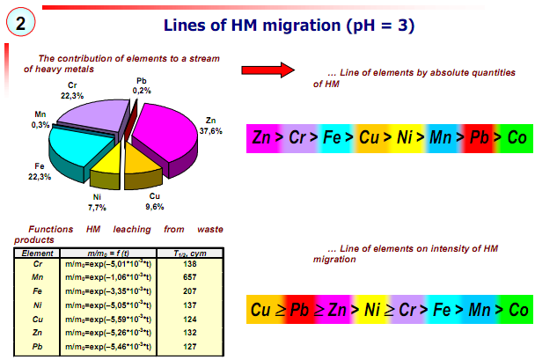

Slide 6
The three principal stages of technogenic HM transformation in “wastes-soil” system are
1) HM leaching;
2) transformation connected with HM deponing and ion-exchange by the soil substance;
3) conversion caused by HM transportation in the filtration flow.
Heavy metals technogenic transformation peculiarities in “wastes-soil”
system is defined by
1) complex formation;
2) HM highly intensive migration;
3) high humus horizon intrusion.
The following HM succession from wastes is fixed:
Pb > Cu ≥ Zn ≥ Ni > Mn > Cr ≥ Fe > Co.
Notes:
Zink, lead, copper and nickel are claimed to possess the highest migration
intrusion in the acid oxidized medium. The following HM succession from
wastes is fixed: Pb > Cu ≥ Zn ≥ Ni > Mn > Cr ≥ Fe > Co. The greatest
contribution into the polymetal soil pollution is made by the elements possessing the highest relative atom mass and various migration types.
The degree of pollution of a soil solution on depth and time is
experimentally assessed; function of the response of system «industrial
wastes - grey forest soils» (fig. 3) is received.

Slide 7
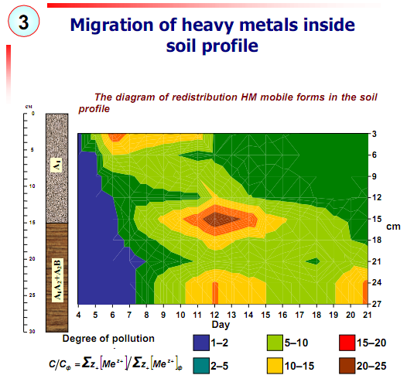

Slide 8
The main factor causing HM leaching is the medium reaction.
Under the polymetal pollution conditions, heavy metals solution and migration capacity is higher than of separate HM compounds that is typical of lead.
Soil horizon polymetal pollution expands the upper half-meter soil level threatening the ground waters pollution.
Within 3 years were traced maintenance of HMs in the top half-meter layer soils and their change in places of local influence of waste products.
Notes:
In acid and slightly acid medium industrial wastes is able to create impact, collision technogenic load on the polymetal soil type.

Slide 9
1) Migration of metals from industrial wastes polymetal structure into grey forest and turf podsol soils is characterized by its high intensity.
2) Up to 50 % of the heavy metals contained in wastes, migrates on a structure soils within one year that creates real threat of sharp local pollution of subsoil waters.

Slide 10
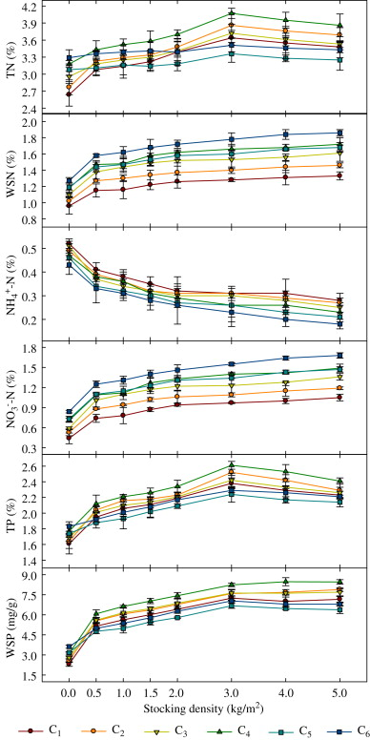
Effects of environmental conditions and earthworm densities on dynamics of major nutrients (N and P) transformation (total and water soluble) during vermicomposting of primary sewage sludge (PSS).
http://www.sciencedirect.com/science/article/pii/S0147651312000085

Slide 11
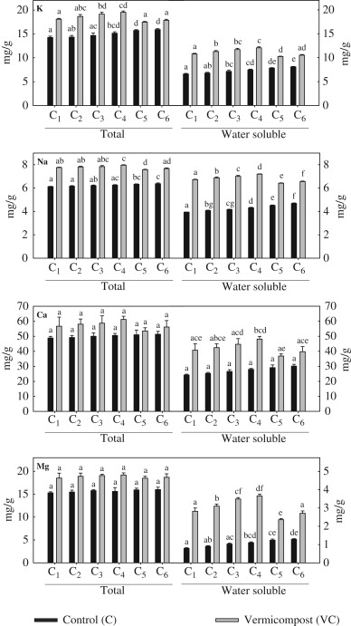
Effect of environmental conditions on the change in total and water soluble macro-nutrients (K, Na, Ca and Mg) contents in primary sewage sludge (PSS) with and without earthworm treatment.
Columns followed by the same letter for control and vermicompost do not differ significantly (ANOVA; Tukey's test, P<0.05)
http://www.sciencedirect.com/science/article/pii/S0147651312000085

Slide 12
Modeling and Simulation of Transport of Heavy Metals in Soils
Developing computer methods is one of the driving forces in modern environmental chemistry. In the 1970s the modern discipline of chemistry was born - chemometrics.
Modeling and simulation is one of the most important parts of chemometrics. These two mentioned methods are very useful in describing the chemical problems in different environmental matrices.
Each model is created on the data received as result of observation of simplified (“pseudo-natural”) system, which must be accurately defined and in controlled conditions.
Obtained results are transformed into a general formula.
Notes:
Chemometrics is the new domain, which can improve the understanding of chemical information, characterize multidimensional data and get some model of described chemical phenomena by applying different mathematical, statistical, graphical or symbolic methods.

Slide 13
Where:
S_{i} - concentration of sorbent in solid state;
C - concentration of solution in equilibrium;
K - equilibrium constant;
b - capacity of monolayer;

Slide 14
On the ground of this formula a researcher chooses a suitable model.
On account of the role of soil in ecosystems, a lot of models of different heavy metals sorption and transportation in this matrix have arisen.
The most of well-known sorption models are partitioned into two groups:
- models, which takes account of electrostatic forces and bonding.
- models, which do not include these interaction.
Notes:
. This model permits us to obtain some parameters characterizing occurrences reaching the examined system. The last step is checking our model in different physicochemical conditions to define where and when this model can be applied.

Slide 15

(iii)Transport of heavy metals in the environment: examples and mechanisms
Video recording.
http://www.youtube.com/watch?v=HohP5UTIoSg&feature=related

Slide 16
(IV)Heavy metal transformation: examples and mechanisms
Growing use of alternative water supplies including recycled waste-water for irrigation purposes.
Waste-water is derived from a number of sources including domestic sewage effluent or municipal wastewater, agricultural (farm effluents) and industrial effluents, and storm-water.
There are problems associated with it such as health risks to irrigators, build-up of chemical pollutants (e.g., heavy metal(loid)s and pesticides) in soils and contamination of groundwater.
Notes:
Although wastewater irrigation has many positive effects like reliable water supply to farmers, better crop yield, pollution reduction of rivers, and other surface water resources.

Slide 17
Waste-water irrigation can act as a source of heavy metal(loid) input to soils. The various sources of wastewater irrigation and heavy metal(loid) input to soil are identified;
Waste-water irrigation affects soil properties - affecting heavy metal(loid) interactions.
Waste-water irrigation plays role in heavy metal(loid) dynamics including adsorption and complexation, redox reactions, transport, and bioavailability. It is hihly relevant to strategies designed to mitigate wastewater-induced environmental impacts.
Notes:
Since the environment comprises soil, plants, and soil organisms, wastewater use is directly associated with environmental quality due to its immediate contact with the soil–plant system, and consequently, can impact on it. For example, the presence of organic matter in wastewater-irrigated sites significantly affects the mobility and bioavailability of heavy metal(loid)s in the soil.

Slide 18
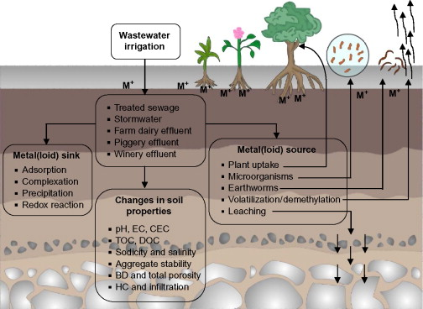
Schematic representation of waste-water sources and their effect on metal(loid) transformation and fate in soils by acting as a source and sink for metal(loid)s and by altering soil properties.
http://www.sciencedirect.com/science/article/pii/B9780123942760000056

Slide 19
Heavy metals migration
A number of trace metals are used by living organisms to stabilize protein structures, facilitate electron transfer reactions and catalyze enzymatic reactions.
For example, copper (Cu), zinc (Zn), and iron (Fe) are essential as constituents of the catalytic sites of several.
Other metals, however, such as lead (Pb), mercury (Hg), and cadmium (Cd), may displace or substitute essential trace metals and interfere with proper functioning of enzymes and associated cofactors.

Slide 20
Content of the practical work:
Content of the practical work: Bleaching of the materials exposed to light.
Monitor (by spectrophotometer) degradation of diclofenac in aqueous medium (with and without contact with soil).
Redox reactions mechanisms and examples on how to solve a problem (http://www.shodor.org/unchem/advanced/redox/index.html)
The Hydrolysis of Salts in Water (http://www.chemteam.info/AcidBase/Hydrolysis.html)

Slide 21
Mathematical Modelling and
Simulation of Mobility of Heavy Metals in
Soil contaminated With Sewage Sludge
All heavy metal exist in waste water in colloidal, particulate and dissolve phases.
In dissolve concentration metals may be found the colloidal and particulate phases as hydroxide, oxide, silicate or ‘unchanged’ substance: or sorbed to clay, silica or organic matter.
Notes:
In process industries such as: fertilizer breweries, refineries, paper mills, textiles, chemical and petrochemicals, water could be used as coolant, process water, and raw material solvent etc. However, in the process of usage, industrial water becomes polluted and contaminated with various substances it comes in contact with and this gives rise to waste water, which consists of water with variety of potentially harmful substance which is the sources of environmental pollution. Sewage sludge is therefore, a by - product of purification of waste water. The resulting sewage sludge has significant organic mater content and contained macro and micro nutrient that are essential for plant growing. These heavy metals which may include cadmium, lead, arsenic etc are metallic element with relatively high atomic weight that can contaminate ground water, surface water, food etc. and have the potential to be toxic and relatively low concentration metal.

Slide 22
While remaining in the soil solution as iron and organic and inorganic complexes some are mobile for uptake by plants.
Changes can occur in chemical form and mobility of metal in the leachate, such as complexities of chelation which are usually the result of variation in PH or reduction-oxidation.
Only relatively small amounts of metal were available for transport in the soil water immediately after sludge application to soil.
Under excessive leaching condition, movement of heavy metal in soil is somewhat greater from inorganic than from complexes sources found in sewage sludge.
Notes:
This mobility and availability depends on several factor including soil texture and pH (Nouri., 1980 and Alloway., 1995). Mobile forms of metals release from sludge, which are not taken up by plant root, may move down the profile and reach the water table. This pollution of ground water may affect surface water and possibly portable water supplies.
Several worker have already investigated the mobility of heavy metal in the soil amended with sewage sludge and concluded that only relatively small amount of metal were available for transport in the soil water immediately after sludge application (Slide and Kardos, 1977).
However, little or nothing had been done as regard to modeling of the process of mobility of heavy metals in the soil after the application of sewage sludge. This research work, therefore aimed at developing a mathematical model equation that shows the mobility of heavy metals in the soil amended with sewage sludge.

Slide 23
Developing a mathematical model equation can be achieved through the realization of the following objectives:
Collection of data showing the concentration of heavy metals at different percentage of sewage sludge amended to the soil with respect to distance and time.
Development of mathematical model equations for the mobility of heavy metals in the soil amended with different percentage of sewage sludge.
Simulation of the model equation using computer software programmed.
Compare the simulated result with the experimental data.

Slide 24

Modeling of Mobility of Heavy Metals in Soil
Assumptions
The assumptions involved in this modeling of the mobility of heavy metals in the soil are thus:
1)Porous medium is homogeneous, isotropic, and saturated
2) There is no dispersion in the directions transverse to the flow direction
Modeling of the system
The equation that describes the flow of heavy metals material through soil is shown in equation:

Slide 25
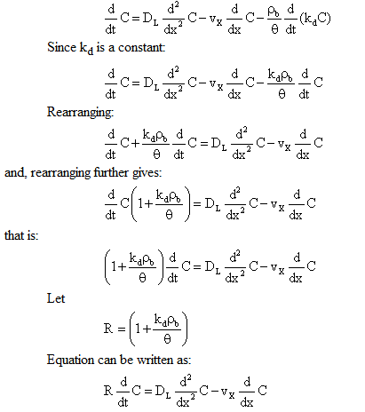
where k_{d} = distribution coefficient
Equation can then be written as:

Slide 26
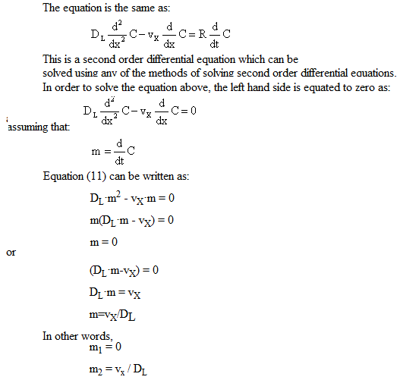

Slide 27
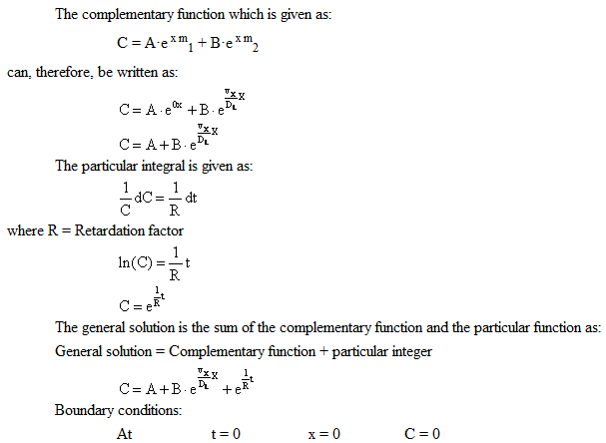

Slide 28
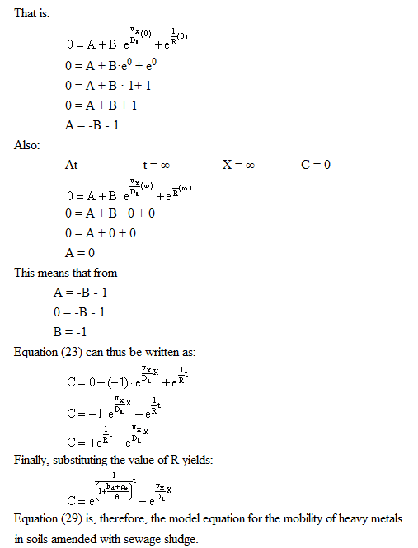

Slide 29
References:
V. Antoniadis · J. D. McKinley - "Measuring heavy metal migration rates in a low-permeability soil“ - http://www.environmental-expert.com/Files/6063/articles/10010/Measuringheavymetalmigrationrates.pdf
David Kier Building, Stranmillis Road, Belfast, BT9 5AG, UK,2003, pg 103-106, DOI 10.1007/s10311-002-0019
Chen YX, Hua YM, Zhang SH, Tian GM - "Transformation of heavy metal forms during sewage sludge bioleaching“ - J Hazard Mater. 2005 Aug 31; pg 123(1-3):196-202., PMID: 15905024
Run Dong Li – “Migration and Transformation of Heavy Metals during Thermal Treatment of Solid Waste” - Faculty of Power & Energy Engineering, Shenyang Aerospace University, Shenyang 110136, China, http://www.jst.go.jp/sicp/ws2010_ch_nsfc7th/abst/abst_04.pdf
A. Dube, R. Zbytniewski, T. Kowalkowski, E. Cukrowska, B. Buszewski - "Adsorption and Migration of Heavy Metals in Soil“ -; August 12, 2000, EuroCat Project No. EVK1-2000-00510.

