Slide 1
Organic matter migration through sediments without water
4(v)

Slide 2
The lecture content:
- The composition of soluble organic matter in sediments (bitumen/oil) and its related physical characteristics (e.g. fluidity).
- Interactions of organic – inorganic sediment matter.

Slide 3
The composition of bitumen/oil:
1) Asphaltenes
2) Maltenes
3) Volatile components

Slide 4
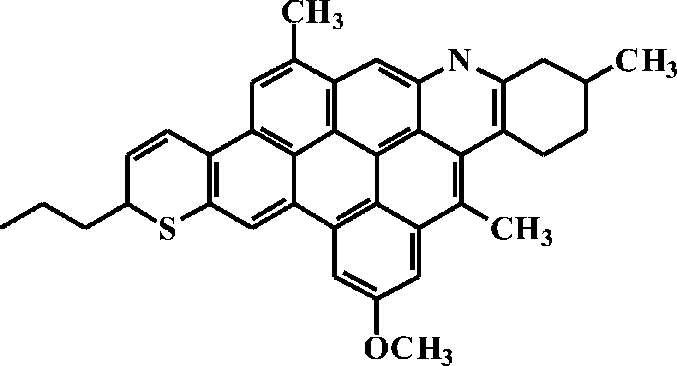
1) Asphaltenes
The part of asphaltene structure.

Slide 5
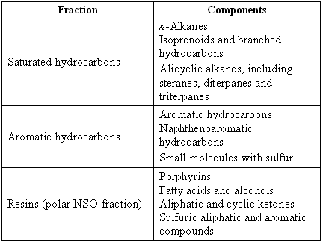
2) Maltenes - main components

Slide 6
Biological markers
Back in the late sixties, compounds that were structurally identical or very similar to compounds that are known to exist in the biosphere were found in bitumens and oils. Such compounds were named "chemical fossils" and they found a wide application in organic geochemical investigations very quickly. Today, in the organic geochemical literature they are often referred to as "biological markers", or "biomarkers".

Slide 7
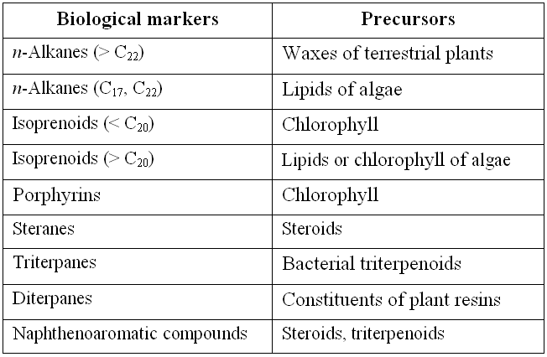
The most important biological markers and their biological precursors

Slide 8
3) Volatile components
These are hydrocarbons with less than 12 C-atoms. They mostly "evaporate" during the laboratory investigations of oil, since most analytical methods include experiments at elevated temperatures.

Slide 9
The degree of fluidity, depending on the type of oil:
Paraffinic < Naphthenic ≈ Aromatic type
Migration through the sediment without water is somewhat possible only with of the oil of the high degree of fluidity.

Slide 10
Interactions of organic – inorganic sediment matter
The influence of minerals on organic matter alterations in the geosphere may be considered in two ways:
- by monitoring the effects of minerals on certain classes of organic compounds that can be found in the geological environment (for example, fatty acids, n-alkanes, alcohols, or steroids),
- by monitoring the effects of minerals on complex sedimentary organic materials, mostly on bitumen and kerogen.

Slide 11
Interactions of organic – inorganic sediment matter
One of the oldest known examples of the influence of minerals on certain organic compounds identified in geological samples is the influence of bentonite on the changes in behenic acid:
if behenic acid (C21H43COOH) is heated in the presence of bentonite at 200 °C without access of air, n-C21 hydrocarbon is obtained. Concentration of all other n-alkanes in the range C12-C36 in this case is only about 0.3%. In this way it is proved that bentonite catalyzes the process of decarboxylation of behenic acid.

Slide 12
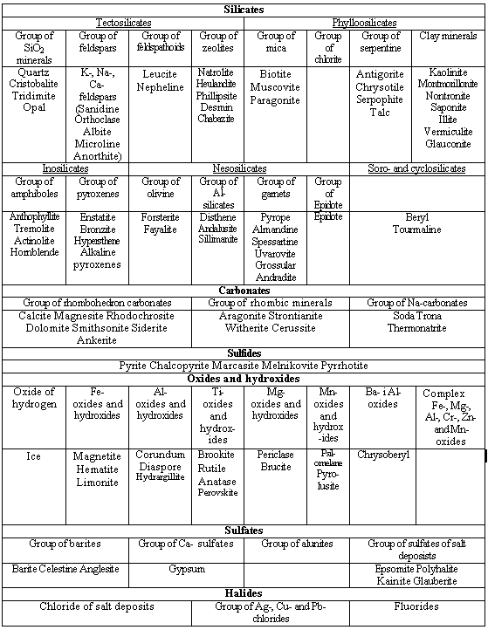
The most important minerals in geosphere

Slide 13
The most important types of organic matter in geosphere are:
- the fulvic and humic acids,
- humin,
- kerogen
(in coal, oil shales, source rocks or in sediments),
- bitumen and inherited bitumen,
- oil (petroelum),
- gas and
- graphite.

Slide 14
The most intense adsorption and catalytic effect on the change of sediment organic matter have silicate minerals:
1) montmorillonite,
2) illite and
3) kaolinite.

Slide 15
Silicate minerals have the most intense catalytic effect on the shanges of:
1) n-alkanes,
2) isoprenoids,
3) diasteranes,
4) steranes,
5) hopanes,
6) monoaromatic steroids,
7) triaromatic steroids.

Slide 16
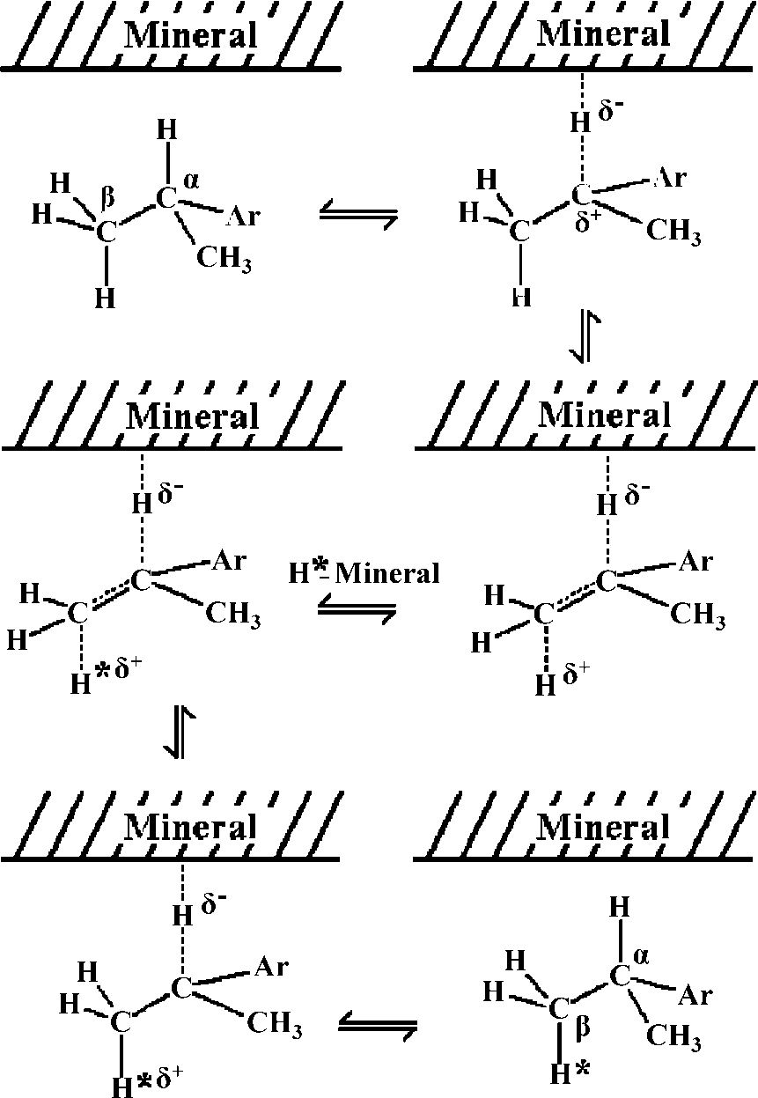
Possible mechanism of hydrogen exchange between montmorillonite and cumol.

Slide 17
Mineral influence on bitumen
Free bitumen (bitumen 1) should be distinguished from the bound bitumens (bitumens 2 and 3). The first can be extracted from a crude sedimentary rock, and the other two only after removal of carbonates (bitumen 2) and silicates (bitumen 3).
Between these bitumens there are significant differences in the composition as a result of adsorption and thermocatalytic mineral effects. Bitumen 1, as bitumen, which is in the weakest interaction with minerals, has the least amount of polar NSO-compounds, and the greatest amount of saturated hydrocarbons. Since the NSO-compounds easily adsorb on minerals, their amount is greater in the bound bitumens.

Slide 18
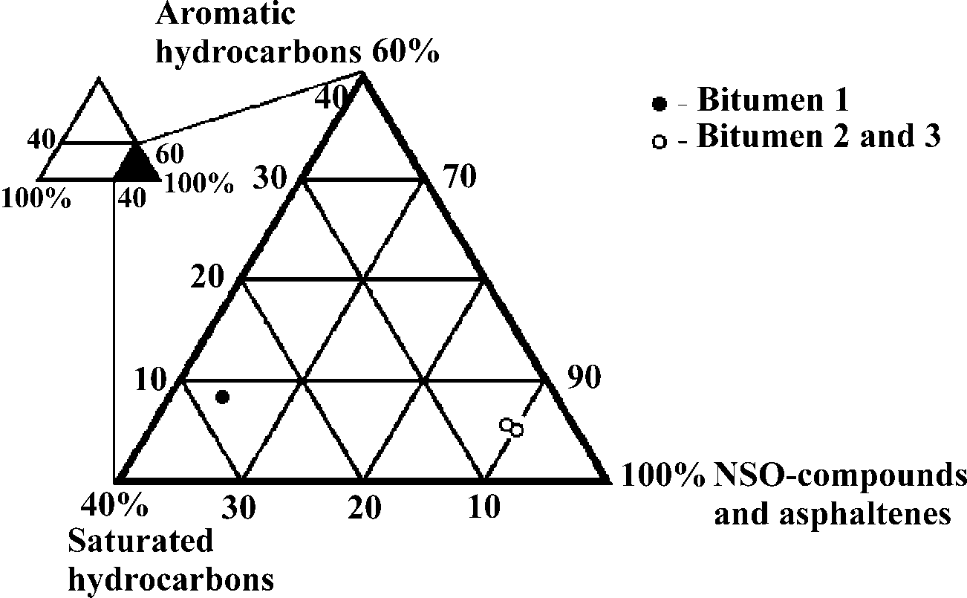
Example of group composition of oil shale free and bound bitumens,
presented by the triangular diagram.

Slide 19
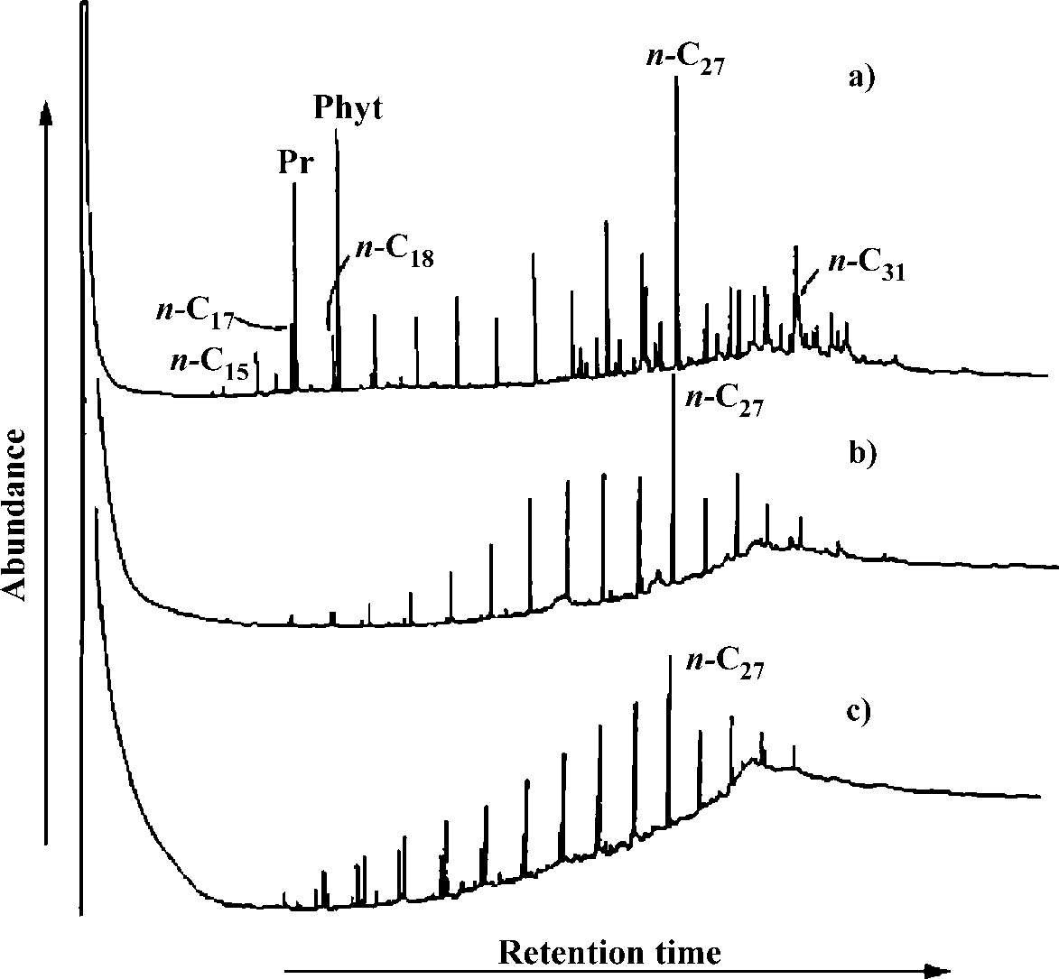
Gas chromatograms of saturated hydrocarbon fractions of bitumen 1 (a),
bitumen 2 (b) and bitumen 3 (c) of an oil shale sample.

Slide 20
Mineral influence on kerogen
- Minerals in sediments have very little catalytic effect on the pyrolysis of kerogen.
- Certain catalytic effect is exerted only by silicate minerals (illite and montmorillonite).
- They influence to some extent the increase in the yield of gaseous and liquid products, the homolytic bonds cleavage involving the heavier carbon isotope, the reduction of n-alkanes in relation to n-alkenes, the formation of thermodynamically stable sterane and triterpane isomers, and the reactions of cracking of side chains of higher members of triaromatic steroids.

