Slide 1
Thermodynamic, kinetics and pathways of transformation reactions
Reactions involving intermediates produced by radiation (2 hrs)

Slide 2
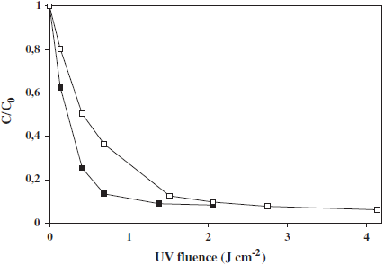
Pollutant Degradation by Ultraviolet Photolysis
Mercury lamps
Excimer lamps (excilamps)
4-CP removal under direct UV photolysis by XeBr (■) and KrCl (□) excilamps in a batch reactor (C/C₀ vs. UV fluence, C₀ = 20 mg L⁻¹, pH 5.7).

Slide 3
Photooxidation reactions upon electronic excitation of the organic substrate imply in most cases an electron transfer from the excited-state (C*) to ground-state molecular oxygen
subsequent recombination of the radical ions or hydrolysis of the radical cation, or homolysis forms radicals which then react with oxygen

Slide 4
Hydroxyl Radical Generation
Oxidation of organic pollutants by the combination of ultraviolet light and oxidants (H₂O₂,O₃, etc.) implies in most cases generation and subsequent reaction of hydroxyl radicals.
species | oxidation potential (V)
fluorine atomic oxygen ozone hydrogen peroxide perhydroxyl radical permanganate hypobromous acid chlorine dioxide hypochlorous acid hypoiodous acid chlorine bromine iodine | 3.03 2.42 2.07 1.78 1.70 1.68 1.59 1.57 1.49 1.45 1.36 1.09 0.54

Slide 5
Ozone/UV Process
It was proved that hydrogen peroxide is in fact the primary product of ozone photolysis.
O₃ + H₂O → H₂O₂ + O₂

Slide 6
O₃/H₂O₂/UV Process
During ozone decomposition significant amounts of hydrogen peroxide can be formed. The concentration of formed hydrogen peroxide is independent of the initial ozone concentration or pH, but only depends on the temperature: more H₂O₂ is formed at higher temperature.
This H₂O₂ formation results either directly from O₃ decomposition through
O₃ + •OH → O₂ + HO₂ •
or from the hydrolysis of organic ozonation products. The hydrogen peroxide formed in this way appeared to enhance the O₃ decomposition rate.

Slide 7
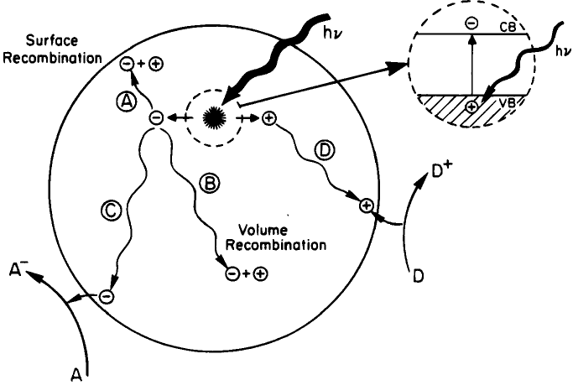
TiO2/UV Process
Schematic photoexcitation in a solid followed by deexcitation events.

Slide 8
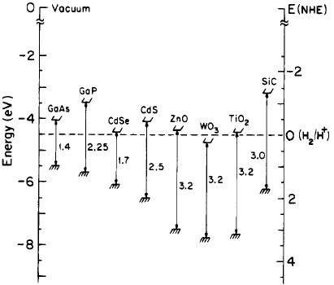
Energies for various semiconductors in aqueous
electrolytes at pH = 1.

Slide 9
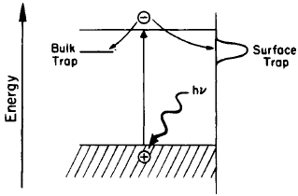
Surface and bulk electron carrier trapping

Slide 10
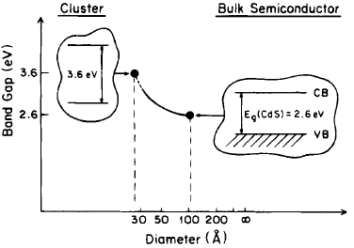
Quantum size effect on semiconductor band gap.

Slide 11
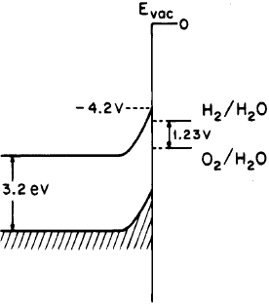
Potential energy diagram for the H₂O and O₂/H₂O
redox couples relative to the band-edge positions
for TiO₂.

Slide 12
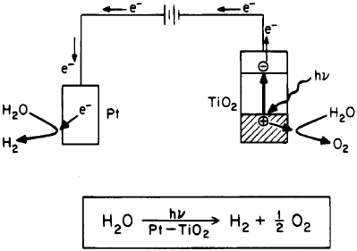
Photosplitting of water in a photoelectrochemical cell.

Slide 13
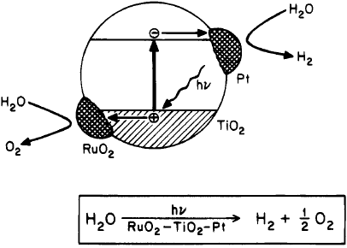
Photosplitting of water on composite catalyst

Slide 14
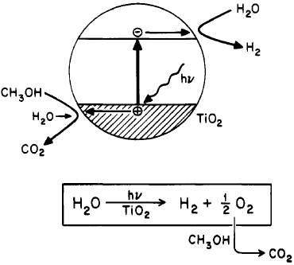
Photosplitting of water: sacrificial donor effect.

Slide 15
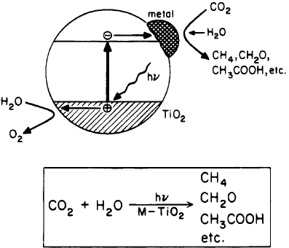
Photosplitting of water: sacrificial acceptor effect.

Slide 16
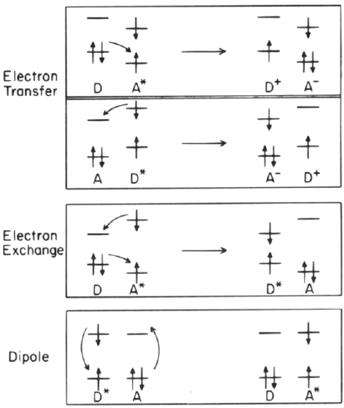
Electron transfer and energy transfer processes.

Slide 17
Vacuum Ultraviolet (VUV) Process
Besides being used for the photohomolysis of the target substance, VUV photolysis of H₂O is a means of highly efficient generation of hydroxyl radicals, which then attack the dissolved or dispersed substrate
Xe excimer lamps, now available, can be used for water photolysis on a preparative scale without any attenuation. Filter effects by dissolved pollutants have to be concerned.
Suitable photochemical reactors are at present developed for the purpose of ground- and wastewater decontamination, as well as for the production of ultrapure water for the use in the pharmaceutical and microelectronic industries.

Slide 18
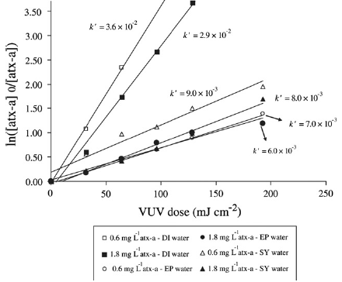
Degradation of anatoxin-a (atx-a) in different water matrices using VUV AOP. DI: ultrapure water, EP: natural water, and SY: synthetically produced model water. The fluence-based rate constants are in cm⁻² mJ.

Slide 19
Energy-Transfer Processes

Slide 20
Energy-transfer processes may occur between a large number of organic compounds present in surface waters.
humic and fulvic acids may act as singlet oxygen sensitizers, the quantum yield of singlet oxygen production being ca. 3% and depending on the nature of the sensitizer
The importance of singlet oxygen reactions in aquatic systems is reduced by its efficient physical deactivation by H₂O; additional deactivation may take place by transition metals present in surface waters.

Slide 21
Photochemical Electron-Transfer Processes
The UV energy efficiency
      φ_{e} = Q_{UV}/Δ(mg C)
where Q_{UV} is the absorbed energy in the UV spectral domain, has been proposed in order to express the absorbed energy in the UV region per milligram of carbon oxidized.
The efficiency of the oxidative degradation by O₃/UV is sometimes expressed by the ratio of ΔTOC to the quantity of ozone consumed

Slide 22
In general, TOC diminution is following apparent zero-order kinetics for a large fraction of the irradiation time, leading to complete mineralization. Under conditions of substrate photolysis, pseudo-first-order regime is found when initial substrate concentrations are very low and absorbance variations negligible.
In mediated processes, the rate of all oxidative degradation reactions depends on the concentration of hydroxyl radicals acting as initiator and on the concentration of dissolved molecular oxygen.
For TiO₂-photocatalyzed processes, apparent zero-order kinetics of TOC diminution is observed under conditions, where saturation coverage of the active surface sites by organic molecules is achieved, or where a steady-state concentration of hydroxyl radicals is generated at the surface of the irradiated TiO₂.
Therefore, determination of TOC depletion rates may be achieved without difficulty in applications focusing on incomplete degradation processes of aqueous systems of high initial pollutant concentration

