Slide 1
Petroleum transformations
5(ii)

Slide 2
The lecture content:
- Petroleum transformation in reservoir rocks (as a native matter).
- Petroleum transformation in the environment (as an anthropogenic matter).

Slide 3
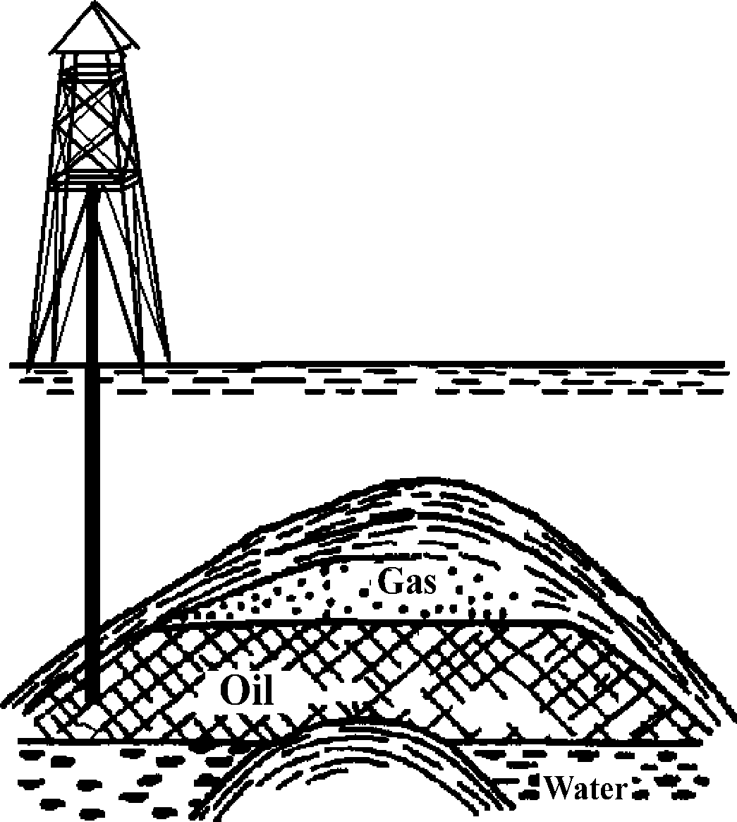
Reservoir rocks
A simplified illustration of the oil reservoir rock.

Slide 4
Accumulation is the collection process of bitumen in tight reservoir rocks – the end of migration
- The temperature pressures in reservor rocks are generally lower.
- The contact of oil with inorganic environment in the reservoirs is weaker.
- Further changes in the composition of oil still take place in the reservoir rocks:
1) maturation changes,
2) deasphalting process,
3) water washing and
4) biodegradation.

Slide 5
1) Maturation changes
- Regardless of the slightly lower temperatures and pressures and a weaker contact with potential mineral catalysts, all the maturation processes which took place in bitumen are continued in the oil reservoir rocks, which leads to the increased amounts of low molecular weight compounds, and thermodynamically more stable structural and stereochemical isomers of certain compounds.

Slide 6
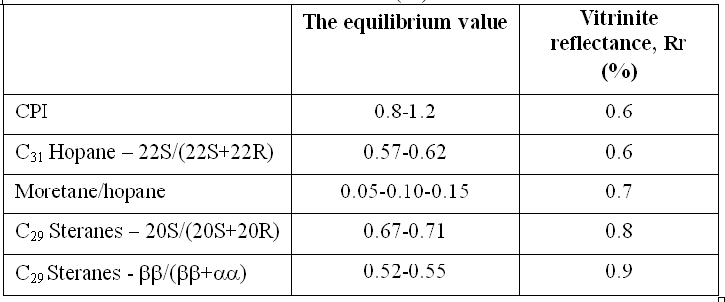
The equilibrium values of most important maturation parameters (n-alkanes, terpanes and steranes) and the corresponding values of vitrinite reflectance (Rr)
- All maturation changes of n-alkanes, isoprenoid aliphatic alkanes, polycyclic alkanes and naphthenic aromatic compounds are continued, if an equilibrium state has not already been reached in the "bituminous stage“.

Slide 7
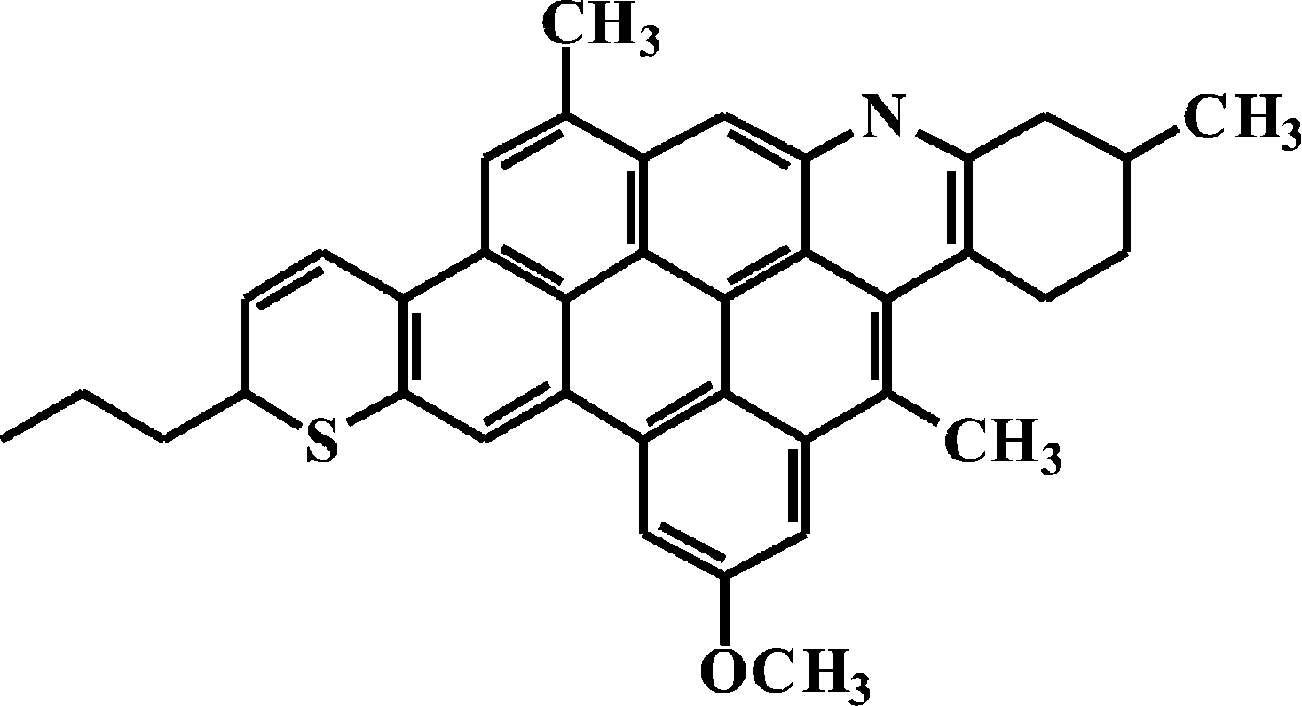
2) Deasphalting process
The part of asphaltene structure.

Slide 8
Deasphalting process
- Since the amount of lower hydrocarbons increases during the cracking, including pentane, hexane and heptane, which are excellent solvents for the whole oil, except for asphaltene, deasphalting takes place, i.e. precipitation of asphaltenes in reservoir rocks, and thus the contents of compounds soluble in alkane solvents, saturated and aromatic hydrocarbons and NSO-compounds increases.
- In organic geochemistry, these three fractions are often collectively referred to as "maltenes".
- In addition to asphaltenes and maltenes, oil contains also "volatile components". These are hydrocarbons with less than 12 C-atoms. They mostly "evaporate" during the laboratory investigations of oil, since most analytical methods include experiments at elevated temperatures.

Slide 9
3) Water washing
- Water plays a crucial role in the transmission of the bitumen from source to reservoir rocks. Therefore, water and above it oil, as it has lower specific gravity, are accumulated together in the reservoir.
- In the reservoir rocks, oil is in constant contact with water and therefore in a long geologic time, it is subject to continuous water washing.
- Oil is, as a mixture of nonpolar hydrocarbons, poorly soluble in water. However, it also contains some compounds that are soluble in water, especially at higher temperatures and pressures. This is primarily about compounds with heteroatoms, nitrogen, sulphur and oxygen, forming the so-called NSO-fraction. Therefore water washing is mostly "washing" of NSO-compounds, which of course does not mean that some low molecular weight hydrocarbons cannot be "washed", although to much lesser extent.

Slide 10
4) Biodegradation
- Biodegradation (microbiological degradation) is the process that can largely alter the composition of oil in the reservoir rocks.
- It occurs only in reservoir rocks that contain water as well.
- Biodegradation is possible only in reservoir rocks with the temperature below 66 degrees.

Slide 11
Petroleum transformation from
paraffinic type to naphthenic and aromatic type:
A good process from the technical
and technological aspects
(Naphthenic oil is a better raw material for producing high quality gasoline )
Undesirable process from organic-geochemical,
fundamental, aspect
(Degradation of biological markers as a tool for assessing the origin and geological history of oil)

Slide 12
The classification of crude oils based on the degree of biodegradation
(1983)
1. No
2. The lower n-alkanes ………….. minimum of biodegradation
3. More than 99% of n-alkanes ………………….. moderate (I)
4. Alkylcyclohexanes; partially isoprenoids ……..moderate (II)
5. All isoprenoids ………………………………. moderate (III)
6. Bicyclic alkanes ……………………………..medium strong
7. More than 50% of regular steranes ………………….. strong
8. Steranes changed, a lot of demethylated hopanes very strong
9. All regular steranes, domination of diasteranes and demethylated hopanes ………………..……... the maximum

Slide 13
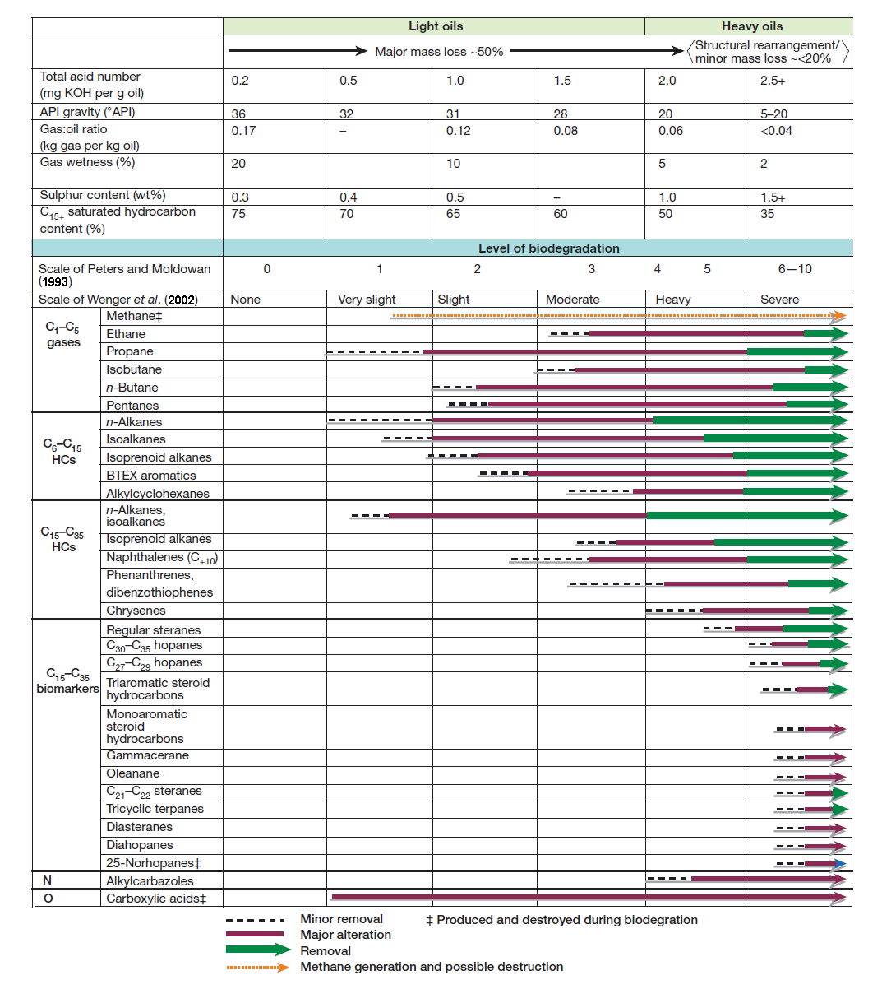
Schematic diagram of physical and chemical changes
occurring during crude oil and natural gas biodegradation (2003).

Slide 14
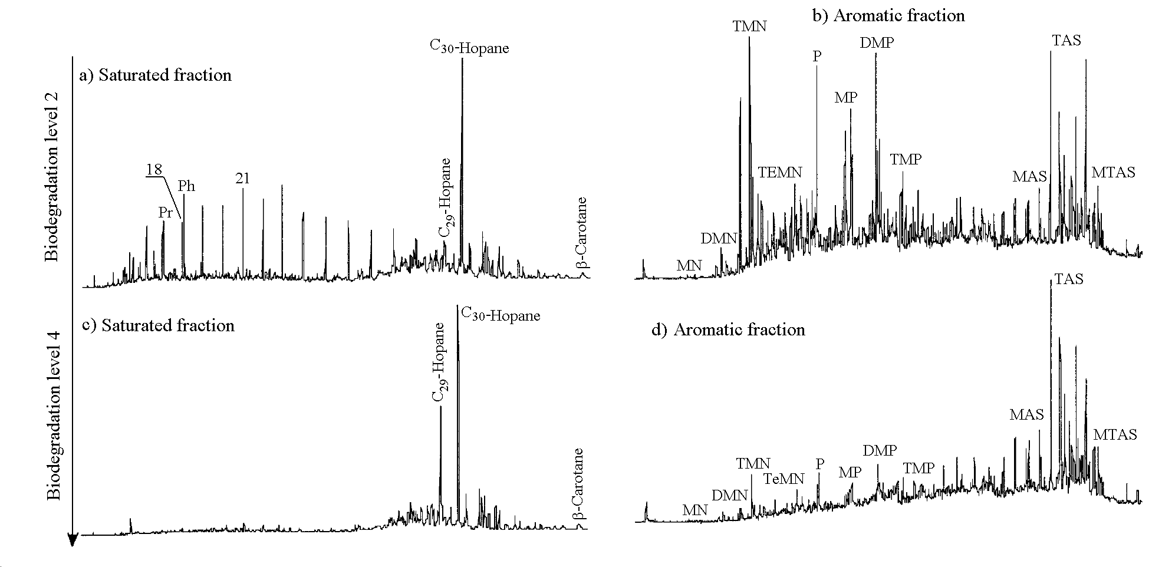
TICs showing aliphatic and aromatic hydrocarbon distributions in oils
(collected from reservoirs) at various levels of biodegradation (Huang et al., 2004).
MN – methylnaphthalenes; DMN – dimethylnaphthalenes; TMN – trimethylnaphthalenes;
TEMN – tetramethylnaphthalenes; P – phenanthrene; MP – methylphenanthrenes;
DMP – dimethylphenanthrenes; MAS – monoaromatic steroid hydrocarbons;
TAS – triaromatic steroid hydrocarbons; MTAS – methyl triaromatic steroid hydrocarbons

Slide 15
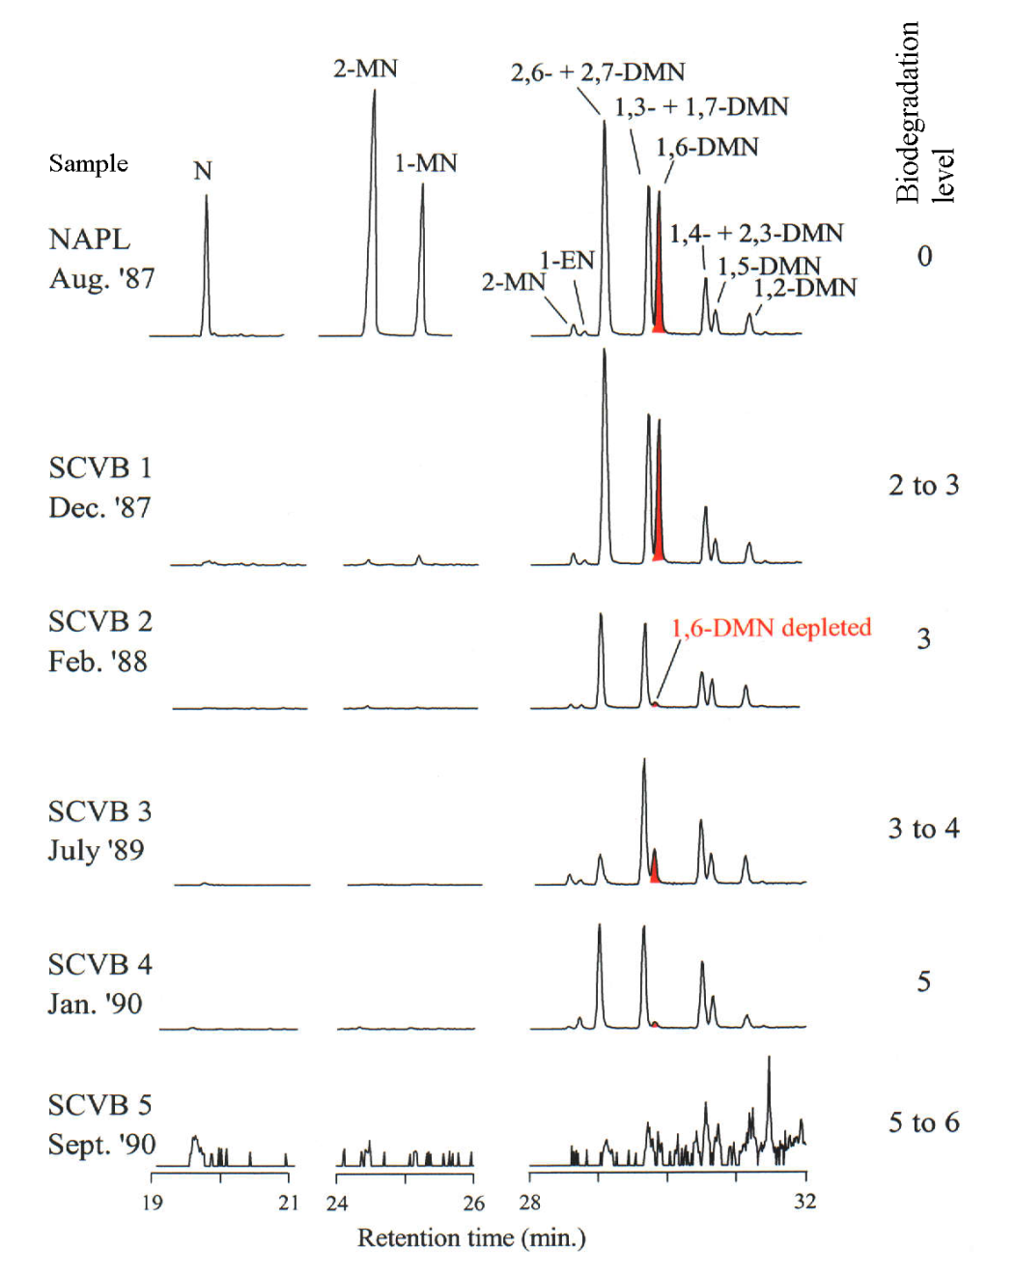
Biodegradation of naphthalene (N), methylnaphthalenes (MN) and dimethylnaphthalenes
(DMN) in natural marine environment (coastal sediments) (2002).
Numbers designate positions of methyl group in naphthalene

Slide 16
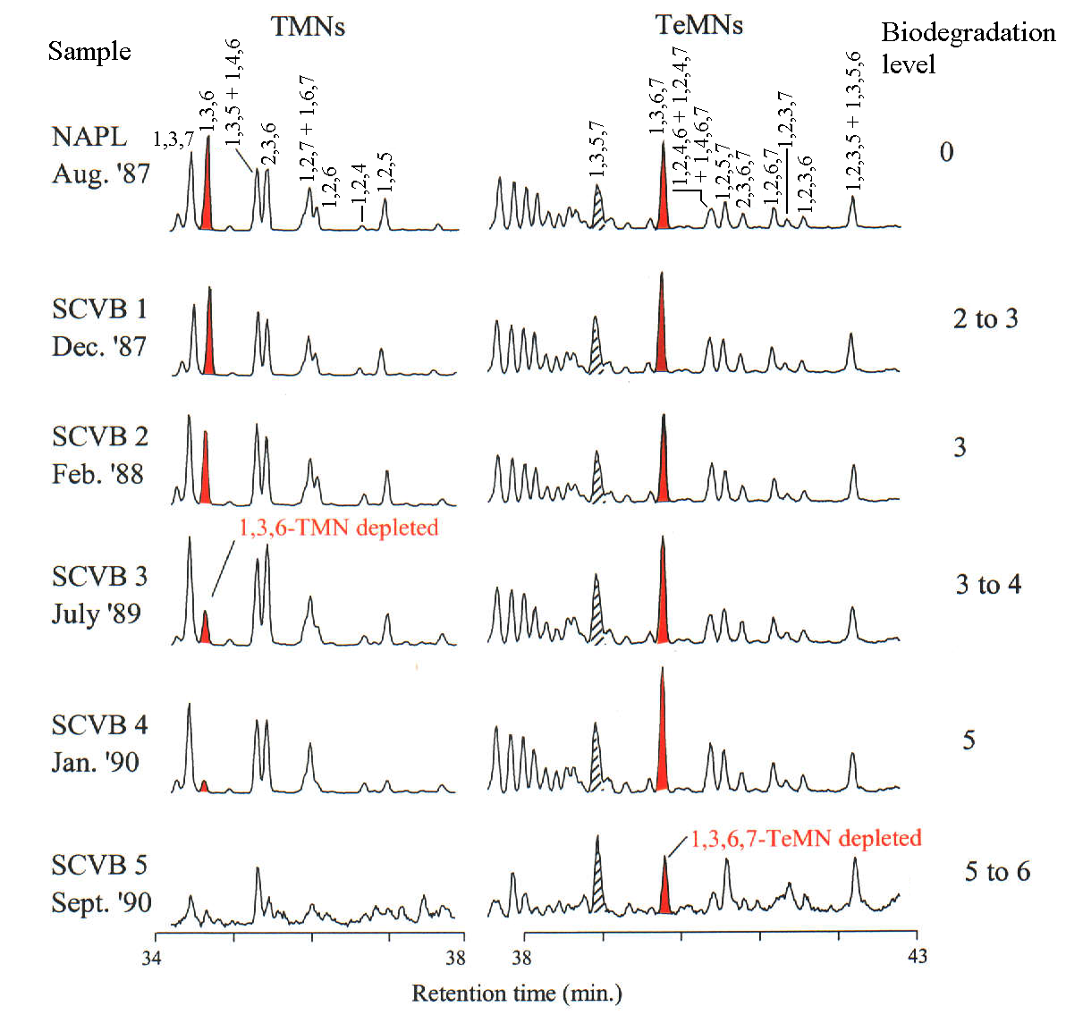
Biodegradation of trimethylnaphthalenes (TMNs) and tetramethylnaphthalenes (TeMNs)
in natural marine environment (coastal sediments) (2002).
Numbers designate positions of methyl group in naphthalene

Slide 17
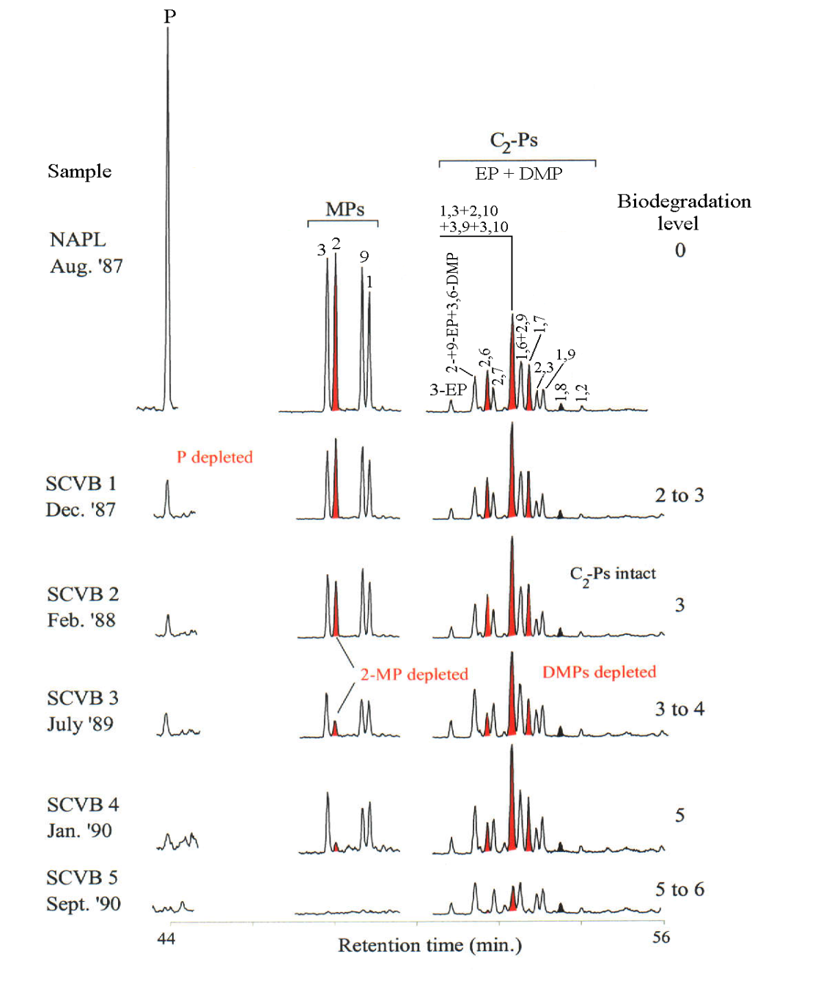
Biodegradation of phenanthrene (P), methylphenanthrenes (MPs) and C2 substituted
phenanthrenes (C2-PS) in natural marine environment (coastal sediments; 2002).
DMPs – dimethylphenanthrene; EP– ethylphenanthrene; Numbers designate positions of methyl group in phenanthrene

Slide 18
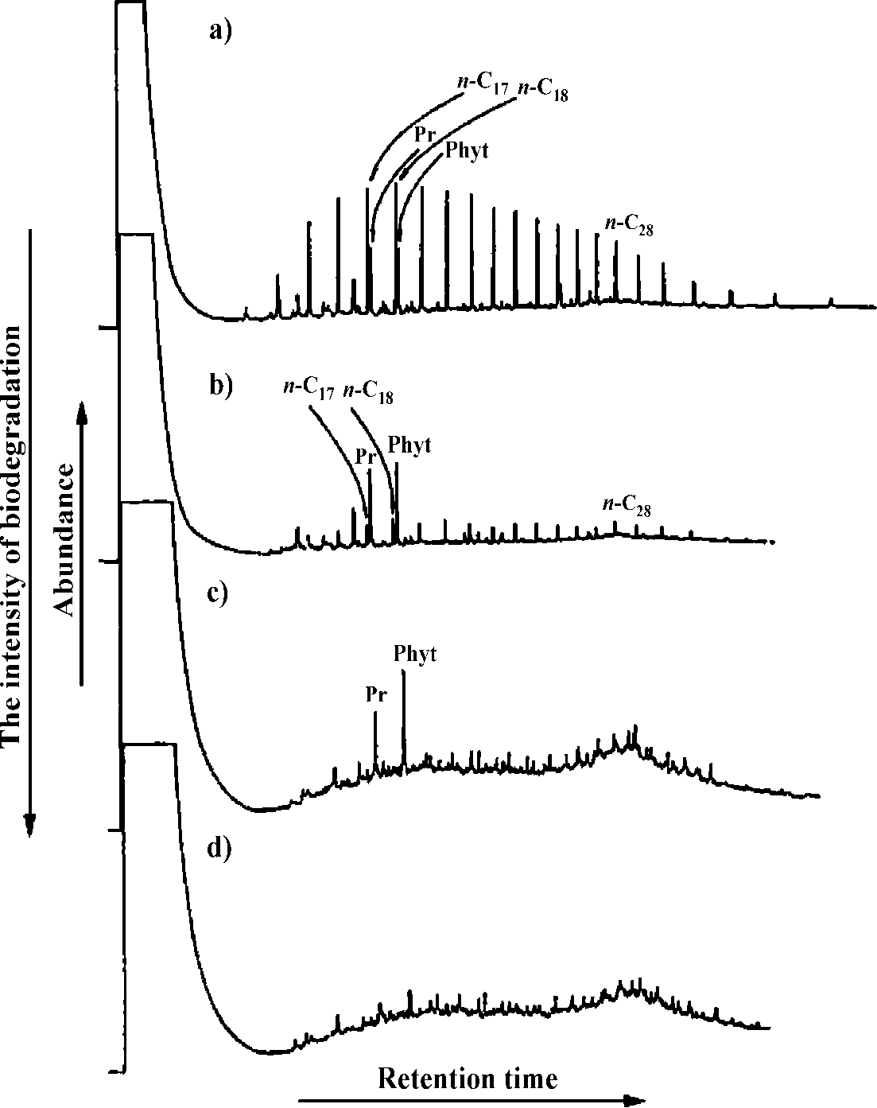
Gas chromatograms of total alkane oil fractions ranked according to the intensity of biodegradation: a) non-biodegraded oil, b) at least biodegraded oil, c) moderate (I) biodegraded oil and d) moderate (III) biodegraded oil.

Slide 19
1) Natural biodegradation.
2) Biodegradation of the oil pollutant in the laboratory.
3) in situ Bioremediation.
BIODEGRADATION OF PETROLEUM AS POLLUTANT IN THE ENVIRONMENT – the most important type of transformations

Slide 20
1) Natural biodegradation (example)
Alkanes isolated from oil polluted alluvial ground waters (Pančevo Oil Refinery locality). November 1997 (a), May 1998 (b), September 1998 (c), September 1999 (d) and February 2000 (e).

Slide 21
2) Biodegradation of the oil pollutant in the laboratory (example)
The fate of a petroleum-type pollutant in environment was foreseen on the basis of laboratory simulation experiments of microbiological degradation of petroleum using microorganism consortiums similar to those typical for the natural environment.

Slide 22
- Experiments of simulated biodegradation after 15, 30, 45, 60, and 75 days, and experiment with blind trial after 75 days, were stopped for sterilisation at 120 ºC for 25 minutes.
- In the extracts, group composition was determined and fractions of saturated hydrocarbons, aromatic hydrocarbons, alcohols and fatty acids were isolated by column chromatography.
- Alkane fraction was analysed by gas chromatography - mass spectrometry (GC-MS) technique.

Slide 23
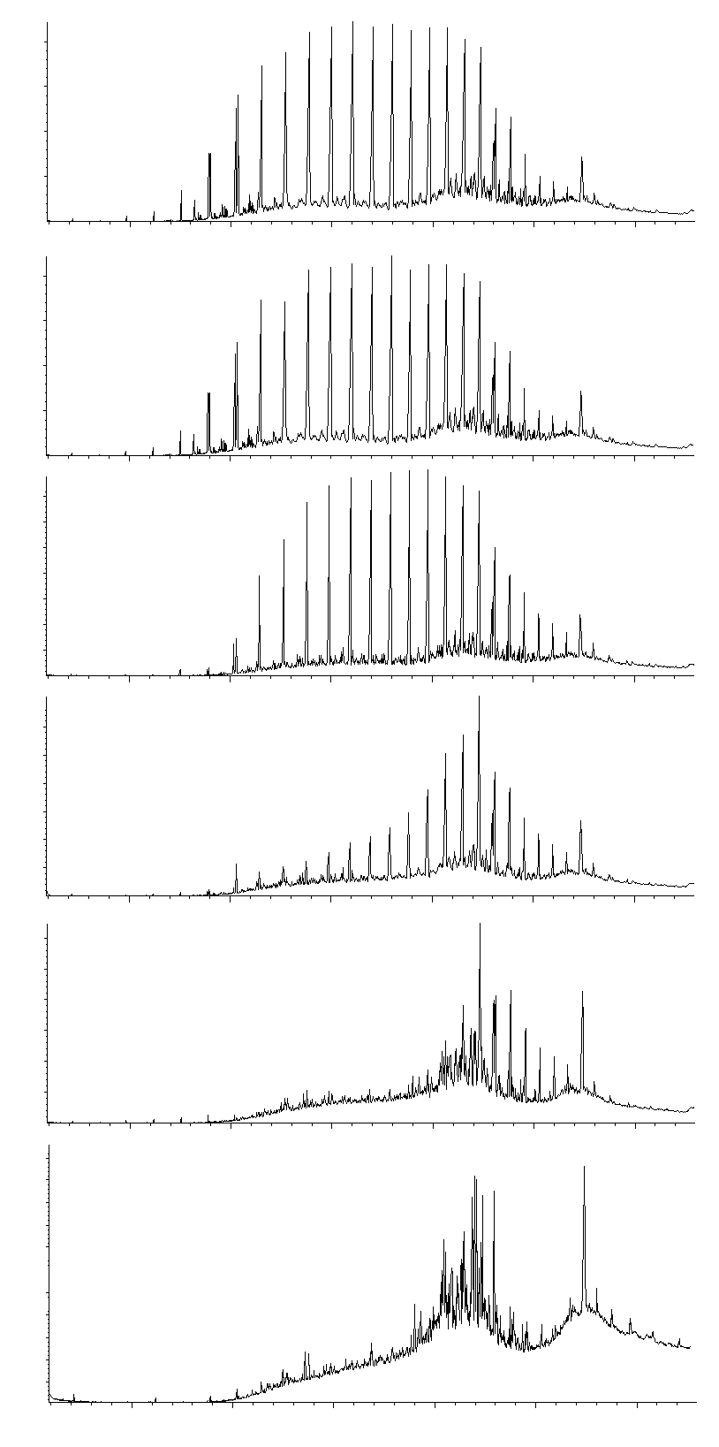
n-C20
n-C25
n-C30
0. day
n-C18
Fit
Abundance
Pr
n-C17
n-C35
n-C15
15. day
Abundance
30. day
Abundance
45. day
Abundance
60. day
Abundance
75. day
Abundance
Retention time (min)
Total ion chromatograms (TIC) of saturated fractions after the experiment
of simulated biodegradation with bacteria.

Slide 24
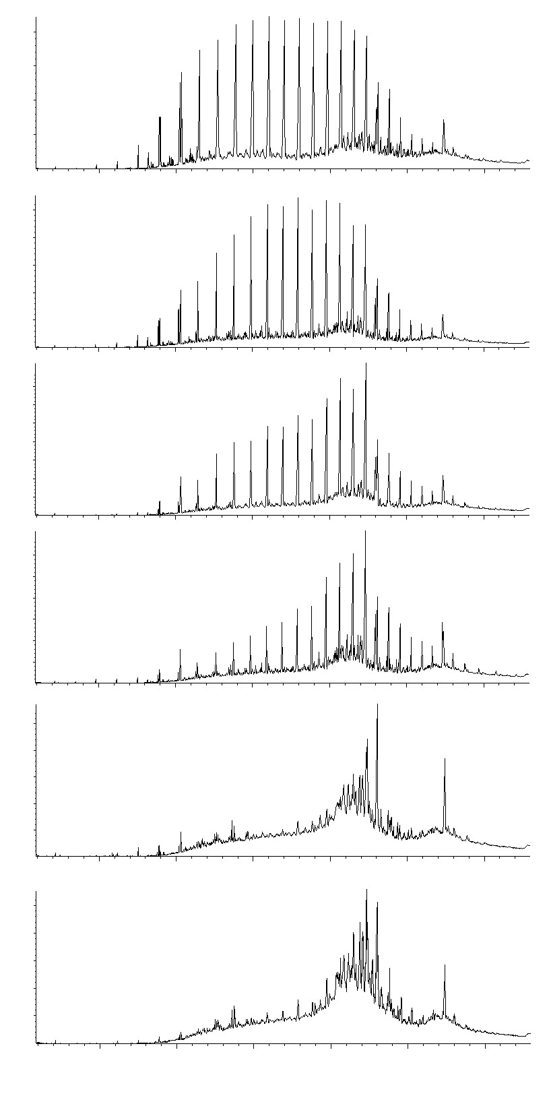
n-C18
Fit
n-C20
n-C25
n-C30
0. day
n-C17
Pr
Abundance
n-C35
n-C15
15. day
Abundance
30. day
Abundance
45. day
Abundance
60. day
Abundance
75. day
Abundance
Retention time (min)
Total ion chromatograms (TIC) of saturated fractions after the
experiment of simulated biodegradation with fungi.

Slide 25
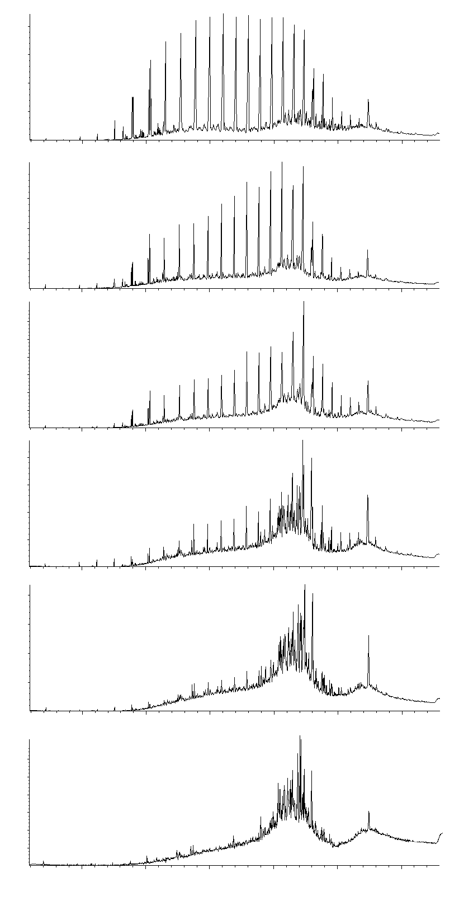
n-C18
Fit
n-C20
n-C25
n-C30
0. day
n-C17
Pr
Abundance
n-C35
n-C15
15. day
Abundance
30. day
Abundance
45. day
Abundance
60. day
Abundance
75. day
Abundance
Retention time (min)
Total ion chromatograms (TIC) of saturated fractions after the experiment
of simulated biodegradation with consortium of bacteria and fungi.

Slide 26
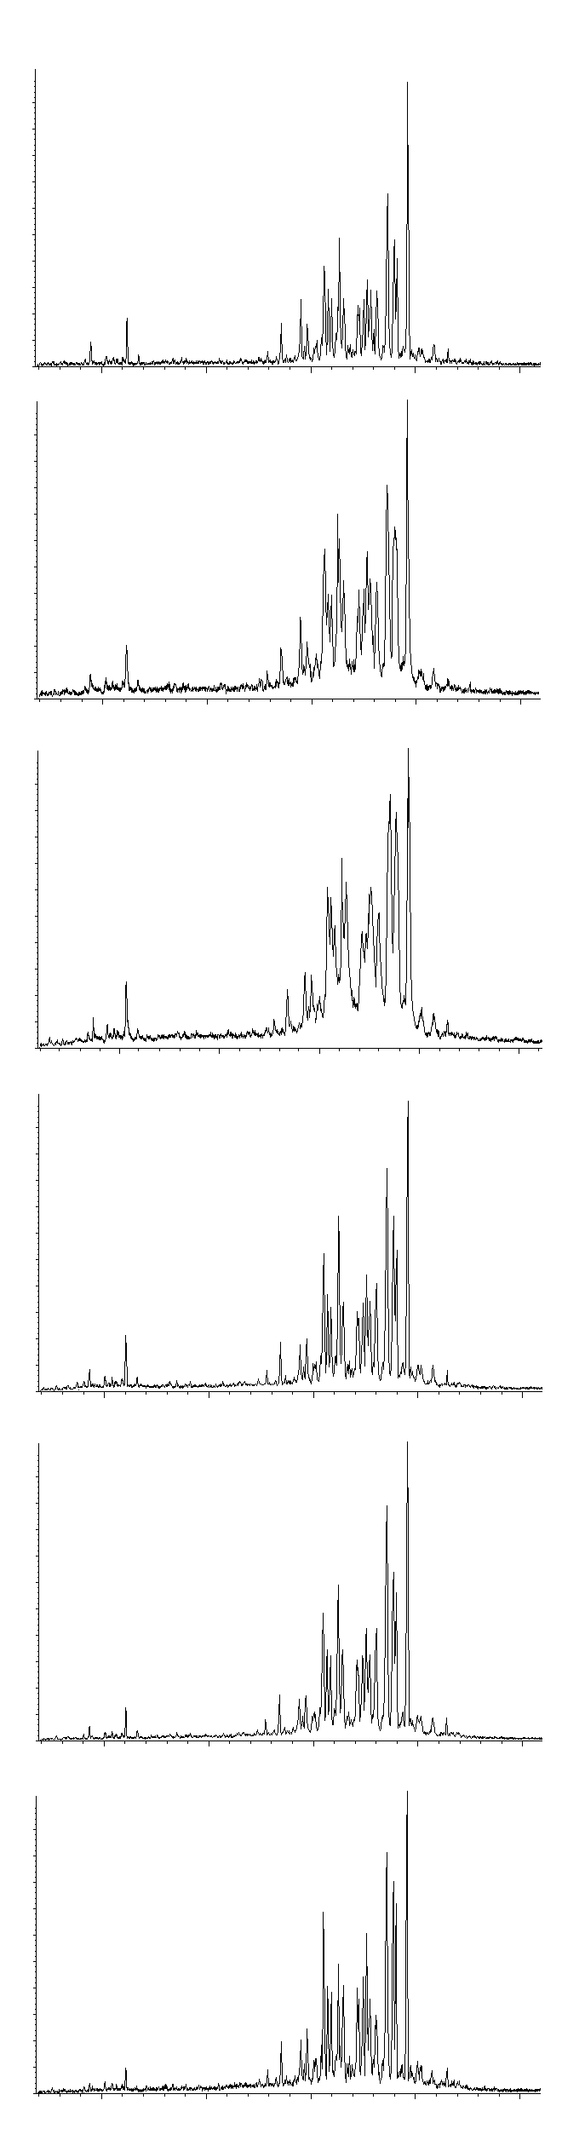
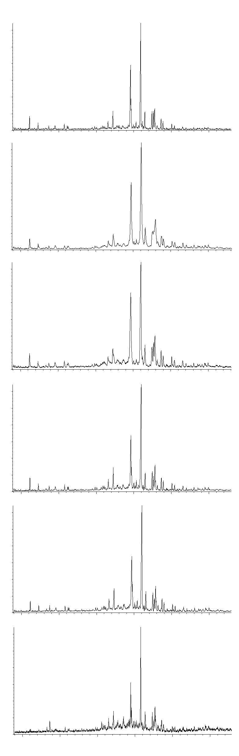
Steranes
C29
Terpanes
Pentaciclyc
terpanes
0. day
Abundance
C27
C28
Abundance
Triciclyc
terpanes
C21
Diasteranes
C20
15. day
Abundance
Abundance
30. day
Abundance
Abundance
45. day
Abundance
Abundance
60. day
Abundance
Abundance
75. day
Abundance
Abundance
Retention time (min)
Retention time (min)
GC-MS ion fragmentograms of steranes (m/z = 217) and terpanes (m/z = 191)
after the experiment of simulated biodegradation with consortium of bacteria and fungi.

Slide 27
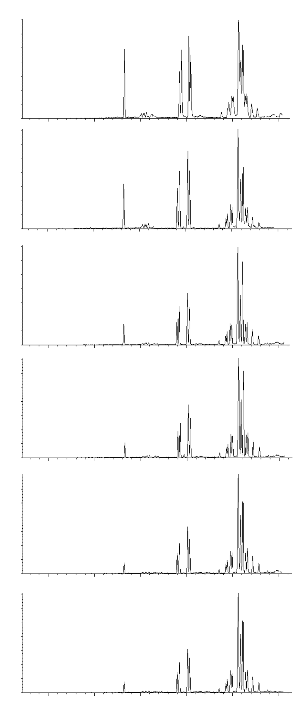
MP
DMP
0. day
P
Abundance
15. day
Abundance
30. day
Abundance
45. day
Abundance
Abundance
60. day
GC-MS ion fragmentograms of phenanthrene (P; m/z = 178), methylphenanthrenes (MP; m/z = 192) and dimethylphenanthrenes (DMP; m/z = 206) after the experiment of simulated biodegradation with bacteria.
Abundance
75. day
Retention time (min)

Slide 28
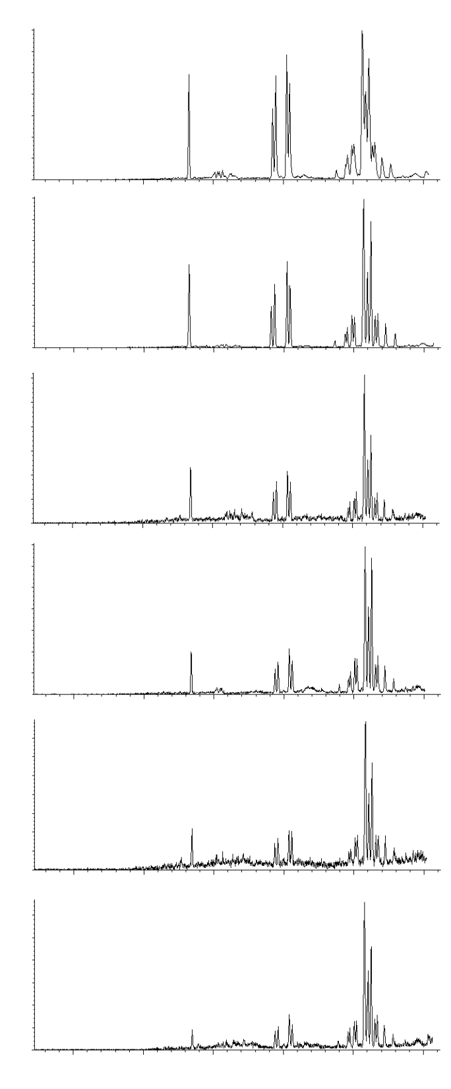
MP
DMP
0. day
P
Abundance
15. day
Abundance
30. day
Abundance
45. day
Abundance
60. day
Abundance
GC-MS ion fragmentograms of phenanthrene (P; m/z = 178), methylphenanthrenes (MP; m/z = 192) and dimethylphenanthrenes (DMP; m/z = 206) after the experiment of simulated biodegradation with fungi.
75. day
Abundance
Retention time (min)

Slide 29
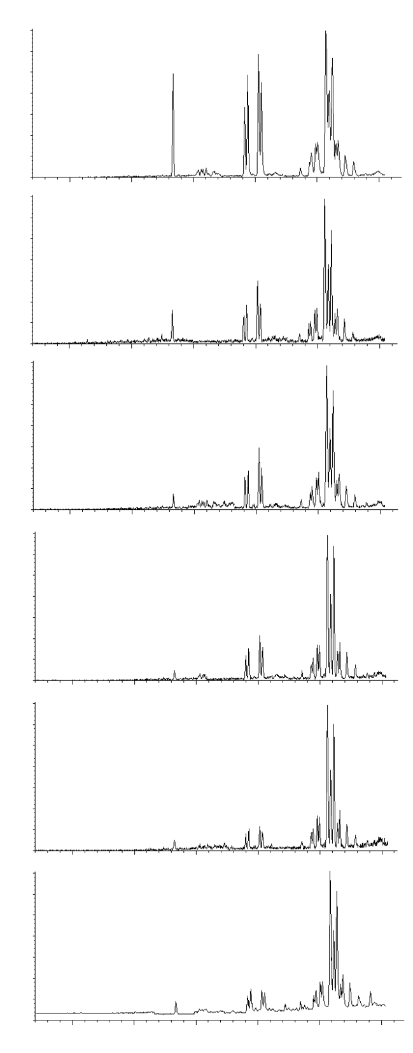
MP
DMP
0. day
P
Abundance
15. day
Abundance
30. day
Abundance
45. day
Abundance
60. day
Abundance
GC-MS ion fragmentograms of phenanthrene (P; m/z = 178), methylphenanthrenes (MP; m/z = 192) and dimethylphenanthrenes (DMP; m/z = 206) after the experiment of simulated biodegradation with consortium of bacteria and fungi.
75. day
Abundance
Retention time (min)

Slide 30
3) in situ Bioremediation (example)
- Ground waters (GW) which contained dissolved hydrocarbons and a floating layer of an oil pollutant were treated with filtration-adsorption remediation technique, using the columns filled with natural inorganic hydrophobic adsorbents, and in situ bioremediation based on the principle of “bipolar” model.
- In situ bio/remediation of GW and soil layers in contact with groundwater was accomplished by chemical and biological stimulation, augmentation and aeration in closed “bipolar” system (pumping out – pumping in), with adsorption in the “external unit”.
- Natural microbial processes in groundwater were additionally stimulated by chemical or physical increase in the aeration capacity.
- Bioaugmentation was achieved by injection of biomass of zymogenous microorganisms isolated from treated polluted GW.

Slide 31
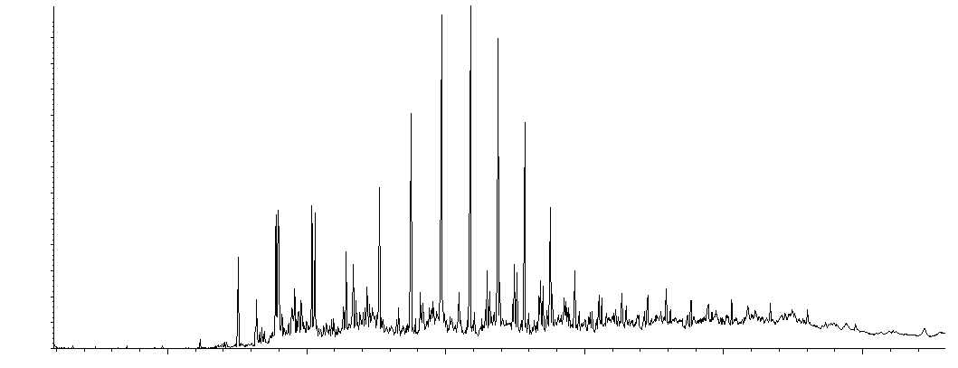
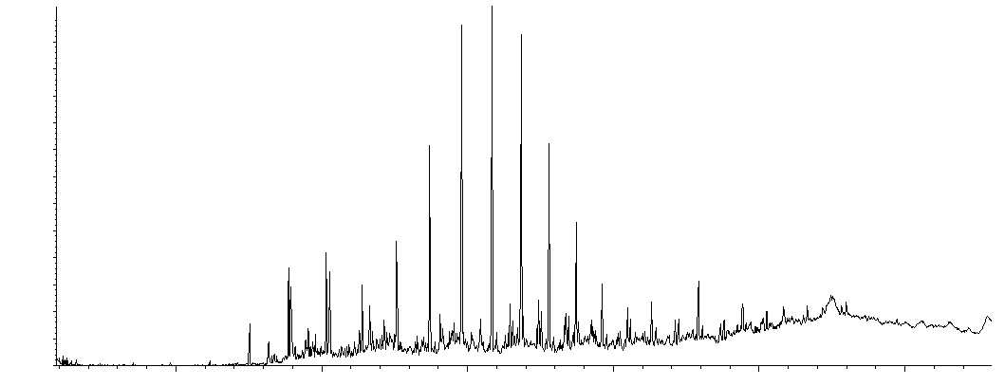
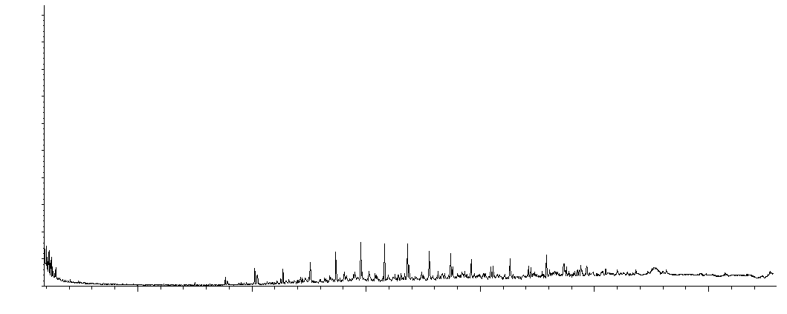
1st May 2012
n-C25
Pr
n-C18
n-C17
Fit
n-C20
Abundance
in situ Bioremediation
(example)
n-C30
n-C15
1st June 2012
Abundance
1st July 2012
Fragmentograms of n-alkanes and isoprenoids (m/z = 71) obtained by GC-MS analysis of the extracts isolated from the samples at the beginning of the experiment, after 30 days and after 60 days.
Abundance
Retention time (min)

Slide 32
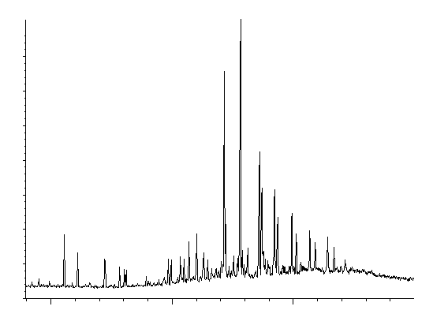
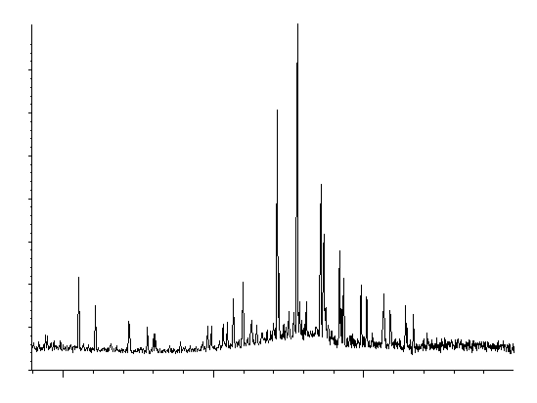
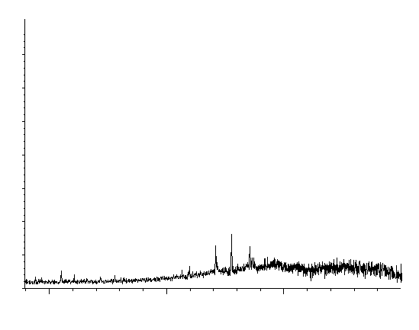
Pentaciclyc
terpanes
1st May 2012
Abundance
Triciclyc
terpanes
in situ Bioremediation
1st June 2012
Abundance
1st July 2012
Fragmentograms of terpanes (m/z = 191) obtained by GC-MS analysis of the extracts isolated from the samples at the beginning of the experiment, after 30 days and after 60 days.
Abundance
Retention time (min)

Slide 33
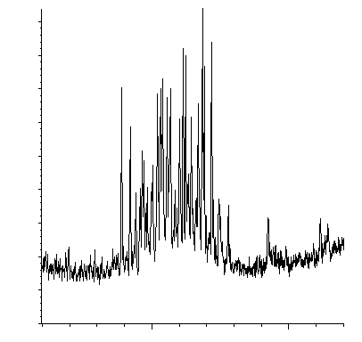
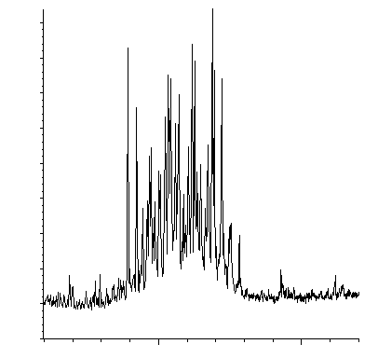
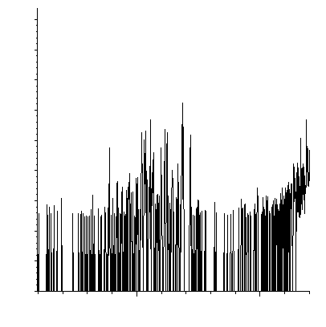
C29
C27
C28
1st May 2012
Diasteranes
Abundance
in situ Bioremediation
1st June 2012
Abundance
1st July 2012
Fragmentograms of steranes (m/z = 217) obtained by GC-MS analysis of the extracts isolated from the samples at the beginning of the experiment, after 30 days and after 60 days.
Abundance
Retention time (min)

Slide 34
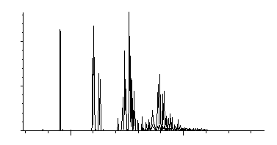
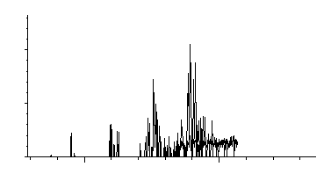
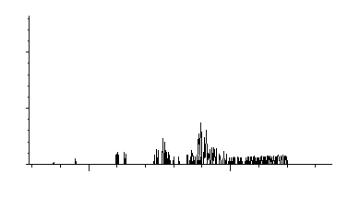
DMP
1st May 2012
P
MP
TMP
Abundance
in situ Bioremediation
1st June 2012
Abundance
Fragmentograms of phenanthrene (P; m/z = 178), methylphenanthrenes (MP; m/z = 192), dimethylphenanthrenes (DMP; m/z = 206) and trimethylphenanthrenes (TMP; m/z = 220) obtained by GC-MS analysis of the extracts isolated from the samples at the beginning of the experiment, after 30 days and after 60 days.
1st July 2012
Abundance
Retention time (min)

