Slide 1
5.3. POPs Transformation
EP
Environmental Processes

Slide 2
Aims and Outcomes
Aims:
to give students overview of important mechanisms and pathways of pollutants transformation in environmental compartments
to discuss thermodynamic and kinetic aspect of pollutant transformation with extension to practical applications
Outcomes:
students will be able to understand the principles and pathways of pollutant transformations
students will be able to estimate potential transformation pathways of most common transformation reactions of standard and new types of pollutants and predict possible transformation products

Slide 3
Lecture Content
Mechanisms and kinetic aspects of pollutants transformation reactions in environmental compartments
  light-induced transformations, hydrolysis, biodegradation
  examples of important transformation pathways

Slide 4
Chemical kinetics
Chemical kinetics (also reaction kinetics): focused on the determination of reaction rates
Reaction rates of chemical reactions are influenced by:
Type of the reactants: reactions of acids and bases are usually fast, as well as ion exchange; formation of covalent bonds and formation of large molecules are usually slow
Physical state of reactants
  Reactants in the same phase (homogeneous) → reaction takes place in whole volume
  Reactants in different phases (heterogeneous) → reaction is limited to the interface between the reactants
Concentration: the higher concentration – the higher number of collisions necessary for the reaction

Slide 5
Chemical kinetics (contd.)
Reaction rates are influenced by:
Temperature: the higher temperature – the higher reaction rate (“golden rule”: the rate of chemical reactions doubles for every 10 °C temperature rise – not valid in all cases, exception e.g. catalyzed reactions)
Catalysis: The catalyst increases rate reaction by providing a different reaction mechanism to occur with a lower activation energy. Enzymes are special type of catalysts.
Pressure: Increasing the pressure in a gaseous reaction will increase the number of collisions between reactants, increasing the rate of reaction.

Slide 6
Chemical thermodynamic
Chemical thermodynamics determines the extent to which reactions occur.
In a reversible reaction, chemical equilibrium is reached when the rates of the forward and reverse reactions are equal and the concentrations of the reactants and products no longer change.

Slide 7

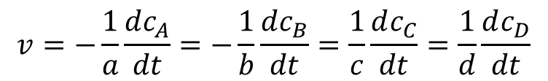
Reaction Rate
Common chemical reaction:
$$aA+bB→cC+dD$$
Rate of chemical reaction:
$$v=−\frac{1}{a}\frac{dc_{A}}{dt}=−\frac{1}{b}\frac{dc_{B}}{dt}=\frac{1}{c}\frac{dc_{C}}{dt}=\frac{1}{d}\frac{dc_{D}}{dt}$$
k … rate constant
Sum of exponents (a+b) … overall reaction order.
a … partial reaction order of component A
b … partial reaction order of component B

Slide 8
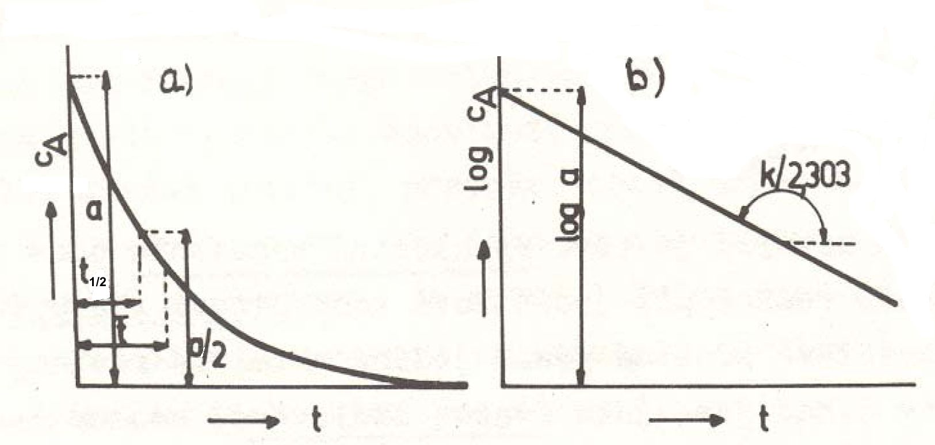

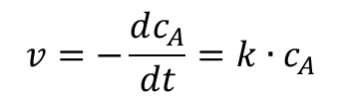
Chemical reaction of first order
Reaction of first order:
Rate of this reaction:
$$v=−\frac{dc_{A}}{dt}=k∙c_{A}$$
After integration:
$$c_{A,t}=c_{A,0}∙e^{−k∙t}$$
Where
c_{A,t} … concentration at time t
c_{A,0} … initial concentration
k … rate constant of the first order reaction [s⁻¹]

Slide 9
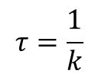
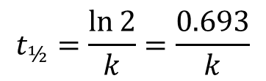
Chemical reaction of first order
Half-time of the reaction t_{½} (i.e. time, after which the concentration drops to half):
$$t_{½}=\frac{\ln{2}}{k}=\frac{0.693}{k}$$
Lifetime, τ, of a species in a chemical reaction is defined as the time it takes for the species concentration to fall to 1/e of its initial value (e is the base of natural logarithms, 2.718).
$$τ=\frac{1}{k}$$
Examples of first order reactions:
  Radioactive decay
Remark:
Lifetime is a result of chemical reaction.
Residence time of any compound in environmental compartment is a result of chemical and transport processes.
2 H₂O₂(l) → 2 H₂O (l) + O₂(g)
2 SO₂Cl₂(l) → SO₂(g) + Cl₂(g)
2 N₂O₅(g) → 4 NO₂(g) + O₂(g)

Slide 10
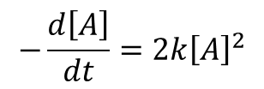
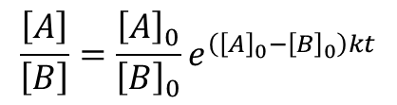

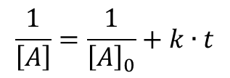
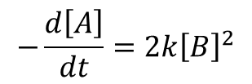
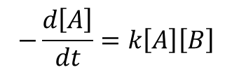
Second order reactions
$$A+B→Products$$
Reaction could depend on the concentrations of one second-order reactant, or two first-order reactants
$$−\frac{d\left[A\right]}{dt}=2k{\left[A\right]}^{2}$$
or
$$−\frac{d\left[A\right]}{dt}=k\left[A\right]\left[B\right]$$
or
$$−\frac{d\left[A\right]}{dt}=2k{\left[B\right]}^{2}$$
After integration:
$$\frac{1}{\left[A\right]}=\frac{1}{{\left[A\right]}_{0}}+k∙t$$
$$\frac{\left[A\right]}{\left[B\right]}=\frac{{\left[A\right]}_{0}}{{\left[B\right]}_{0}}e^{\left({\left[A\right]}_{0}−{\left[B\right]}_{0}\right)kt}$$
or
Physical dimension of second-order-reaction rate constant k: [dm³.mol⁻¹.s⁻¹]

Slide 11
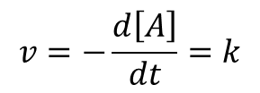

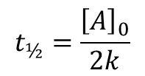

Zero order reactions
In this case the reaction rate is independent of the concentration of the reactant(s).
$$v=k$$
$$v=−\frac{d\left[A\right]}{dt}=k$$
After integration:
$${\left[A\right]}_{t}=−k∙t+{\left[A\right]}_{0}$$
$$t_{½}=\frac{{\left[A\right]}_{0}}{2k}$$
The half-life of the zero-order reaction:
Remark:
This order of reaction is often observed in enzymatic reactions.

Slide 12
Environmental transformations of pollutants
Abiotic transformations of pollutants :
  Chemical (redox reactions, hydrolysis)
  Photochemical
    Direct photolysis (absorption of photon(s) initiates chemical reaction)
    Indirect photolysis (reaction of compound with highly reactive species produced by photolysis like radicals or singlet oxygen)
Biotic transformations of pollutants:
  Microbial degradations

Slide 13
Chemical transformations of organic pollutants - examples
Nucleophilic substitution
Benzyl chloride
Benzyl alcohol
Methyl bromide
Methanol
Elimination
1,1,2,2-tetrachloroethane
trichloroethene

Slide 14
Chemical transformations of organic pollutants – examples (contd.)
Ester hydrolysis
Dibutyl phthalate
Phthalate
Butanol
Parathion
Thiophosphoric acid
p-nitrophenol

Slide 15
Chemical transformations of organic pollutants – examples (contd.)
2 CH₃SH + ½ O₂ → H₃C-S-S-CH₃ + H₂O
Oxidation
Methylmercaptan
Dimethyl disulfide
Reduction
Nitrobenzene
Aniline

Slide 16
Hydrolysis
Substitution of atom or functional group by water molecule or hydroxonium anion
Very important process in natural waters
Products of hydrolysis are more polar then parent compounds, which have different environmental properties
Usually the products of hydrolysis show lower environmental risk than parent compounds
Hydrolysis is usually considered as irreversible reaction
Hydrolysis is often catalyzed by H⁺ or OH⁻ ions

Slide 17

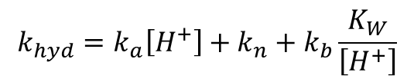
Hydrolysis
Rate of hydrolysis:
$$v=\frac{d\left[RX\right]}{dt}=k_{hyd}∙\left[RX\right]=k_{a}\left[H^{+}\right]\left[RX\right]+k_{n}\left[RX\right]+k_{b}\left[{OH}^{−}\right]\left[RX\right]$$
Where
[RX] … concentration of hydrolyzable compound
k_{hyd} … velocity constant of hydrolysis
k_{a}, k_{n}, k_{b} … rate constants for the acid-catalyzed, neutral and base-catalyzed processes
Assuming the first-order kinetics of acid, neutral and base hydrolysis with respect to hydrolyzable compound RX, k_{hyd} could be expressed as:
$$k_{hyd}=k_{a}\left[H^{+}\right]+k_{n}+k_{b}\left[{OH}^{−}\right]$$
or
$$k_{hyd}=k_{a}\left[H^{+}\right]+k_{n}+k_{b}\frac{K_{W}}{\left[H^{+}\right]}$$

Slide 18
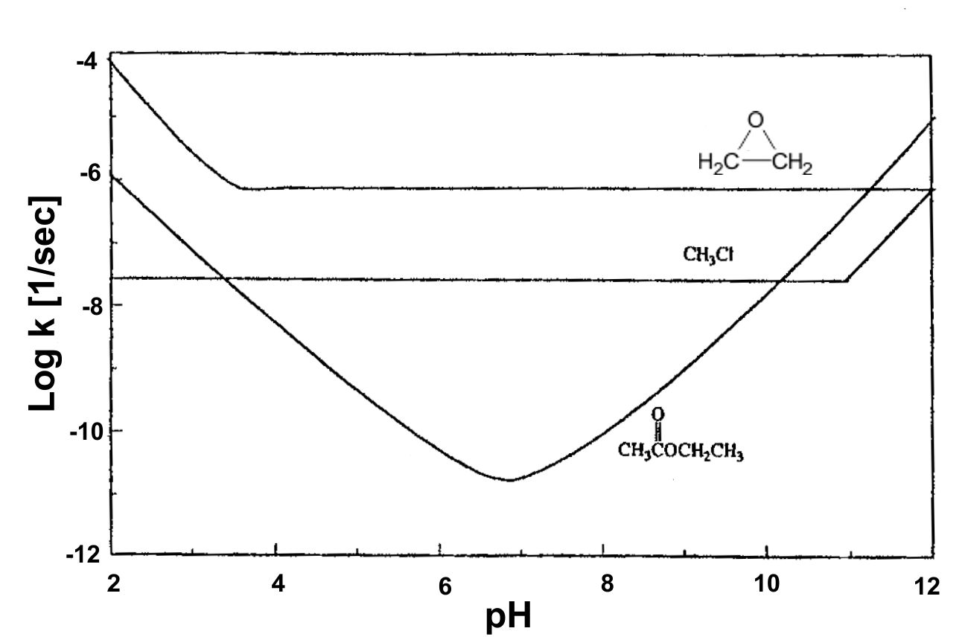
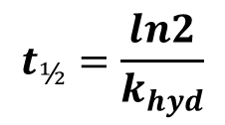
Hydrolysis
Half-life for hydrolysis:
$$t_{½}=\frac{ln2}{k_{hyd}}$$
Rate of hydrolysis could be dependent on pH – value:
pH = rate constant profiles for the hydrolysis of ethylene oxide, methyl chloride and ethyl acetate
Notes:
Mabey W and Mill T., Critical review of hydrolysis of organic compounds in water under environmental conditions. J. Phys.Chem. Ref. Data, 7/2 (1978) 383-415

Slide 19
Hydrolysis
Compounds resistant to hydrolysis | Compounds amenable to hydrolysis
Alkanes, alkenes, alkines | Alkylhalogenides
Aromatic and polyaromatic hydrocarbons | Amides of carboxylic acids
Halogen- and nitro-derivatives of PAHs | Alkylamines
Arylamines | Carbamates
Alcohols, phenols, glycols | Carboxylic acid esters
Ethers | Epoxides
Aldehydes, ketones | Carboxylic acid nitriles
Carboxylic acids | Phosphoric acid esters
Sulfoacids | Sulfuric acid esters
Notes:
Mabey W and Mill T., Critical review of hydrolysis of organic compounds in water under environmental conditions. J. Phys.Chem. Ref. Data, 7/2 (1978) 383-415

Slide 20
Redox reactions
Reactions based on electron transfer from reducing to oxidizing compounds:
Two half-reactions:
Oxidation is the main transformation process of most organic compounds in troposphere and also participates at the transformation of various pollutants in surface waters.

Slide 21
Redox reactions
Examples of important environmental oxidants present in atmosphere at sufficient concentrations, which react readily with organic compounds:
    alkoxy radicals RO•
    peroxy radicals ROO•
    hydroxy radicals OH•
    singlet oxygen ¹O₂
    ozone O₃
These oxidants are mostly generated from the photochemical reactions in atmosphere.

Slide 22
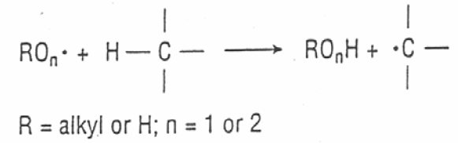
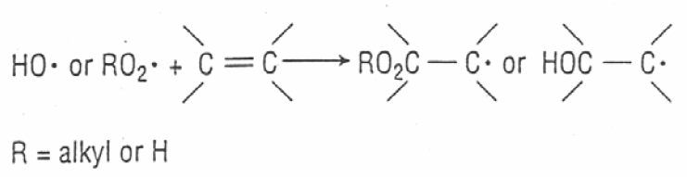
Redox reactions
Main reaction pathways for environmental oxidation:
H-atom transfer
2. Addition to double bonds

Slide 23
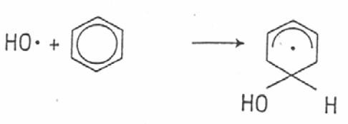

Redox reactions
Main reaction pathways for environmental oxidation:
OH• addition to aromatic compounds
4. Transfer of O from ROO• to nucleophilic species

Slide 24

Redox reactions
Rate of oxidation:
Half-lives for tropospheric oxidation of various organic compounds in the northern hemisphere:
$$R_{ox}=k_{ox}∙\left[C\right]∙\left[OX\right]$$
R_{ox} … rate of oxidation [mol.l⁻¹.s⁻¹]
K_{ox} … velocity constant of oxidation [l.mol⁻¹.s⁻¹]
[C] … concentration of compound [mol.l⁻¹]
[OX] … concentration of oxidant [mol.l^{˗1}]
Compound | Half-live [d]
Alkanes | 1 - 10
Alcohols | 1 – 3
Aromatics | 1 – 10
Olefins | 0.06 – 1
Halomethanes | 100 – 47,000

Slide 25
Redox reactions
Reduction
Transfer of electrons from reducing agent (which is oxidized) to reduced compound
Reducing environments in nature:
Subsurface waters and soils, aquatic sediments, sewage sludge, waterlogged peat soils, hypolimnia of stratified lakes, oxygen free sediments of eutrophic rivers

Slide 26
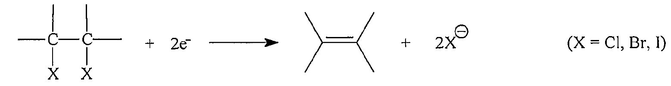
Redox reactions
Reductive environmental transformations
1. Hydrogenolysis
2. Vicinal dehalogenation

Slide 27
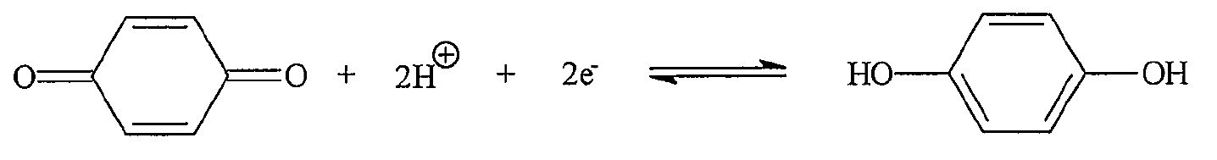
Redox reactions
Reductive environmental transformations
3. Quinone reduction
4. Reductive dealkylation
5. Nitroaromatic reduction

Slide 28
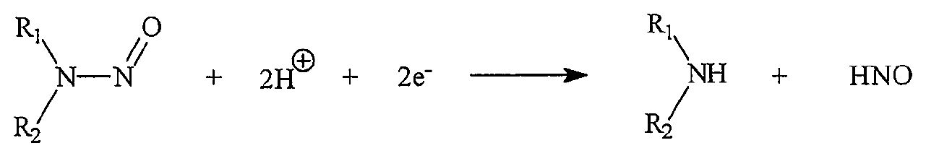
Redox reactions
Reductive environmental transformations
6. Aromatic azo reduction
7. N-nitrosoamine reduction

Slide 29
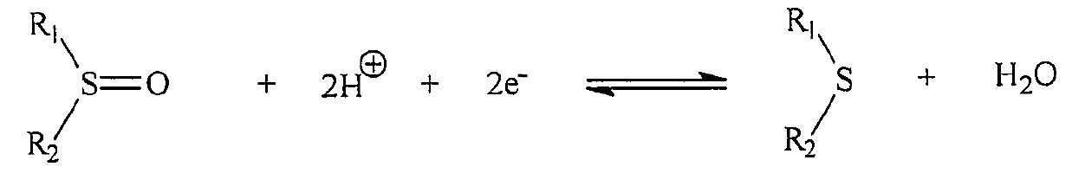
Redox reactions
Reductive environmental transformations
8. Sulfoxide reduction
9. Disulfide reduction

Slide 30
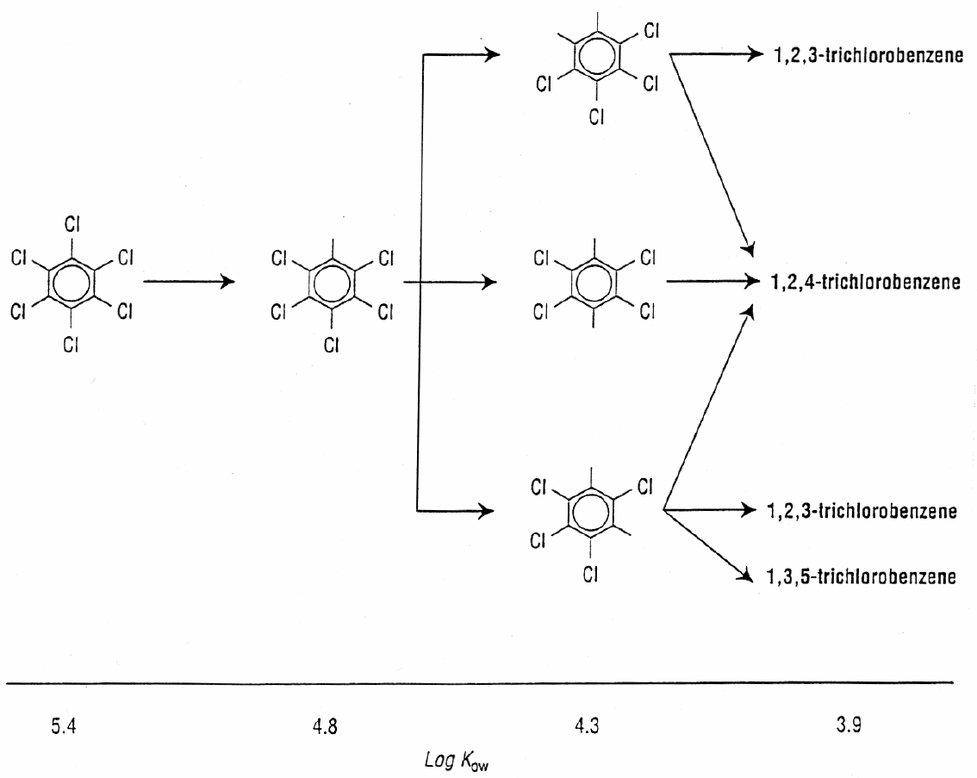
Reductive dehalogenation of HCB

Slide 31
Selected reductive (anaerobic) reactions of xenobiotics
Pentachloro-
nitrobenzene
Pentachloro-
nitroaniline
Lindane
Benzene
DDT
DDD
Parathion
Amino-parathion

Slide 32
Photochemical transformation processes
Photochemistry
study of chemical reactions that proceed with the absorption of light by atoms or molecules.
Examples:
  photosynthesis
  degradation of plastics
  formation of vitamin D with sunlight.
Principle:
  Absorption of photon (UV, VIS) by atom or molecule
  Changes induced by the gained energy
    physical
    chemical

Slide 33
Photochemical transformation processes
+ h.ν
Compound
Compound*
excitation
Physical processes
Chemical reactions
Vibrational loss of energy (heat transfer)
Loss of energy by emission (luminescence)
Energy transfer promoting an electron in another chemical species (photosensitization)
Fragmentation
Intramolecular rearrangement
Isomerization
Hydrogen abstraction
Dimerization
Electron transfer (from or to the compound)
Compound
Products

Slide 34
Photochemical transformation processes
Photochemical environmental processes take place in:
  Atmosphere
  Upper part of hydrosphere
  Surface of pedosphere
  Surface of vegetation
Typical environmental photochemical process covers 3 steps
  Absorption of photon → excitation of atom or molecule (electronic)
  Primary photochemical process → transformation of electronic excited state, deexcitation
  Secondary reactions of compounds resulting from primary photochemical processes

Slide 35
Photochemical transformation processes
For photochemical processes two demands are essential:
Ability of photon absorption by compound
  Presence of (conjugated) double bonds
  Aromatic cycles
Sufficient amount of solar energy
Direct absorption of photon leads to:
Bond cleavage
Dimerization
Oxidation
Hydrolysis
Rearrangements

Slide 36
Selected photochemical transformations
Trifluralin
Chlorbenzene derivatives

Slide 37
Biochemical transformations of pollutants
Biodegradation can be defined as the biologically catalyzed reduction of complexity of chemicals
Microbial degradation plays key role in removal of xenobiotics from the water and terrestric environment
Biodegradation under aerobic conditions leads to inorganic end products (CO₂, H₂O) – mineralization (or ultimate biodegradation)
Biodegradation in anaerobic conditions is usually much slower and in most cases doesn’t lead to mineralization.
In methanogenic environment mineralization is defined as conversion to single-carbon end products like CO₂ and CH₄.
For effective biodegradation the mixed cultures of microorganisms are preferable

Slide 38
Mechanisms of biodegradation
Mineralization
  Complete destruction of organic molecules to simple inorganic compounds (CO₂, H₂O, …)
Co-metabolism
  Co-metabolization of molecules in the presence of another compound
  Production of dead-end metabolites
Detoxification
  Transformation to non-toxic or less-toxic compounds
Polymerization
  Bonding of identical molecules

Slide 39
Mineralization
Organic compounds serve as carbon source and energy source for microorganisms
Organic compounds
natural - xenobiotics
monooxygenases
dioxygenases
hydrolases
dehydrogenases
amidases
transferases
NH₄⁺, Cl⁻, SO₄²⁻
Specific catabolic
enzymes
Metabolic intermediates
Electron acceptor
O₂, NO₃⁻, SO₄²⁻
NADPH₂
ATP
Mineral products
CO₂, H₂O
Cell mass
growth

Slide 40
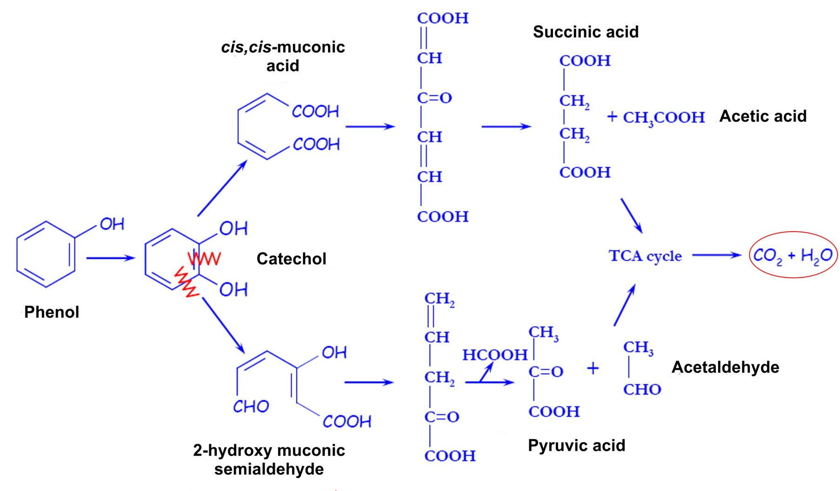
Mineralization - example

Slide 41
Cometabolism
simultaneous degradation of two compounds, in which the degradation of the second compound (the secondary substrate) depends on the presence of the first compound (the primary substrate)
Example: bacteria Pseudomonas stutzeri OX1 metabolizes methane using enzyme methane monooxygenase. This enzyme could also degrade chlorinated solvents like tetrachloroethylene.
Co-metabolized compounds don’t serve as source of carbon or energy
Products of co-metabolism could accumulate, which could become a problem when these products are toxic

Slide 42
Examples of co-metabolized compounds:
Cyclohexane → cyclohexanol
PCBs
Selected chlorophenols
3,4-dichloroaniline
1,3,5-trinitrobenzene
Chlorobenzene → 3˗chlorocatechol
Alachlor, propachlor
Parathion → 4-nitrophenol
DDT → DDE, DDD, DBP
Propane → propionate, acetone
Methyl fluoride → formaldehyde

Slide 43
Microbial Detoxification
Removal or lowering of compounds toxicity
Most frequent reactions:
  Hydrolysis (water addition)
  Hydroxylation
  Dehalogenation
  Demethylation – dealkylation
  Reduction of nitro group
  Deamination
  Ether cleavage
  Conversion of nitriles to amides
  Conjugation

Slide 44
Microbial Activation
On the contrary, in selected cases the result of microbial transformation of non-toxic precursor is toxic product
Examples:
  Dehalogenation of TCE to vinyl chloride
  Halogenation of phenol to pentachlorophenol
  Metabolic activation of PAHs

Slide 45
Further reading
J.E.Girard: Principles of environmental chemistry. Jones and Bartlett Publishers, 2010, ISBN 978-0-7637-5939-1
M.H. van Agteren, S. Keunig, D.B. Janssen: Handbook on biodegradation and biological treatment of hayardous organic compounds. Kluwer Academic Press, 1998, ISBN 0-7923-4989-X
M. S. El-Shahawi, A. Hamza, A. S. Bashammakh and W. T. Al-Saggaf: An overview on the accumulation, distribution, transformations, toxicity and analytical methods for the monitoring of persistent organic pollutants. Talanta 80/5 (2010) 1587-1597
M. la Farre, S. Perez, L. Kantiani and D. Barcelo: Fate and toxicity of emerging pollutants, their metabolites and transformation products in the aquatic environment. Trac-Trends in Analytical Chemistry 27/11 (2008) 991-1007
C. S. Wong: Environmental fate processes and biochemical transformations of chiral emerging organic pollutants. Analytical and Bioanalytical Chemistry 386/3 (2006) 544-558

