Slide 1
Heavy metal transformations
5(iv)

Slide 2
Aims
(i) To provide an overview of heavy metals’ transformations and their thermodynamic and kinetic processes in the environment.

Slide 3
Outcams
(i)students will be able to interpret dependence of heavy metals state and intensity of transformations.

Slide 4
A sequential extraction procedure, used to remove the heavy metals in specifically adsorbed and easily reducible manganese (Mn) oxide fractions, was used to study the transformation of heavy metals added to an alkaline soil.
Most of the endogenous Cu (86%) and Pb (79%) were found in the residual fraction (RES) which was considered to be mainly highly crystalline Fe oxides and silicate minerals.
The recently added Cu, Pb and Cd existed mainly on the surfaces of the soil particles as reactive fractions (water-soluble plus exchangeable and NaCaHEDTA-extractable fractions) and as highly stable forms (RES fraction).

Slide 5
The reactive forms then slowly transform into highly stable forms. The processes associated with the transformation of added Cu and Pb can be described by a diffusion equation.
The processes may be attributed mainly to the diffusion of the surface species into micropores and the entrapment in microporous solids.

Slide 6
Unlike Cu and Pb, most of the exchangeable Cd transformed to the forms extracted with NaCaHEDTA and to residual forms.
The slow processes of the transformation of Cd added to soil may be attributed to inner-sphere surface complexation via partial or complete dehydration of surface species.
The relative diffusion rate coefficients (D/r²) were found to be of the order of 10⁻¹⁰ to 10⁻¹¹ s⁻¹. Addition of CaCO₃ decreased the reactivity or extractability of added heavy metals through the increase in pH.

Slide 7
Heavy metal transformations
A sequential extraction procedure, used to remove the heavy metals in specifically adsorbed and easily reducible manganese (Mn) oxide fractions, was used to study the transformation of heavy metals added to an alkaline soil.
Most of the endogenous Cu (86%) and Pb (79%) were found in the residual fraction (RES) which was considered to be mainly a highly crystalline Fe oxides and silicate minerals. The recently added Cu, Pb and Cd existed mainly on the surfaces of the soil particles as reactive fractions (water-soluble plus exchangeable and NaCaHEDTA-extractable fractions) and as highly stable forms (RES fraction).
When water-soluble heavy metals are added to the soil, they are rapidly retained by the soil. The reactive forms then slowly transform into highly stable forms. The processes associated with the transformation of added Cu and Pb can be described by a diffusion equation.
There is a particularly high affinity of Pb for Mn oxides. The concentrations of metals in the reactive fractions were in the order:
Cd > Cu > Pb.
Notes:
Most of the endogenous Cu (86%) and Pb (79%) were found in the residual fraction (RES) which was considered to be mainly a highly crystalline Fe oxides and silicate minerals. The recently added Cu, Pb and Cd existed mainly on the surfaces of the soil particles as reactive fractions (water-soluble plus exchangeable and NaCaHEDTA-extractable fractions) and as highly stable forms (RES fraction).
When water-soluble heavy metals are added to the soil, they are rapidly retained by the soil. The reactive forms then slowly transform into highly stable forms. The processes associated with the transformation of added Cu and Pb can be described by a diffusion equation.

Slide 8
The processes may be attributed mainly to the diffusion of the surface species into micropores and the entrapment in microporous solids.
The relative diffusion rate coefficients (D/r²) were found to be of the order of 10⁻¹⁰ to 10⁻¹¹ s⁻¹.
Addition of CaCO₃ decreases the reactivity or extractability of added heavy metals through the increase in pH.
Unlike Cu and Pb, most of the exchangeable Cd transformed to the forms extracted with NaCaHEDTA and to residual forms. The slow processes of the transformation of Cd added to soil may be attributed to inner-sphere surface complexation via partial or complete dehydration of surface species.
Notes:
.

Slide 9
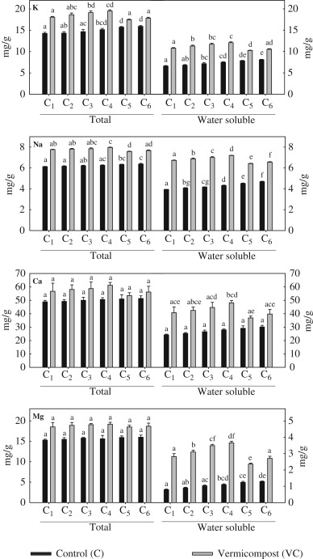
Effect of environmental conditions on the change in total and water soluble macro-nutrients (K, Na, Ca and Mg) contents in primary sewage sludge (PSS) with and without earthworm treatment. Columns followed by the same letter for control and vermicompost do not differ significantly (ANOVA; Tukey's test, P<0.05)

Slide 10
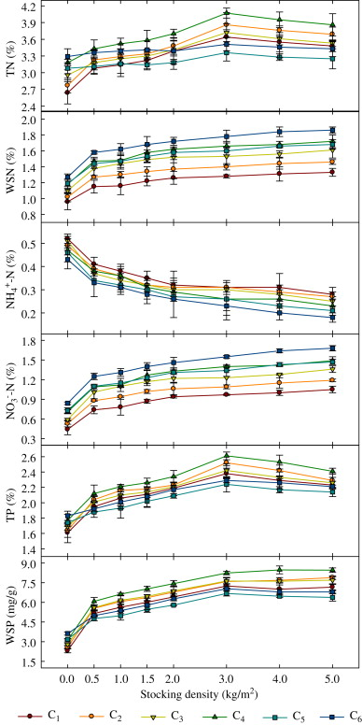
Effects of environmental conditions and earthworm densities on dynamics of major nutrients (N and P) transformation (total and water soluble) during vermicomposting of primary sewage sludge (PSS). http://www.sciencedirect.com/science/article/pii/S0147651312000085

Slide 11
Heavy metal transformation: examples and mechanisms
Waste-water is derived from a number of sources including domestic sewage effluent or municipal waste-water, agricultural (farm effluents) and industrial effluents, and storm-water.
Although waste-water irrigation has many positive effects like reliable water supply to farmers, better crop yield, pollution reduction of rivers, and other surface water resources, there are problems associated with it such as health risks to irrigators, build-up of chemical pollutants (e.g., heavy metal(loid)s and pesticides) in soils and contamination of ground-water.
With pressure increasing on potable water supplies worldwide, interest in using alternative water supplies including recycled waste-water for irrigation purposes is growing.
Notes:
With pressure increasing on potable water supplies worldwide, interest in using alternative water supplies including recycled waste-water for irrigation purposes is growing.

Slide 12
Waste-water use is directly associated with environmental quality due to its immediate contact with the soil–plant system, and consequently, can impact on it.
Wastewater irrigation can also act as a source of heavy metal(loid) input to soils.
The various sources of wastewater irrigation and heavy metal(loid) input to soil are identified;
second, the effect of wastewater irrigation on soil properties affecting heavy metal(loid) interactions is described; and
third and finally, the role of wastewater irrigation on heavy metal(loid) dynamics including adsorption and complexation, redox reactions, transport, and bioavailability is described in relation to strategies designed to mitigate wastewater-induced environmental impacts.
For example, the presence of organic matter in wastewater-irrigated sites significantly affects the mobility and bioavailability of heavy metal(loid)s in the soil.
Notes:
For example, the presence of organic matter in wastewater-irrigated sites significantly affects the mobility and bioavailability of heavy metal(loid)s in the soil.

Slide 13
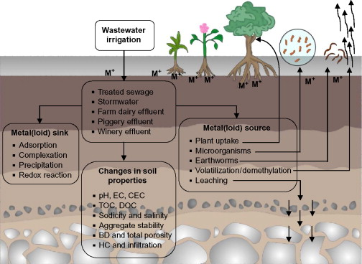
Schematic representation of waste-water sources and their effect on metal(loid) transformation and fate in soils by acting as a source and sink for metal(loid)s and by altering soil properties.
http://www.sciencedirect.com/science/article/pii/B9780123942760000056

Slide 14
References:
Selivanova N.,Shirkin L., Trifonova T. - "The heavy metals migration and transformation from industrial wastes in soils“ - , Russia, 600000, Vladimir, 87, Gorkiy str., Vladimir state university. http://www.bodenkunde2.unifreiburg.de/eurosoil/abstracts/id657_Selivanova_full.pdf
2. Department of Water Resources Engineering, Lund University, Sweden - "Estimation of heavy metal transformations in municipal solid waste.“ - Sci Total Environ. 1997 May 30;pg 198(2):123-133, PMID: 9167265. http://europepmc.org/abstract/MED/9167265/reload=0;jsessionid=0nHYpyDWI67Hfng6gsyk.18
3. Run Dong Li – “Migration and Transformation of Heavy Metals during Thermal Treatment of Solid Waste” - Faculty of Power & Energy Engineering, Shenyang Aerospace University, Shenyang 110136, China, http://www.jst.go.jp/sicp/ws2010_ch_nsfc7th/abst/abst_04.pdf

Slide 15
4. Transformations of heavy metals added to soil — application of a new sequential extraction procedure. Ma Y.B.; Uren N.C.
June 1997. School of Agriculture, La Trobe University, Bundoora, Bundoora, Vic. 3083, Australia.
http://ysgeo.yonsei.ac.kr/abstractII/B0108401010.html
5. Transformation and availability of nutrients and heavy metals during integrated composting–vermicomposting of sewage sludges
Subrata Hait, Vinod Tare
Environmental Engineering and Management Programme, Department of Civil Engineering, Indian Institute of Technology Kanpur, Kanpur 208 016, India, May 2012 , Pg 214–224
http://www.nextbio.com/b/search/article.nb?id=22277776

