Slide 1
6.i. Modelling environmental processes: kinetic and equilibrium (quasi-thermodynamic) modelling
6(i)

Slide 2
Goals and outcomes
Goals
  To provide overview of mathematical models describing adsorption kinetics and equilibrium of sorption onto natural solid material
Outcomes
  Students will be able to use ADE model for substance transport through aquifer material under saturated conditions (groundwater, bank filtration).

Slide 3
Content
Kinetic of sorption
External mass transfer
Internal mass transfer
Mass balance equations
Application of transport models – pore and surface diffusion models

Slide 4
Solute transport influenced by geosorption
Source: Worch (2004) J. Cont. Hydrobiol. 68, 97-120
Local equilibrium exists in any cross section
Therefore spreading is only result of diffusion and dispersion
Sorption can be linear or non-linear
Non-equilibrium transport model is based on equations for external film difussion and internal (pore difussion). Such models widely used in modelling of technical processess (film difussion, pore difussion, surface diffusion, dispersion)
Simplification is done by explaining intraparticle difussion by linear driving force equation and mass transfer coefficient is directly correlated to the pore or surface difussion coefficient. Further simplification is combination of dispersion and film difussion.
Model is applicable for non-linear and linear sorption and can be extended to multi-solute.

Slide 5
6.i.i. Kinetic of adsorption
the rate of reaching adsorption equilibrium by two diffusion steps:
  from the solution to the external surface of the adsorbent (external mass transfer or film diffusion) and
  Intraparticle difussion includes pore difussion and surface difussion (internal mass transfer).

Slide 6
6.i.ii. External mass transfer
k_{F} mass transfer coerfficient for film difussion
Driving force is difference in concentration in the fluid phase and concentration at solid particle surface.
a_{V} area available for mass transfer

Slide 7
6.i.iii Internal mass transfer
k_{S} intraparticle mass transfer coefficient
k_{S}a_{V} volumetric intraparticle mass transfer coefficient
Driving force is difference between loading at the outer particle surface and mean loading if the particle

Slide 8

6.i.iv. Mass balance equations
DF-LEM (dispersed flow /local equilibrium model) or so called advection-dispersion equation.
Individual terms presents advection, accumulation, adsorption and dispersion

Slide 9



Assuming linear isotherm, retardation factor can be calculated :
Linear sorption coefficient
ν_{w} pore water velocity
ν_{c} velocity of the transported substance
ƿ density
ɛ porosity
Therfore:

Slide 10



Where
Retarded dispersion coefficient, L²/T
D_{ax} dispersion coefficient in axial direction
Analytical solution:
(5)
Software Transport Modeling (Sorption and Biodegradation); TransMod 2.2 Eckhard Worch, 2006.

Slide 11


Hydrodynamic dispersion is sum of mechanical and molecular difussion.
Α is dispersivity and D_{L} is aqueous difussion coefficient. In case that there is no
sorption D* is equal with Dax. Usually D_{L} is low and difussion term can be neglected.
If necessery it can be estimated from eqution:

Slide 12
Non linear or linear isotherm?
  Cis – adsorbate concentration on adsorbent(mol kg⁻¹)
  Ciw- equilibrium concentration of adsorbate in solution (mol L⁻¹)
  K_{iF} – Freundlich constant (mol kg⁻¹)(mol L⁻¹)^{-ni}
  n_{i} – Freundlich exponent

Slide 13
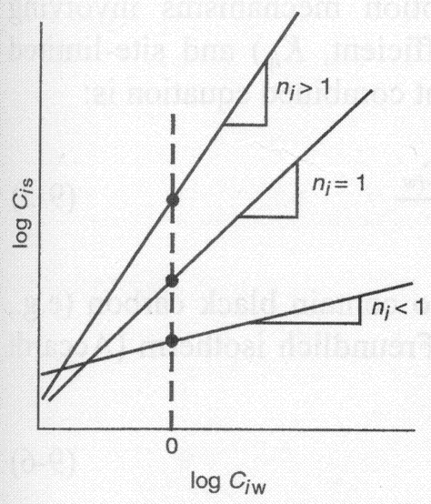
n_{i} represents change in free energy of sorption of solute on sorbent in certain concentration range
  n_{i} = 1, izotherm is linear and free energy of sorption is same for all concentrations
  When n_{i} < 1, isotherm is concave and with increase of sorbate concentration free energy of sorption decrease
  when n_{i} > 1, isotherm is convex and with increase of sorbate concentration free energy of sorption increase

Slide 14
Freundlich isotherm includes linear isotherm
With sorption coefficient Kd as a special case
K_{F}= K_{d}=q_{s} /c_{s} n=1

Slide 15
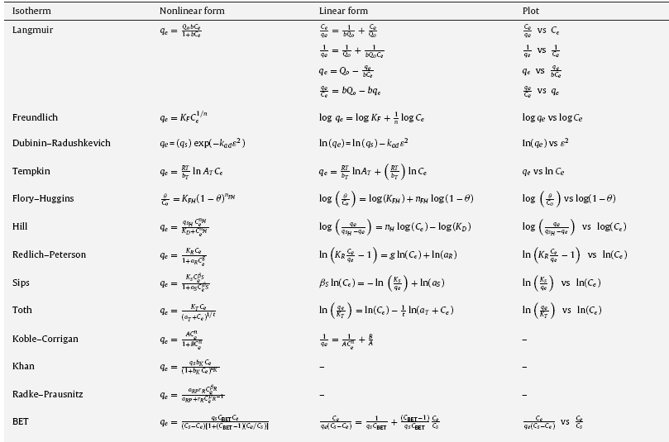
Foo and Hameed (2010) Chemical Engineering Journal 156,2-10

Slide 16
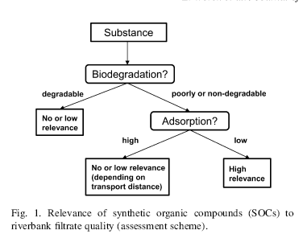

6.v. Application of transport models – pore and surface diffusion models.

Slide 17
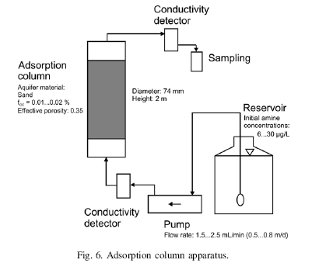
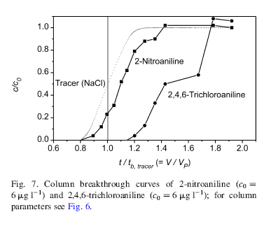
Column studies
Used for calculation of Rd and
prioritisation

Slide 18
Further consideration
Organic cations and anions behavior, possible competitive effects
Influence of NOM
Influence of pH

Slide 19
Practical work
Content of practical work:
  Data analysis of kinetic and adsorption equilibrium data using Excel.
  Selection of appropriate kinetic and isotherm models
  Introduction to box models (one box model)
  When possible students will be able to use ADE model for substance transport through aquifer material under saturated conditions (groundwater, bank filtration), application of comercial software.

Slide 20
Questions
1. Explain internal and external mass transfer
2. Explain advective-dispersive equation
3. Explain importance of transport modelling

Slide 21
Further reading
Niedbala, A., et al. Influence of competing inorganic cations on the ion exchange equilibrium of the monovalent organic cation metoprolol on natural sediment. Chemosphere (2012), http://dx.doi.org/10.1016/j.chemosphere.2012.10.036
F. Amiri et al. / Water Research 39 (2005) 933–941
Bi E., Schmidt T.C., Haderlein S.B. (2007) Environmental factors influencing sorption of heterocyclic aromatic compounds in soils: Environ.Sci.Technol, 41, 3172-3178.

