Slide 1
6.2. Estimating phase distribution of contaminants in model worlds
EP
Environmental Processes

Slide 2
Aims and Outcomes
Aims:
to provide overview of main transport mechanisms in all environmental compartments
to give information about methods of estimation of distribution of pollutants in the environment
Outcomes:
students will be able to estimate main transport mechanisms of real pollutants on the base of their physical-chemical properties
students will be able to estimate the distribution of pollutants in the environment on the base of environmental models

Slide 3
Lecture Content
Description of basic transport mechanisms of pollutants in environmental compartments (diffusion, dispersion, advection)
Definition of fugacity
Multi-media fugacity models (level I, II, III)
Content of the practical work:
Transport in porous media.
Transport through boundaries (bottleneck/wall and diffusive boundaries)

Slide 4
Compartment system
The whole environment is highly structured
Simplification for modeling: compartment system
  Compartment
    Homogeneously mixed
    Has defined geometry, volume, density, mass, …
Closed and open systems
Compartment 1
Compartment 1
Closed
system
Open
system
Compartment 2
Compartment 2
Compartment 3
Compartment 3

Slide 5
Transport Mechanisms in the Environment
Diffusion
  movement of molecules or particles along a concentration gradient, or from regions of higher to regions of lower concentration.
  does not involve chemical energy (i.e. spontaneous movement)
  Fick’s First Law of Diffusion:
N_{diff} … net substance flux [kg.s⁻¹]
J_{diff} … net substance flux through the unit area [kg s⁻¹ m⁻²]
A … cross-sectional area (perpendicular to diffusion) [m²]
D … diffusion coefficient [m² s⁻¹]
ΔC/Δx … concentration gradient [kg m⁻³ m⁻¹]

Slide 6
Transport Mechanisms in the Environment
Diffusion (contd.)
  Fick’s First Law of Diffusion is valid when:
    The medium is isotropic (the medium and diffusion coefficient is identical in all directions)
    the flux by diffusion is perpendicular to the cross section area
    the concentration gradient is constant
  Usual values of D:
    Gases: D ≈ 10⁻⁵ - 10⁻⁴ m² s⁻¹
    Liquids: D ≈ 10⁻⁹ m² s⁻¹
    Solids: D ≈ 10⁻¹⁴ m² s⁻¹
Barrow, G.M. (1977): Physikalische Chemie Band III. Bohmann, Wien, Austria, 3rd ed.

Slide 7
Transport Mechanisms in the Environment
Diffusion coefficient (or diffusivity)
  Proportional to the temperature
  Inversely proportional to the molecule volume (which is related to the molar mass)
  Relation between diffusion coefficients of two substances:
D_{i}, D_{j} … diffusion coefficients of compounds i and j [m² s⁻¹]
M_{i}, M_{j} … molar masses of compounds i and j [g mol⁻¹]
Tinsley, I. (1979): Chemical Concepts in Pollutant Behaviour. John Wiley & Sons, New York.

Slide 8


Transport Mechanisms in the Environment
Diffusion conductance (g), diffusion resistance (r)
g … diffusion conductance [m s⁻¹]
r … diffusion resistance [s m⁻¹]
D … diffusion coefficient [m² s⁻¹]
Δx … diffusion length [m]
More than 1 resistance in system ⇒ calculation of total resistance using Kirchhoff laws
Resistances in series:
$$r_{total}=r_{1}+r_{2}+ …+r_{n}$$
Resistances in parallel:
$$g_{total}=g_{1}+g_{2}+ …+g_{n}$$

Slide 9
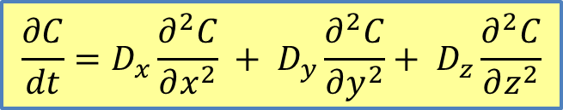
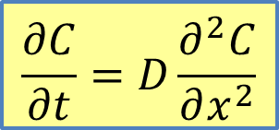
Transport Mechanisms in the Environment
Fick Second Law of Diffusion:
For three dimensions:
$$\frac{∂C}{∂t}=D\frac{∂^{2}C}{∂x^{2}}$$
$$\frac{∂C}{dt}=D_{x}\frac{∂^{2}C}{∂x^{2}} + D_{y}\frac{∂^{2}C}{∂y^{2}}+ D_{z}\frac{∂^{2}C}{∂z^{2}}$$
D_{x}, D_{y}, D_{z} … diffusion coefficients in x, y and z direction

Slide 10
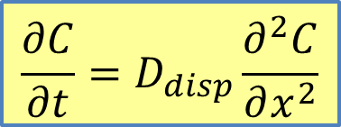
Transport Mechanisms in the Environment
Dispersion:
  Random movement of surrounding medium in one direction (or in all directions) causing the transport of compound
  Mathematical description similar to diffusion
N_{disp} … net substance flux [kg.s⁻¹]
J_{disp} … net substance flux through the unit area [kg s⁻¹ m⁻²]
A … cross-sectional area (perpendicular to dispersion direction) [m²]
D_{disp} … dispersion coefficient [m² s⁻¹]
ΔC/Δx … concentration gradient [kg m⁻³ m⁻¹]
$$\frac{∂C}{∂t}=D_{disp}\frac{∂^{2}C}{∂x^{2}}$$

Slide 11
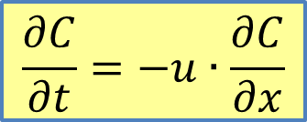
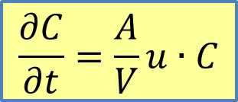
Transport Mechanisms in the Environment
Advection (convection):
  the directed movement of chemical by virtue of its presence in a medium that happens to be flowing
N_{adv} … net substance flux [kg.s⁻¹]
J_{adv} … net substance flux through the unit area [kg.s⁻¹.m⁻²]
A … cross-sectional area (perpendicular to u) [m²]
u … flow velocity of medium [m.s⁻¹]
$$\frac{∂C}{∂t}=\frac{A}{V}u∙C$$
$$\frac{∂C}{∂t}=−u∙\frac{∂C}{∂x}$$

Slide 12

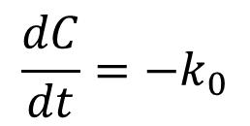
Chemical reaction
  Process which changes compound’s chemical nature (i.e. CAS number of the compound(s) are different)
Zero order reaction
reaction rate is independent on the concentration of parent compounds
$$\frac{dC}{dt}=−k_{0}$$
k₀ … zero order reaction rate constant [mol.s⁻¹]
C₀ … initial concentration of compound [mol.L⁻¹]
C_{t} … concentration of compound at time t [mol.L⁻¹]
$$C_{t}=C_{0}−k_{0}∙t$$

Slide 13

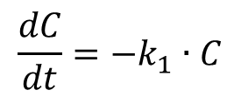
Chemical reaction
First order reaction:
Reaction rate depends linearly on the concentration of one parent compound
$$\frac{dC}{dt}=−k_{1}∙C$$
k₁ … first order reaction rate constant [s⁻¹]
C₀ … initial concentration of compound [mol.L⁻¹]
C_{t} … concentration of compound at time t [mol.L⁻¹]
$$C_{t}=C_{0}e^{−k_{1}∙t}$$

Slide 14

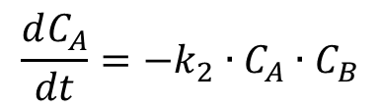
Chemical reaction
Second order reaction:
Reaction rate depends on the product of concentrations of two parent compounds
$$\frac{dC_{A}}{dt}=−k_{2}∙C_{A}∙C_{B}$$
k₂ … second order reaction rate constant of compound A [mol^{˗1}.s⁻¹]
C_{A}, C_{B} … initial concentration of compounds A and B [mol.L⁻¹]
Pseudo-first order reaction:
Reaction of the second order could be expressed as pseudo-first order by multiplying the second order rate constant of compound A with the concentration of compound B:
$$k_{1,A}=k_{2}∙C_{B}$$
k₂ … pseudo-first order reaction rate constant of compound A [s⁻¹]

Slide 15
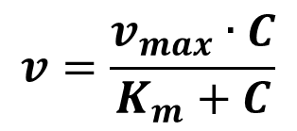
Chemical reaction
Michaelis-Menten kinetics:
Takes place at enzymatic reactions
Reaction rate v [mol.L⁻¹] depends on
  enzyme concentration
  substrate concentration C
  affinity of enzyme to substrate K_{m} (Michaelis-Menten constant)
  maximal velocity v_{max}
$$v=\frac{v_{max}∙C}{K_{m}+C}$$
When C << K_{m} ⇒ approx. first order reaction (transformation velocity equal to C)
When C >> K_{m} ⇒ approx. zero order reaction (transformation velocity independent on C)

Slide 16

Fugacity
Fugacity – symbol f - proposed by G.N. Lewis in 1901
  From Latin word “fugere”, describing escaping tendency of chemical
  In ideal gases identical to partial pressure
  It is logarithmically related to chemical potential
  It is (nearly) linearly related to concentration
Fugacity ratio F:
  Ratio of the solid vapor pressure to supercooled liquid vapor pressure
  Estimation:
$$\log{F=−0.01\left(T_{M}−298\right)}$$
T_{M} … melting point [K]

Slide 17
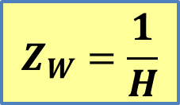
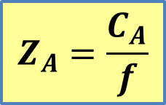
Fugacity
Fugacity capacity Z
Gas phase:
$$Z_{A}=\frac{C_{A}}{f}$$
Z_{A} … fugacity capacity of air [mol.m⁻³.Pa⁻¹]
C_{A} … air concentration [mol.l⁻¹]
f … fugacity [Pa]
Water phase:
$$Z_{W}=\frac{1}{H}$$
Z_{W} … fugacity capacity of water [mol.m^{˗3}.Pa⁻¹]
H … Henry’s law constant [Pa.m³.mol⁻¹]

Slide 18
Multimedia Environmental Models
Reason for the using of environmental models:
Possibility of describing the potential distribution and environmental fate of new chemicals by using only the base set of physico-chemical substance properties
Their use recommended e.g. by EU Technical Guidance Documents
  multi-media model consisting of four compartments recommended for estimating regional exposure levels in air, water, soil and sediment.
    Technical Guidance Documents in Support of The Commission Directive 93/67/EEC on Risk Assessment For New Notified Substances and the Commission Regulation (EC) 1488/94 on Risk Assessment For Existing Substances

Slide 19
Multimedia Environmental Models
Classification of environmental models:
Level 1: Equilibrium, closed system, no reactions
Level 2: Equilibrium, open system, steady state, reactions
Level 3: Non-equilibrium, open system, steady-state
Level 4: Non-equilibrium, open system, non-steady state.

Slide 20
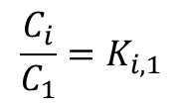


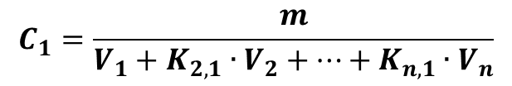
Multimedia Environmental Models
Environmental Models Level 1: Closed system, equilibrium, no reactions
Total mass in system: m [kg]
Volumes of compartments V_{n} [m³]
Unknown concentrations C_{n}
Compartment 1
Compartment 2
Compartment 3
In equilibrium:
$$\frac{C_{i}}{C_{1}}=K_{i,1}$$
i = 1, …, n
$$m=C_{1}∙V_{1}+C_{2}∙V_{2}+ … +C_{n}∙V_{n}$$
$$C_{i}=K_{i,1}∙C_{1}$$
$$C_{1}=\frac{m}{V_{1}+K_{2,1}∙V_{2}+…+K_{n,1}∙V_{n}}$$
$$m_{i}=V_{i}∙C_{i}$$

Slide 21

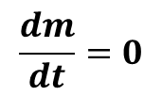
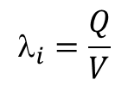
Multimedia Environmental Models
Environmental Models Level 2: Equilibrium with source and sink, steady-state, no reactions
Steady-state:
INPUT
$$\frac{dm}{dt}=0$$
Compartment 1
Compartment 2
Compartment 3
Input = Output
OUTPUT
Advection into the system [mol.s⁻¹] : I = Q . C
Q … flow [m³.s⁻¹]
C … concentration [mol.m⁻³]
Advection out of the system:
$$O=\sum_{i}{\left(V_{i}∙C_{i}∙λ_{i}\right)}$$
$$_{i}=\frac{Q}{V}$$
λ_{I} … elimination rate (first order rate), flux per volume

Slide 22
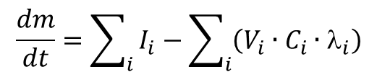
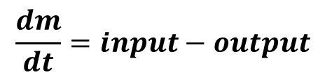
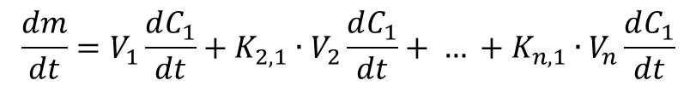
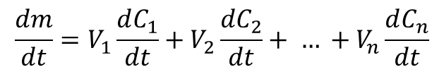
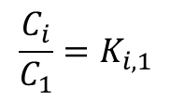
Multimedia Environmental Models
Environmental Models Level 2: Equilibrium with source and sink, unsteady state, no reactions
$$\frac{dm}{dt}=input−output$$
$$\frac{dm}{dt}=\sum_{i}{I_{i}−\sum_{i}{\left(V_{i}∙C_{i}∙λ_{i}\right)}}$$
$$\frac{dm}{dt}=V_{1}\frac{dC_{1}}{dt}+V_{2}\frac{dC_{2}}{dt}+ … +V_{n}\frac{dC_{n}}{dt}$$
$$\frac{C_{i}}{C_{1}}=K_{i,1}$$
In equilibrium:
i = 1, …, n
$$\frac{dm}{dt}=V_{1}\frac{dC_{1}}{dt}+{K_{2,1}∙V}_{2}\frac{dC_{1}}{dt}+ … +{K_{n,1}∙V}_{n}\frac{dC_{1}}{dt}$$

Slide 23
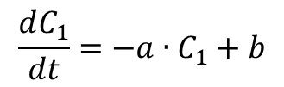
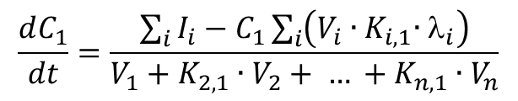
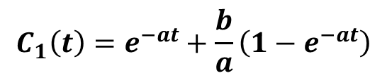
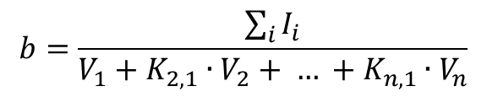
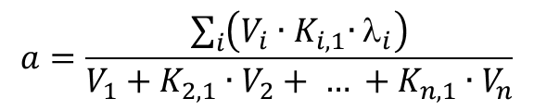
Multimedia Environmental Models
Environmental Models Level 2: Equilibrium with source and sink, non-steady state, no reactions (cont.)
$$\frac{dC_{1}}{dt}=\frac{\sum_{i}{I_{i}−C_{1}\sum_{i}{\left(V_{i}{∙K}_{i,1}∙λ_{i}\right)}}}{V_{1}+K_{2,1}∙V_{2}+ … +K_{n,1}∙V_{n}}$$
$$\frac{dC_{1}}{dt}=−a∙C_{1}+b$$
or
$$a=\frac{\sum_{i}{\left(V_{i}{∙K}_{i,1}∙λ_{i}\right)}}{V_{1}+K_{2,1}∙V_{2}+ … +K_{n,1}∙V_{n}}$$
$$b=\frac{\sum_{i}{I_{i}}}{V_{1}+K_{2,1}∙V_{2}+ … +K_{n,1}∙V_{n}}$$
Solution for C₁(t):
$$C_{1}\left(t\right)=e^{−at}+\frac{b}{a}\left(1−e^{−at}\right)$$

Slide 24
Multimedia Environmental Models
Environmental Models Level 3:
No equilibrium, sources and sinks, steady state, degradation.
For every single compartment input and/or output may occur.
The exchange between compartments is controlled by transfer resistance.
INPUT 1
INPUT 2
Compartment 1
Compart-ment 2
Compart-ment 3
OUTPUT 2
OUTPUT 1

Slide 25
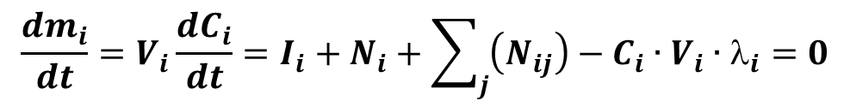
Multimedia Environmental Models
Environmental Models Level 3 (contd.):
$${\frac{dm_{i}}{dt}=V}_{i}\frac{dC_{i}}{dt}=I_{i}+N_{i}+\sum_{j}{\left(N_{ij}\right)−C_{i}∙V_{i}∙λ_{i}=0}$$
Change of substance mass in compartment (i) = Input I_{i} + advective transport N_{i} + diffusive transport N_{ij} – output = 0 (steady state)

Slide 26
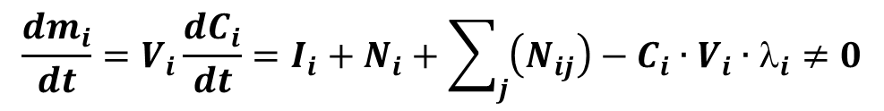
Multimedia Environmental Models
Environmental Models Level 4:
No equilibrium, sources and sinks, unsteady state, degradation.
For every single compartment input and/or output may occur.
The exchange between compartments is controlled by transfer resistance.
$${\frac{dm_{i}}{dt}=V}_{i}\frac{dC_{i}}{dt}=I_{i}+N_{i}+\sum_{j}{\left(N_{ij}\right)−C_{i}∙V_{i}∙λ_{i}≠0}$$
Change of substance mass in compartment (i) = Input I_{i} + advective transport N_{i} + diffusive transport N_{ij} – output ≠ 0 (unsteady state)

Slide 27
Further reading
D. Mackay: Multimedia environmental models: the fugacity approach. Lewis Publishers, 2001, ISBN 978-1-56-670542-4
S. Trapp, M. Matthies: Chemodynamics and environmental modeling: an introduction. Springer, 1998, ISBN 978-3-54-063096-8
L. J. Thibodeaux: Environmental Chemodynamics: Movement of Chemicals in Air, Water, and Soil. J. Wiley & Sons, 1996, ISBN 978-0-47-161295-7
M.M. Clark: Transport Modeling for Environmental Engineers and Scientists. J. Wiley & Sons, 2009, ISBN 978-0-470-26072-2
C. Smaranda and M. Gavrilescu: Migration and fate of persistent organic pollutants in the atmosphere - a modelling approach. Environmental Engineering and Management Journal, 7/6 (2008), 743-761

